Slide 1
Chapter 49
SAS Institute
December 5, 2022
1:40 – 2:50 pm
Cocoa 1
Amy Lena Dr. Jean M. Dyszel
Dr. Carissa Pokorny-Golden Dr. Brian J. Gasper

Slide 2
TODAY’S TOPICS
1
Chapter 49 Legislation
2
Pre-Service
3
LEA & PDE Responsibilities
4
FRCPP Reporting
5
Q&A

Slide 3
Laws and Regulations
Requirements & Competencies

Slide 4
Program Framework Guidelines
Professional Ethics | The standards of behavior, values, and principles that inform and guide professional decision-making. These standards of behavior, values and principles include those detailed in the Pennsylvania Model Code of Ethics for Educators, as adopted by the Professional Standards and Practices Commission.
Culturally Relevant and Sustaining Education | Education that ensures equity for all students and seeks to eliminate systemic institutional racial and cultural barriers that inhibit the success of all students in this Commonwealth—particularly those who have been historically underrepresented. Culturally relevant and sustaining education encompasses skills for educators including, but not limited to, approaches to mental wellness, trauma- informed approaches to instruction, technological and virtual engagement, cultural awareness and emerging factors that inhibit equitable access for all students in this Commonwealth.
Structured Literacy | Systematic, explicit instruction that provides a strong core of foundational skills in the language systems of English, integrates listening, speaking, reading, spelling, and writing and emphasizes the structure of language across the speech sound system (phonology), the writing system (orthography), the structure of sentences (syntax), the meaningful parts of words (morphology), the relationships among words (semantics), and the organization of spoken and written discourse.
Notes:
These three new sets of competencies became effective when the final amendment to Chapter 49 of Title 22 became effective on April 23, 2022.
Professional Ethics – PA Mode Code of Ethics for Educators.

Slide 5
Chapter 49
Approval of Induction Plans
Amendments to §49.16(a) (relating to approval of induction plans) strengthen the supports available to beginning educators by extending the length of induction programs to 2 years.
Continuing Professional Education
Requires school entities to include competencies related to Professional Ethics and Culturally Responsive and Sustaining Education in induction program plans for new educators
Clarifies new requirements related to training for current educators in Structured Literacy*
*The Department intends to enhance and scale up the current offerings by hiring a Statewide lead for structured literacy efforts and establishing a Statewide system of supports in structured literacy through the existing network of I.U.s.
Notes:
Induction programs will be tasked with CR-SE and Professional Ethics, but not Structured Literacy.

Slide 6
Act 55 of 2022
Teacher Support in the Structured Literacy Program (Section 1205.8.)
Beginning with the 2022-2023 school year, the department shall establish a program of professional development and applied practice in structured literacy for school personnel that includes in-class demonstration, modeling and coaching support to improve reading and literacy outcomes.
A participating school entity* shall adopt high-quality instructional materials grounded in scientific-based reading research in accordance with the State academic standards approved by the State Board of Education.
* a school entity that elects to take part in the Structured Literacy Program.

Slide 7
Implementation Timeline
Competency Program Framework Guidelines | Ed Prep Programs | Induction Programs | Continuing Professional Development Programs
Culturally-Relevant and Sustaining Education | 2024-25 Academic Year | 2024-25 Academic Year | 2023-24 Academic Year
Professional Ethics | 2024-25 Academic Year | 2024-25 Academic Year | 2023-24 Academic Year
Structured Literacy | 2024-25 Academic Year | Not applicable | 2023-24 Academic Year*
Locally Established, Grade-Based Requirement (LEGBR)
Alternative Assessment Pathway:
AP Exam Criterion
Act 55 of 2022 mandates that PDE provide continuing professional development in Structured Literacy in the 2022-23 academic year and educator preparation programs utilize PDE developed reading literacy skill standards beginning in 2024-25. All other dates were set by PDE policy once Chapter 49 became effective on April 23, 2022.

Slide 8
PDE Responsibilities (cont’d)
Beginning with the 2022-2023 school year, the department shall establish a program of professional development and applied practice in structured literacy for school personnel that includes in-class demonstration, modeling and coaching support to improve reading and literacy outcomes.
Notes:
In late December 2022, the Department will be releasing a 10 hr. Act 48 course on Structured Literacy to support professional development. Also, a Structured Literacy Advisor will be hired by the Department to support Structured Literacy professional development and initiatives.

Slide 9
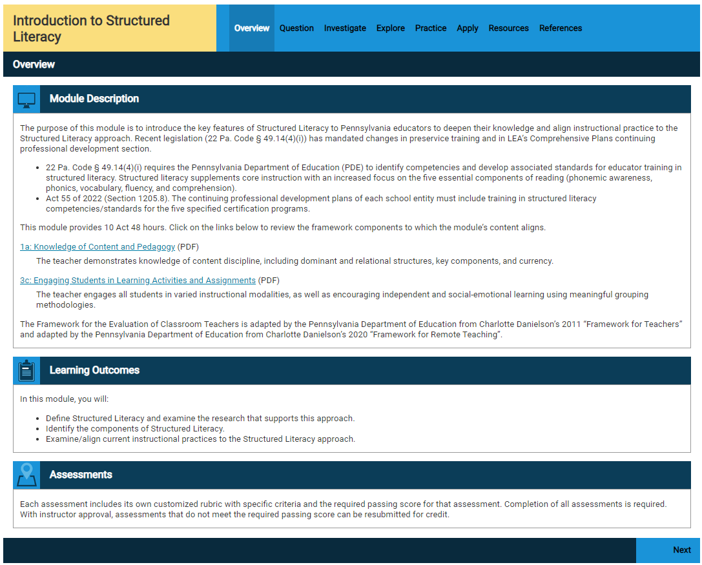
Structured Literacy Course Offering
Notes:
Explanation of the course structure, etc.

Slide 10
LEA Training Requirements
Training in structured literacy for educators who hold instructional certificates in the following areas:
Early Childhood
Elementary/Middle
Special Education PreK—12
English as a Second Language
Reading Specialist
Training in Culturally Responsive and Sustaining Education and Professional Ethics for all educators
Notes:
Clarification on the term “hold” and who will need to engage in Structured Literacy professional development by the end of the 2023-2024 term.
Early Childhood (PreK-3)
Elementary(K-6 or K-4)
Middle (4-8 or 6-9)
Just to clarify, 1205.8(a)-(b) does not specifically limit the PDE developed SL program to these cert areas but the statute clearly limits the continuing professional development plans in statute and regulation to these certs. PDE can assert that the PDE developed SL program is supposed to support professional development which in section 1205.8(c) contains clear specific cert limits.

Slide 11
Structured Literacy Training
To ensure that school personnel have the knowledge and skill to teach all students to read, including students with dyslexia and other language-based learning disabilities, training shall address, but shall not be limited to:
1
Evidence-based intervention practices on structured literacy.
2
Explicit and systematic instruction in phonological and phonemic awareness.
3
The alphabetic principle, decoding and encoding, fluency and vocabulary.
4
Reading comprehension and building content knowledge.

Slide 12
Participating School Entity
A participating school entity* shall adopt high-quality instructional materials grounded in scientific-based reading research in accordance with the State academic standards approved by the State Board of Education.
* A school entity that elects to take part in the Structured Literacy Approach
Notes:
PD is required but implementation is not

Slide 13
Future Ready Comprehensive Planning
Reporting Requirements

Slide 14
Induction Plan
2024-2025
Each school entity shall submit to the Department for approval a plan for a 2-year induction experience for first-year teachers (including teachers in pre-kindergarten programs, when offered) and educational specialists.
Notes:
The induction plan shall reflect a mentor relationship between the first-year teacher, long-term substitute or educational specialist, teacher educator and the induction team, and the mentor relationship should continue for the length of the program.

Slide 15






Induction Plan Topics
Professional Ethics Program Framework Guidelines
Culturally Relevant and Sustaining Education Program Framework Guidelines
Educator Effectiveness
Teacher Competency
Student Learning
Notes:
The continuing professional education plan must include a section which describes how the needs of the school entity, including those of diverse learners, and its professional employees are to be met through implementation of the plan.
The plan must describe how professional development activities will improve language and literacy acquisition for all students, including the provision of training in structured literacy for professional employees who hold instructional certificates in Early Childhood, Elementary/Middle, Special Education PK—12, English as a second language and Reading Specialists. The plan must contribute to closing achievement gaps among students, and improve professional employees knowledge of professional ethics and culturally relevant and sustaining education.

Slide 16





Continuing Professional Education
A school entity shall submit to the Secretary for approval a 3-year professional education plan every 3 years in accordance with the professional education guidelines established by the Secretary…
Notes:
The professional development plan must include a description of how the school entity will offer all temporary and professional employees opportunities to participate in continuing education and must be submitted every three years as a report included in the Comprehensive Plan.

Slide 17



Continuing Professional Education Topics
Professional Ethics Program Framework Guidelines
Culturally Relevant and Sustaining Education Program Framework Guidelines
Language and Literacy Acquisition, including Structured Literacy Program Framework Guidelines
Teaching Diverse Learners in Inclusive Settings
At least 1-hour of Trauma-informed Care Training for All Staff
Notes:
The continuing professional education plan must include, at minimum, trainings that include the following topics:
Professional Ethics
CR-SE
Language and literacy acquisition for all students, including the provision of training in structured literacy for professional employees who hold instructional certificates in Early Childhood, Elementary/Middle, Special Education PK—12, English as a second language and Reading Specialists.
Teaching Diverse Learners in Inclusive Settings
At least 1-hour of Trauma-informed Care Training
School employee Trauma-informed Care Training shall address but not be limited to:
Recognition of the signs of trauma in students
Best practices for schools and classrooms regarding trauma-informed approaches, including utilization of multitiered systems of support
Recognition of the signs of the impact of secondary trauma on school employees and appropriate resources for school employees who are experiencing secondary trauma
The school entity's policies regarding trauma-informed approaches
The school entity's policies regarding connecting students with appropriate services.

Slide 18
Implementation Timeline
Competency Program Framework Guidelines | Ed Prep Programs | Induction Programs | Continuing Professional Development Programs
Culturally-Relevant and Sustaining Education | 2024-25 Academic Year | 2024-25 Academic Year | 2023-24 Academic Year
Professional Ethics | 2024-25 Academic Year | 2024-25 Academic Year | 2023-24 Academic Year
Structured Literacy | 2024-25 Academic Year | Not applicable | 2023-24 Academic Year*
Locally Established, Grade-Based Requirement (LEGBR)
Alternative Assessment Pathway:
AP Exam Criterion
* Act 55 of 2022 mandates that PDE provide continuing professional development in Structured Literacy in the 2022-23 academic year and educator preparation programs utilize PDE developed reading literacy skill standards beginning in 2024-25 . All other dates were set by PDE policy once Chapter 49 became effective on April 23, 2022.

Slide 19

QUESTIONS

Slide 20
INFORMATION
The mission of the Department of Education is to ensure that every learner has access to a world-class education system that academically prepares children and adults to succeed as productive citizens. Further, the Department seeks to establish a culture that is committed to improving opportunities throughout the commonwealth by ensuring that technical support, resources, and optimal learning environments are available for all students, whether children or adults.
Questions? RA-PDE-Evaluation@pa.gov

