Slide 1
Pennsylvania
HS Graduation Requirements
The Tracking Tool
October 10, 2023
Notes:
Welcome & introductions.

Slide 2
TODAY’S TOPICS
Pathways to Graduation Tool
  Access
  Data Entry
  Demonstration
  Frequently Asked Questions
  Populating the Grad Report
  PGT Data Analysis
  Questions

Slide 3
Access
Users access tracking tool through MyPDESuite
Initial access granted to Superintendent/CEO
Access to others granted by the Superintendent/CEO as necessary

Slide 4
Data Entry
All data can be entered via spreadsheet upload
All data entered via spreadsheet upload will populate across all pathways
Notes:
Pause for questions

Slide 5
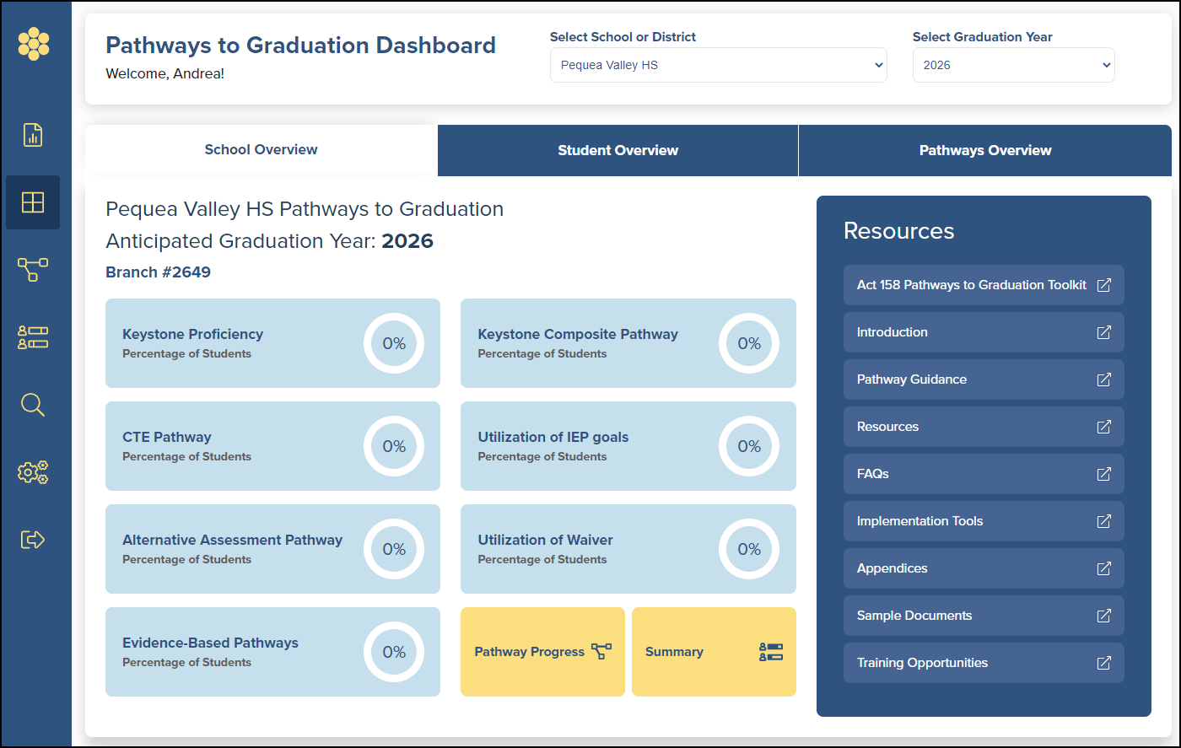
Demonstration
My PDE Suite login

Slide 6
Frequently Asked Questions
What resources are available to assist me in utilizing the Pathways to Graduation Tool?
Where do I get the data to enter into the Pathways to Graduation Tool?
What happens within the Pathways to Graduation Tool when students meet multiple pathways?
How does the Pathways to Graduation Tool handle numeric and non-numeric scores for the same Keystone Exam?
Can data be updated if a score or other piece of information later changes?
What happens when the scores in the upload file are different than what is currently in the system?

Slide 7
New Features
Student Names
Reports –
  Students with no defined pathway
  Students in Warning status
Updates to Batch Uploader to allow for yes/no questions
Automated link between Pathways to Graduation and FRCPP

Slide 8
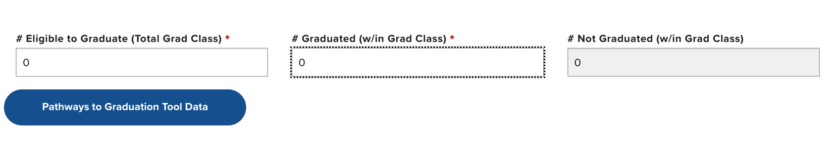
Grad Report Import

Slide 9
Support
Pathways Graduation Toolkit “How To” Documents
https://pdesas.zendesk.com/hc/en-us/categories/4420000463892-Pathways-to-Graduation-Tool
Technical Questions?
helpdesk@pdesas.org
877-973-3727
Act 158 Questions?
ra-edgradrequirement@pa.gov

Slide 10

YOUR QUESTIONS

Slide 11
INFORMATION
TRAINING SCHEDULE (SAS)
Tuesdays 11am - noon
October 17: Grad Data: Informing Local Practice
https://iu13.zoom.us/j/97620634430?pwd=bEM2a0ZTbGlGakFTOVFOSDZXQ2kvQT09
October 24: Frequently Asked Questions
https://iu13.zoom.us/j/91995122014?pwd=cEU0ajJEa0pqY0czL29xMlBIcERyZz09
RESOURCES
WWW.PDESAS.ORG
WWW.EDUCATION.PA.GOV
CONTACT
RA-EDGRADREQUIREMENT@PA.GOV
The mission of the Department of Education is to ensure that every learner has access to a world-class education system that academically prepares children and adults to succeed as productive citizens. Further, the Department seeks to establish a culture that is committed to improving opportunities throughout the commonwealth by ensuring that technical support, resources, and optimal learning environments are available for all students, whether children or adults.

