Slide 1
Science, Technology & Engineering, Environmental Literacy Sustainability STEELS Unpacking the Environmental Literacy and Sustainability Standards
STEELS
Professional Learning Series

Slide 2
STEELS Standards Organization
Science | Technology and Engineering Applying, Maintaining, and Assessing Technological Products and Systems Impacts of Technology Influence of Society on Technological Development | Environmental Literacy & Sustainability Agricultural and Environmental Systems and Resources Agricultural Systems Environment and Society Watersheds and Wetlands Environmental Literacy Skills Investigating Environmental Issues Environmental Experiences Evaluating Solutions Sustainability and Stewardship Environmental Sustainability Environmental Stewardship Environmental Justice
Life Science
Physical Science
Earth and Space Science
 | Design in Technology and Engineering Education
 | Integration of Knowledge, Technologies, and Practices
 | Nature and Characteristics of Technology and Engineering Core Concepts of Technology and Engineering History of Technology

Slide 3
Diving Deeper into the ELS Standards Structure
BASICS
The PA Standards are analogous to a Performance Expectation
All standards are rooted in three dimensions of knowing
Foundation Boxes include:
Disciplinary Core Ideas
Science and Engineering Practices
Crosscutting Concepts
Strands are designed to provide connected cognitive progression through and into each grade band
ELS Strands are best framed through local phenomena inquiry
Designed as a uniting concept to tie standards from other domains and disciplines
Notes:
The ELS standard were developed in specific response to gaps in NGSS in relation to EL development and socio-ecological concepts- identified through research – the content writing team was able to design the ELS domain to address those needs.

Slide 4
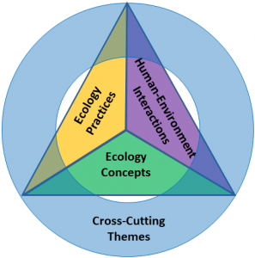
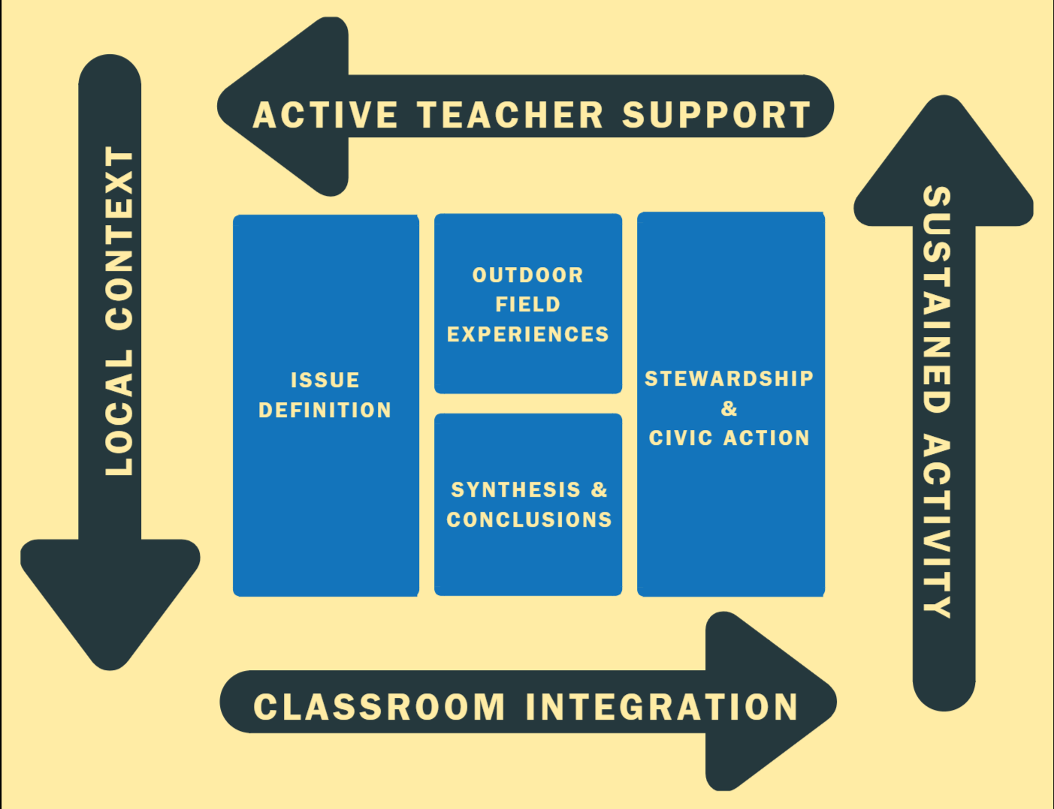
Diving Deeper into the ELS Standards Structure
Interwoven inquiry practice and disciplinary constructs from guiding, well-researched frameworks
Guidelines for Excellence – K-12 Learning (North American Association for Environmental Education – NAAEE )
Four-Dimensional Education (4DEE) (Ecology Society of America - ESA)
Meaningful Watershed Educational Experience (MWEE) Framework Elements (National Oceanographic and Atmospheric Agency – NOAA)

Slide 5
Performance Expectation Structure
Three-dimensional learning uses science and engineering practices to actively engage students in science learning, integrating these with disciplinary core ideas and crosscutting concepts, and explaining phenomena and/or designing solutions to problems to drive student learning.
DCI – Disciplinary Core Idea
SEP – Science and Engineering Practices
CCC – Crosscutting Concepts
3.4.3-5.G
Investigate how perspectives over the use of resources and the development of technology have changed over time and resulted in conflict over the development of societies and nations.

Slide 6
Environmental Literacy and Sustainability: Agriculture and Environmental Systems and Resources
Strand | K-2 | 3-5 | 6-8 | 9-12
Agricultural and Environmental Systems and Resources: Agricultural Systems | 3.4.K-2.A Categorize ways people harvest, redistribute, and use natural resources. | 3.4.3-5.A Analyze how living organisms, including humans, affect the environment in which they live, and how their environment affects them. | 3.4.6-8.A Develop a model to describe how agricultural and food systems function, including the sustainable use of natural resources and the production, processing, and management of food, fiber, and energy. | 3.4.9-12.A Analyze and interpret how issues, trends, technologies, and policies impact agricultural, food, and environmental systems and resources.
Agricultural and Environmental Systems and Resources: Environment and Society | 3.4.K-2.B Examine how people from different cultures and communities, including one’s own, interact and express their beliefs about nature. | 3.4.3-5.B Make a claim about the environmental and social impacts of design solutions and civic actions, including their own actions. | 3.4.6-8.B Analyze and interpret data about how different societies (economic and social systems) and cultures use and manage natural resources differently. | 3.4.9-12.B Apply research and analytical skills to evaluate the conditions and motivations that lead to conflict, cooperation, and change among individuals, groups, and nations.
Agricultural and Environmental Systems and Resources: Watersheds and Wetlands | Refer to other STEELS standards to build a learning progression. | 3.4.3-5.C Examine ways you influence your local environment and community by collecting and displaying data. | 3.4.6-8.C Develop a model to describe how watersheds and wetlands function as systems, including the roles and functions they serve. | 3.4.9-12.C Analyze and interpret how issues, trends, technologies, and policies impact watersheds and water resources.

Slide 7
Environmental Literacy and Sustainability: Environmental Literacy Skills
Strand | K-2 | 3-5 | 6-8 | 9-12
Environmental Literacy Skills: Investigating Environmental Issues | Refer to other STEELS standards to build a learning progression. | 3.4.3-5.D Develop a model to demonstrate how local environmental issues are connected to larger local environment and human systems. | 3.4.6-8.D Gather, read, and synthesize information from multiple sources to investigate how Pennsylvania environmental issues affect Pennsylvania’s human and natural systems. | 3.4.9-12.D Apply research and analytical skills to systematically investigate environmental issues ranging from local issues to those that are regional or global in scope.
Environmental Literacy Skills: Environmental Experiences | 3.4.K-2.C Explain ways that places differ in their physical characteristics, their meaning, and their value and/or importance. | Refer to other STEELS standards to build a learning progression. | 3.4.6-8.E Collect, analyze, and interpret environmental data to describe a local environment. | 3.4.9-12.E Plan and conduct an investigation utilizing environmental data about a local environmental issue.
Environmental Literacy Skills: Evaluating Solutions | Refer to other STEELS standards to build a learning progression. | 3.4.3-5.E Construct an argument to support whether action is needed on a selected environmental issue and propose possible solutions. | 3.4.6-8.F Obtain and communicate information on how integrated pest management could improve indoor and outdoor environments. | 3.4.9-12.F Evaluate and communicate the effect of integrated pest management practices on indoor and outdoor environments.

Slide 8
Environmental Literacy and Sustainability: Sustainability and Stewardship
Strand | K-2 | 3-5 | 6-8 | 9-12
Sustainability and Stewardship: Environmental Sustainably | 3.4.K-2.D Plan and carry out an investigation to address an issue in the local environment and community. | Refer to other STEELS standards to build a learning progression. | 3.4.6-8.G Obtain and communicate information to describe how best resource management practices and environmental laws are designed to achieve environmental sustainability. | 3.4.9-12.G Analyze and evaluate how best resource management practices and environmental laws achieve sustainability of natural resources.
Sustainability and Stewardship: Environmental Stewardship | Refer to other STEELS standards to build a learning progression. | 3.4.3-5.F Critique ways that people depend on and change the environment. | 3.4.6-8.H Design a solution to an environmental issue in which individuals and societies can engage as stewards of the environment. | 3.4.9-12.H Design and evaluate solutions in which individuals and societies can promote stewardship in environmental quality and community well-being.
Sustainability and Stewardship: Environmental Justice | Refer to other STEELS standards to build a learning progression. | 3.4.3-5.G Investigate how perspectives over the use of resources and the development of technology have changed over time and resulted in conflict over the development of societies and nations. | 3.4.6-8.I Construct an explanation that describes regional environmental conditions and their implications on environmental justice and social equity. | 3.4.9-12.I Analyze and interpret data on a regional environmental condition and its implications on environmental justice and social equity.

Slide 9
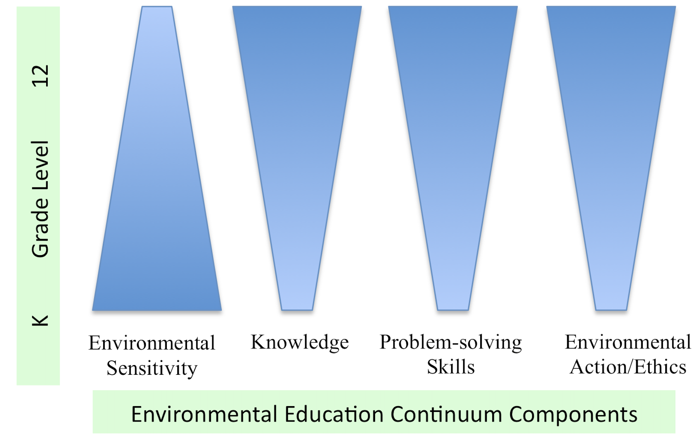
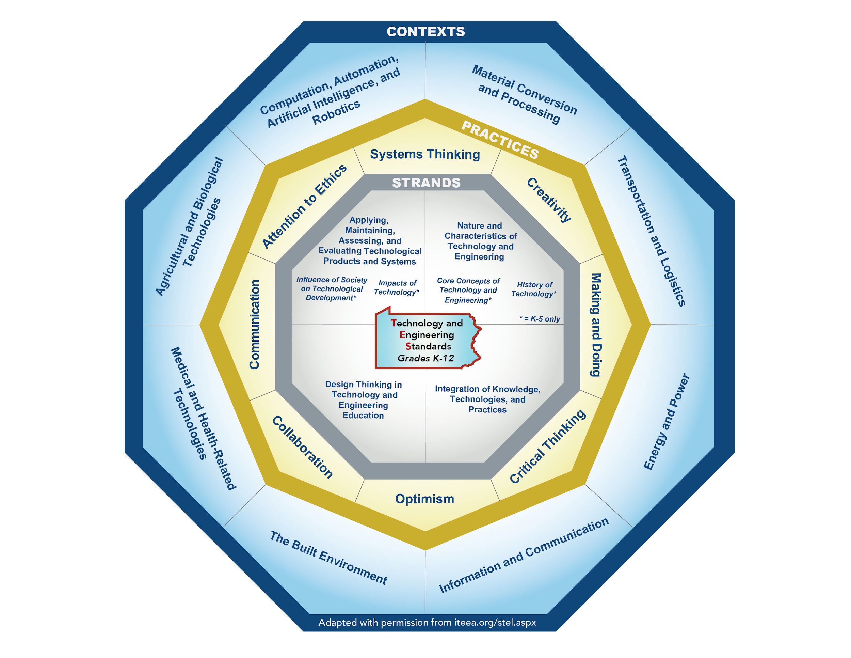
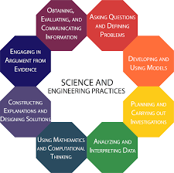
ELS SEP’s Blend Interdisciplinary Inquiry Practices
Notes:
https://www.neefusa.org/education/ee-and-next-generation-science-standards
Examples
SEP 1: Asking Questions and Defining Problems
A class of 2nd graders visits a local nature center on a field trip. As they meander along a short, wooded trail, the students notice that moss tends to grow mainly on one side of the trees—a phenomenon to explore and understand. When they return to class the next day, students develop a question that they will investigate: why does moss grow mainly on the north side of the trees?
SEP 2: Planning and Carrying Out Investigations
A group of students in the lunchroom debate whether a paper lunch bag should be thrown into the trashcan or the compost bin. Some argue it will take too long to decompose, and others feel the paper will break down quickly along with the food scraps. Back in class after lunch, the students design an investigation to determine how long a paper lunch bag takes to decompose.
SEP 3: Analyzing and Interpreting Data
Students monitored the water quality in a stream on their school’s campus once a month for the past six months. As the weather warms, they notice dissolved oxygen levels decreasing each month. Concerned for the organisms that depend on the dissolved oxygen in the stream water, the students analyze trends in their data to determine a cause for the decrease.
SEP 4: Developing and Using Models
Students in a high school gardening club decide they would like to construct a greenhouse to lengthen the growing season. First, they develop a diagram of the proposed greenhouse—including a proposed location, dimensions, building materials, a water source, and plants to be included. They then share the model with their club sponsor as the students make a case for their project.
SEP 5: Constructing Explanations and Designing Solutions
During recess, fourth grade students complain that one area of the playground remains soggy long after it rains. They are learning about plants, and one student remembers aloud that plants need lots of water to grow. The students work with their teacher and a parent volunteer to design and construct a rain garden in the soggy area of the playground.
SEP 6: Engaging in Argument from Evidence
Each spring students at an elementary school participate in a citizen science project to collect data on when the maple trees in their schoolyard flower. Sam, a fifth grader, remembers that in his first-grade year the first flowers were spotted on his birthday, but this year they arrived a full week later. Sam’s teacher helps him to locate data from the past 20 years that students at the school have participated in the project. Sam spotted a trend in the data: the flowers are blooming slightly later each spring. Led by their teacher, Sam’s class engages in a discussion about the reason behind this trend.
SEP 7: Using Mathematics and Computational Thinking
Middle school students would like to install rain barrels on their school’s downspouts to collect water for their vegetable garden. They want to install enough barrels to maximize the amount of rain collected. Using the average rainfall for their town, as well as their calculations of the surface area of the school’s roof, the students are able to determine the volume of water they are likely to collect each month. They then select the size and number of barrels needed to maximize rainwater collected.
SEP 8: Obtaining, Evaluating, and Communicating Information
When learning about the power consumption of electronics, middle school students become concerned about the energy consumed by lights, computers, and other devices that are left on each evening. Students develop data tables and collect information by surveying teachers about what is turned off and what is left on each day. They then develop graphs to visually communicate the data. With help from their teacher, they schedule a meeting with the school principal and use their graphs to make the case that a great deal of energy could be conserved if the school implemented a “lights out” policy for the overnight hours.
However, The ELS Standards encourage not only introductory building of awareness, but encourage full development of the practice into action, including design of actionable questions at each grade level

Slide 10
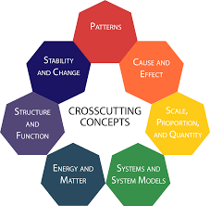
ELS Local Phenomena Focus Contextualizes CCCs
Patterns
Cause and effect
Scale, proportion, and quantity
Systems and system models
Energy and matter
Structure and function
Stability and change
++Sustainability

Slide 11
Promotes Integrative Inquiry
Local phenomena
Issue investigation
Field experiences
Data collection/observation
Synthesis and conclusions
Action design and implementation with claims, evidence, and reasoning embedded
In iterative flow, the inquiry does not end but builds upon new knowledge to expand the breadth and depth of understanding
Accessible locally through outdoor field experiences
Encourage student-driven inquiry
Observable phenomena that occur in students’ communities and surrounding ecosystems.
Wonder and observations grounded learning in relevant, real-world scenarios encourage agency in finding actionable solutions

Slide 12
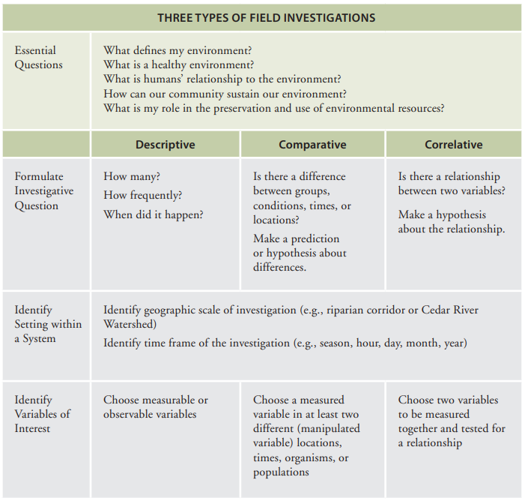
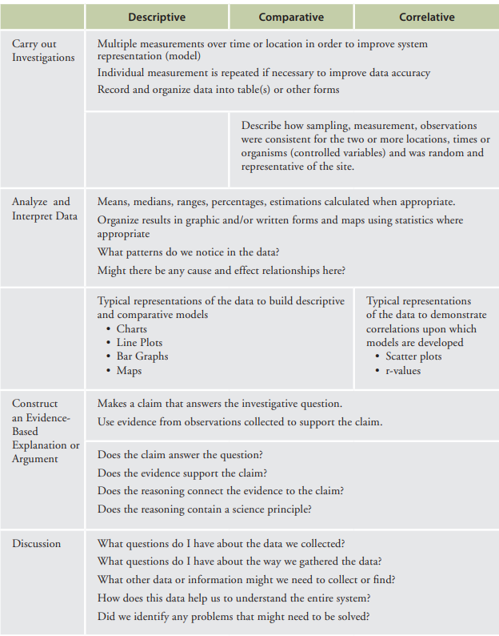
Focuses on Student-Driven Inquiry and Design

Slide 13
ELS Foundation Box Structure
The PA Standards are analogous to a Performance Expectation
All standards are rooted in three dimensions of knowing
Foundation Boxes include:
Disciplinary Core Ideas
Science and Engineering Practices
Crosscutting Concepts
PA additions to the foundation boxes
Clarifying statements
Connections to other academic standards and disciplinary guidance
Pennsylvania Context
PA Career Ready Skills
Notes:
Providing an overview of the foundation box structure for ELS/Science – more detail in ELS Foundation Boxes Webinar found on the PA STEELS Hub/SAS
Clarifying Statements supply examples or additional clarification and emphasis to the language of the performance expectations.
Assessment Boundaries specify limits to large-scale assessment. They are not meant to put limits on what can be taught or how it is taught, but to provide guidance to assessment developers.

Slide 14
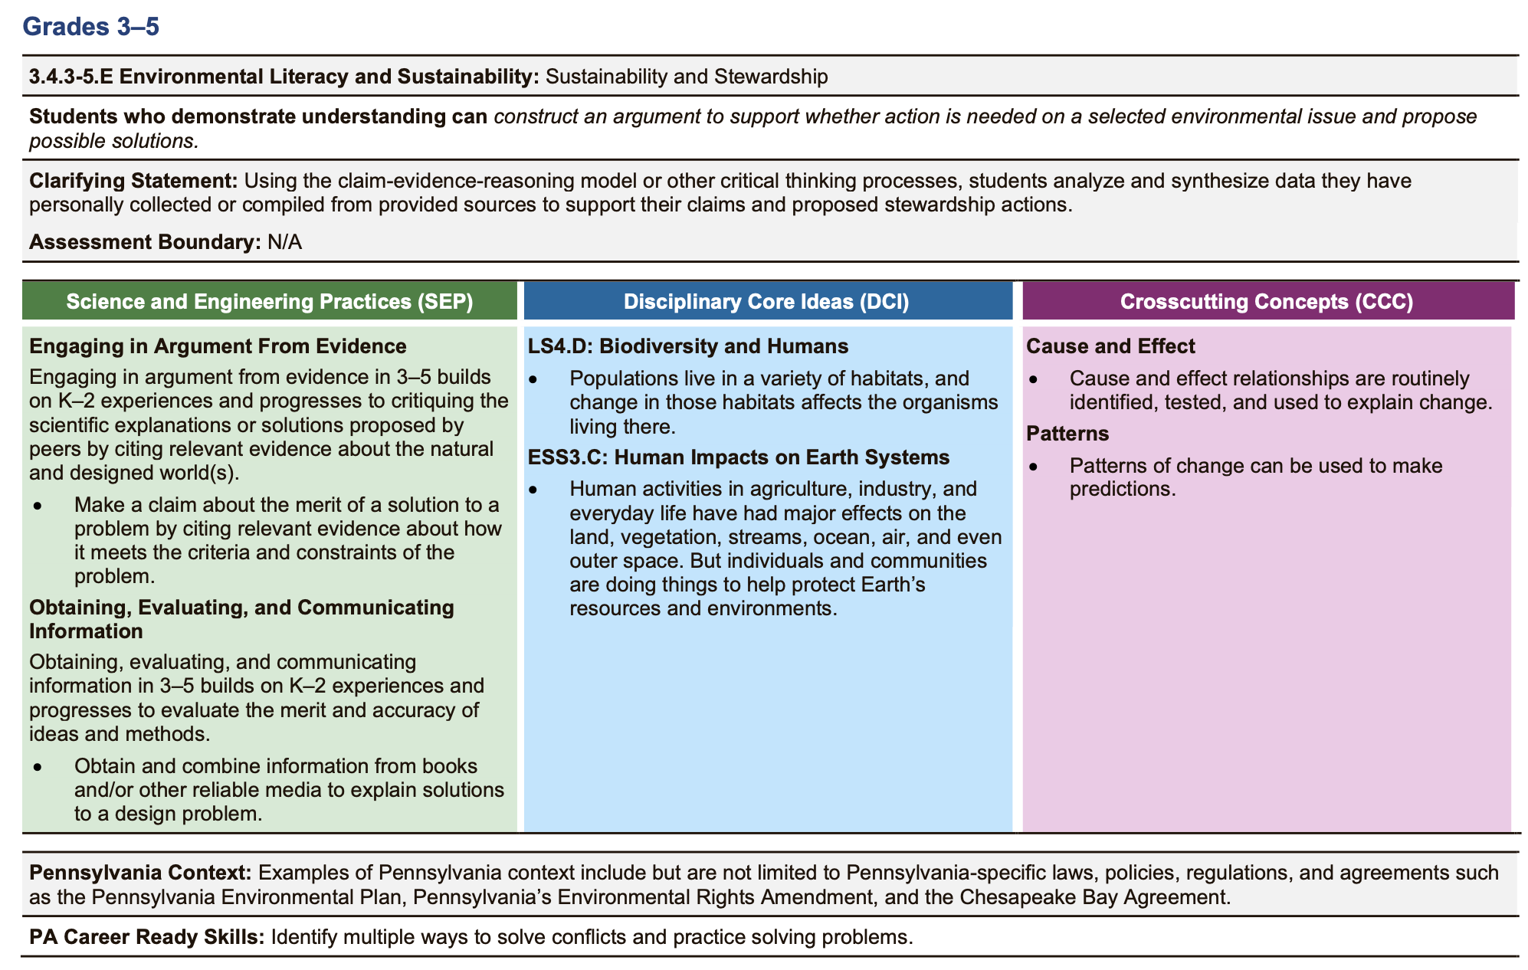
Standard
Notes:
Performance Expectation
Science and Engineering Practices
Disciplinary Core Ideas
Cross-Cutting Concepts
PA Context
Career Ready Skills

Slide 15
Standard, continued

Slide 16
Communication
Please take a moment and tell your peers about the PDE - Environmental Literacy, Sustainability, Ecology, and Agriculture Education Community
To access PDE SAS, one must first register on the PA Department of Education’s Standards Aligned System web page. (http://pdesas.org/).
To join your select Professional Learning Communities follow these steps
Click on the My SAS Tools link in the upper right-hand corner of the landing page.
A series of buttons will open just below the PDE SAS menu bar, select Communities, usually located in the second row towards the left side of the screen.
This will open a listing of all the communities. Scroll down the page and click on PDE - Environmental Literacy, Sustainability, Ecology, and Agriculture Education
Just below the Community description, above the moderator’s message, there will be a link to Join this Community; click the link.

Slide 17
Contact/Mission
For more information on the STEELS Standards,
please visit
the STEELS Hub on SAS.

