Slide 1
Act 13: Rating Tools
February 22, 2022

Slide 2
Agenda
Overview
Professional Educator Categories
Rating Tools

Slide 3



Office Hours Etiquette
Listen to the presenter and enter relevant questions in the chat.
Use pause points to enter questions into the chat.
Monitor chat for responses.

Slide 4
Professional Educator Categories
Professional Educator Categories

Slide 5
Act 13 Requirements
Classroom Teacher*
Non-Teaching Professional*
Principal*
Provides direct instruction to students related to specific subject or grade level
Provides services other than classroom instruction
Examples: Speech Language Pathologist, Social Worker, Home and School Visitor, School Psychologist, Health Specialist, Counselor, Instructional Technology Specialist, Other
Includes the following:
  Principal
  Assistant Principal
  Vice Principal
  Director of Career and Technical Education
  Supervisor of Special Education
  (new with Act 13)
*Includes Professional and Temporary Professional Employee

Slide 6
Classroom Teachers
Data Available Teachers
Non-Data Available Teachers
Teachers w/out Building Level Data
Temporary Teachers

Slide 7
Building Level Score
The Building Level Score will provide a quantitative academic score based upon a 100-point scale to represent the overall academic performance of each school in Pennsylvania.
Academic Achievement
Academic Growth
Academic Achievement
Other Academic Indicators
ELA 15 points
Math 15 points
Science 10 points
ELA 15 pts
Math 15 pts
Science 10 pts
ELA 15 points
Math 15 points
Science 10 points
Attendance Rate 10 pts
Graduation Rate 10 pts
*Absent a Graduation Rate, Attendance Rate is 20 Points.
Where a school is missing an Assessment or Growth indicator, the 100-point scale is reduced proportionally. For example, a K-3 school with no PVAAS data (40 points) and no Science Assessment data (10 points) will have a denominator of 50 points.

Slide 8
Act 13: Teacher Specific Data (Set 10%)
Academic Achievement
Only 2 Measures
available and directly attributable
Only 1 Measure
available and directly attributable
3 Measures
available and directly attributable
ELA 15 points
Math 15 points
Science 10 points
Applicable Measures (5% each)
State Assessments (2.5%)
PVAAS (5.0%)
IEP Goals Progress (2.5%)
Applicable Measure (10%)
If no measures are available and directly attributable to the teacher,
the 10% will be re-allocated to LEA Selected Measures.

Slide 9
Act 13: Data Available Teacher

Slide 10
Act 13: Non-Data Available Teacher
Assessment and Growth removed

Slide 11
Act 13: Teachers w/out Building Level Data

Slide 12
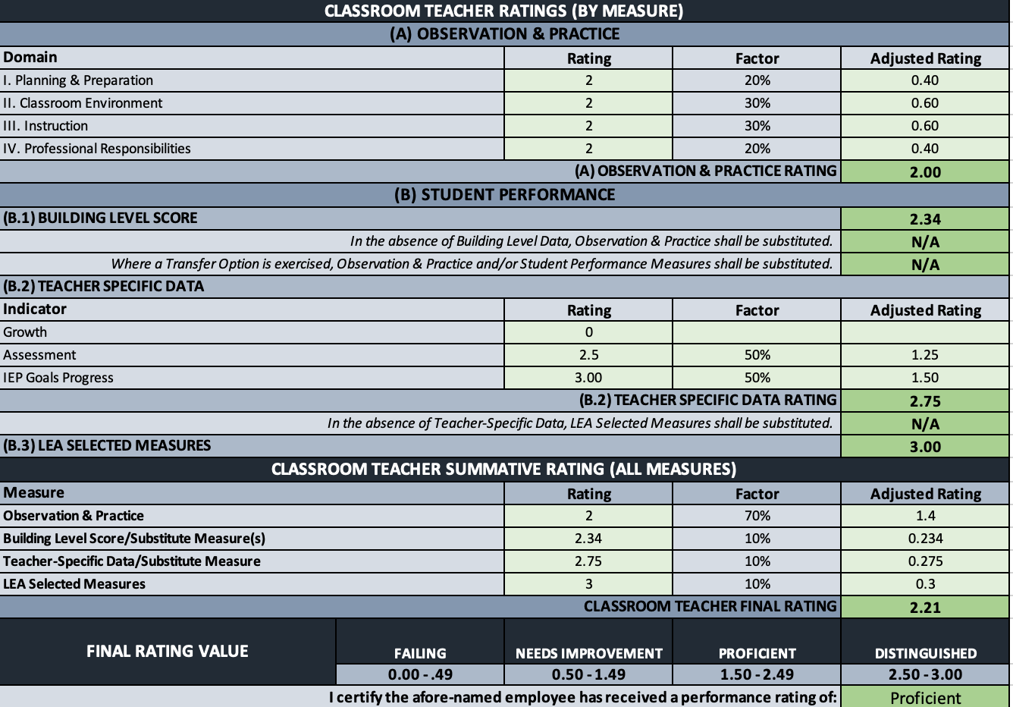
13-1 Classroom Teacher
PE Rating Form
Rating Form

Slide 13
What’s a Temporary Professional Employee?
Article XI of the Pa. Public School Code defines the term "temporary professional employee" (TPE) to mean any individual who has been employed to perform, for a limited time (established by the LEA), the duties of a newly created position or of a regular professional employee whose services have been terminated by death, resignation, suspension, or removal.
Although Pa. Act 13 of 2020 amends the measures by which a TPE will be evaluated, the legislation does not alter the definitions of professional employees under Article XI. Administrators should check with their Human Resource personnel on how professional employees are currently classified by the LEA.
Notes:
Article XI defines the term to mean any individual who has been employed to perform, for a limited time, the duties of a newly created position or of a regular professional employee whose services have been terminated by death, resignation, suspension, or removal.
While the definition does not address tenure explicitly, commonwealth case law has held that the distinction between a professional employee and a temporary professional employee is that the former has secured tenure.

Slide 14
Act 13: Temporary Teacher

Slide 15
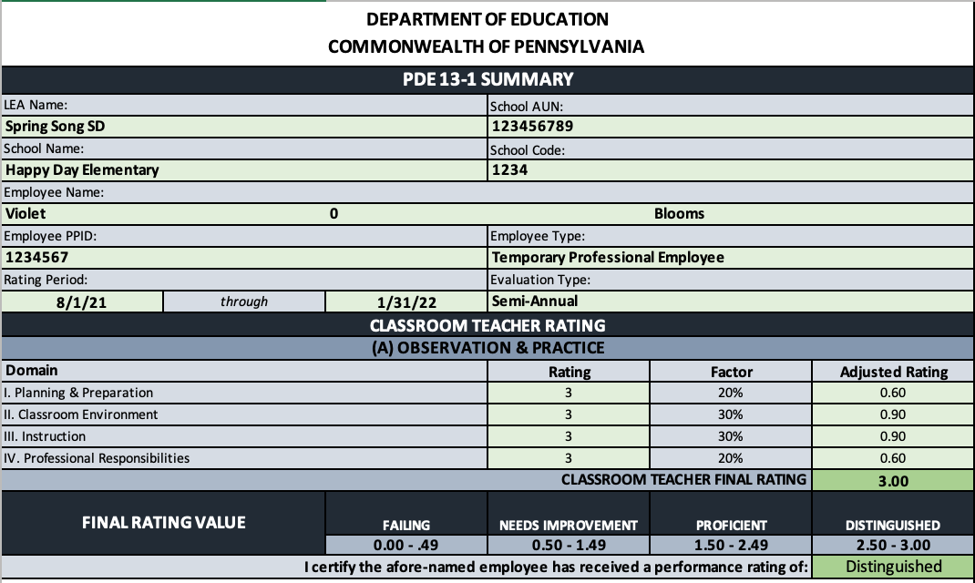
13-1 Classroom Teacher
TPE Rating Form
Rating Form
Notes:
Quick questions:
Name a teaching position that would be considered Data Available?
Name a teaching position that would be considered Non-Data Available?

Slide 16
Data Available or Non-Data Available?
Grade 11 English Teacher
Grade 4 Science Teacher
Middle School Music Teacher
Special Education Teacher
Notes:
Grade 11 English Teacher – Is this person teaching the Keystone course? If yes, then Data Available. If no, then Non-Data Available.
Grade 4 Science Teacher – Data Available
Middle School Music Teacher – Non-Data Available
Special Education Teacher – Are they co-teaching a PSSA or Keystone course (planning, teaching, and assessing)? If yes, then Data Available. If no, then Non-Data Available.

Slide 17
Non-Teaching Professionals
Non-Teaching Professionals w/Building Level Data
Non-Teaching Professionals w/out Building Level Data
Temporary Non-Teaching Professionals

Slide 18
Classroom Teacher vs. NTP
Act 82
To determine whether you are a teaching professional, you must be able to answer yes to the following two questions:
Are you working under your instructional certification?
Do you provide direct instruction* to students in a particular subject or grade level?
*Direct instruction is defined as planning and providing the instruction and assessing the effectiveness of the instruction.
Act 13
Local determination

Slide 19
Act 13: NTP w/Building Level Data

Slide 20
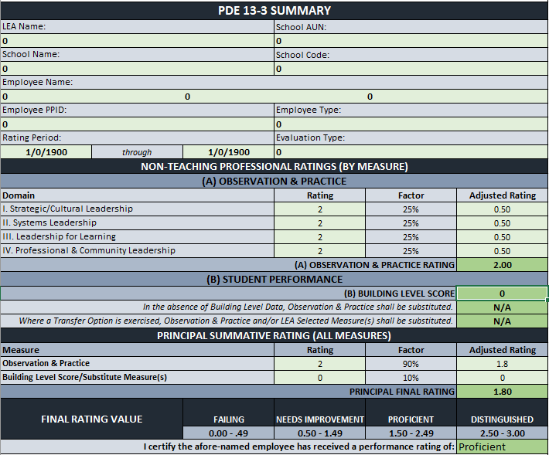

13-3 Non-Teaching Professionals Rating Form
Rating Form

Slide 21
Act 13: NTP w/out Building Level Data or Temporary NTP

Slide 22
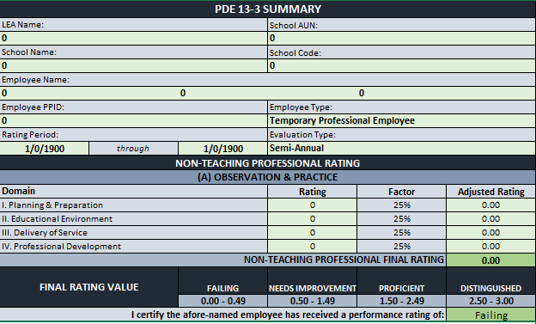
13-3 Non-Teaching Professionals
TPE Rating Form
Rating Form

Slide 23
Principals*
Principals w/Building Level Data
Principals w/out Building Level Data
Temporary Principals
*Principal includes building principals, assistant/vice principals, CTC Directors, and Special Education Directors

Slide 24
Act 13: Data Available Principal

Slide 25
Act 13: Principal w/out Building Level Data

Slide 26
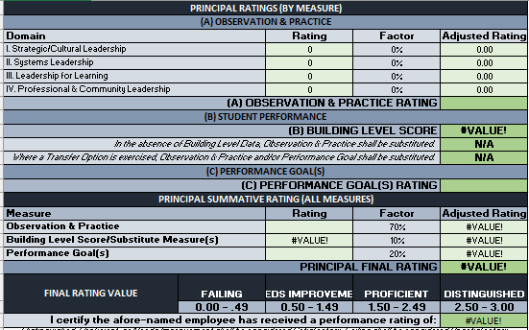
13-2 Principal
PE Rating Form
Rating Form
Notes:
Quick Questions: What form is used for a Temporary Principal? Is the rating changed at all for Temporary Principals?

Slide 27
Interim Rating
Unsatisfactory Professional Employee

Slide 28
13-4 Interim Rating
Professional employees deemed Unsatisfactory in the last evaluation must be rated at least once a year using the measures and weightings appropriate to the employee, as indicated in the table above.
Subsequent ratings during the same evaluation period (i.e., interim evaluations) are not mandated; however, should an LEA elect to perform one, the interim evaluation must be comprised of the following:
  70% Observation & Practice (aligns with the 13-1, 13-2, 13-3)
  30% LEA Selected Measures
For the LEA Selected Measures rating, the LEA should use measure(s) appropriate to the type of professional employee. Examples as follows:
  Performance Goal benchmarks might serve as a locally developed rubric in the evaluation of a principal.
  Student career readiness portfolios might be used in the evaluation of a school counselor.
Notes:
For the Observation & Practice rating, the LEA should apply the same domains, weightings, and professional practice models utilized during the prior annual evaluation.
LEA Selected Measures reflective of the role and responsibility of the professional employee

Slide 29
Act 13: 13-4 Interim Rating Allocations
Notes:
For the Observation & Practice rating, the LEA should apply the same domains, weightings, and professional practice models utilized during the prior annual evaluation.

Slide 30
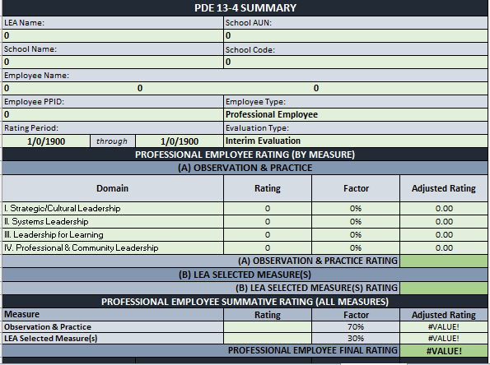
13-4 Interim Rating Form
Rating Form

Slide 31
What Rating Form Should Be Used?
1
Educator A is a second-year classroom teacher with a Level 1 certificate.
Educator B is a social worker and holds a Level 2 certificate.
Educator C is a curriculum director and been with LEA for 10 years.
Educator D is a special education supervisor.
Educator E is a tenured instructional coach who teaches 50% and supports teachers 50%.
2
3
4
5
Notes:
Educator A - 13-1 TPE
Educator B - 13-3
Educator C - 13-3
Educator D - 13-2
Educator E – LEA determined – If Classroom Teacher, use 13-1. If NTP, use 13-3.

Slide 32
Rating Form Example
Trigg Teacher | Elements | Score
Observation & Practice | Planning & Preparation | 2
 | Classroom Environment | 2
 | Instruction | 3
 | Professional Responsibilities | 3
LEA Selected Measure | Solving Word Problems (80%) | 2
 | Graphing Linear Equations and Inequalities (20%) | 3
Teacher Specific Data | Growth
 | Assessment | 75
 | IEP Goals Progress (Organization Goal – 100%) | 2
Building Level Data | Excel Middle School (50%) | 90
 | Striving Middle School (50%) | 75

Slide 33
What’s next?
Targeted Topics
Frequently asked questions will be addressed as well as an opportunity for attendees to ask questions relative to Educator Effectiveness implementation and processes.
March 3 – 3:00
March 10 – 3:00
Notes:
Reminder that all three sessions are presenting the same information. So you only need to register for one session.

Slide 34
Contact/Mission
For more information on Act 13, please visit PDE’s website at www.education.pa.gov ​
https://www.pdesas.org/EducatorFrameworks/EducatorEffectiveness/
Act 13 Questions:
RA-PDE-Evaluation@pa.gov
The mission of the Department of Education is to ensure that every learner has access to a world-class education system that academically prepares children and adults to succeed as productive citizens. Further, the Department seeks to establish a culture that is committed to improving opportunities throughout the commonwealth by ensuring that technical support, resources, and optimal learning environments are available for all students, whether children or adults.​

