Slide 1
Pennsylvania HS Graduation Requirements
Grad Data
Informing Local Practice
October 17, 2023
Notes:
BC: Welcome & introductions.
Thank you all for joining us today. I am Brian Campbell…with me today are members of our team, including Karen Rubican, our school counseling advisor, who will guide us through this presentation.
As we are now in the second year of statewide graduation requirements, it may be helpful to reflect back on year 1 and take a look at various data points to inform programming and practices moving forward. In particular, Karen comes to us from the field and has a keen perspective on the opportunities and challenges in working with students to meet local and state graduation requirements.

Slide 2
TODAY’S TOPICS
Planning for Improvement
Data Sources
Communication
Self-Reflection
School Culture
Monitoring Progress
Beyond Pathways
Q&A
Resources & Contact Information
Notes:
BC: Our agenda will walk you through various data sources and how the data may inform local practice. We’ll explore how we might examine our current practice and what we might consider moving forward. As we take you through this presentation, we’ll be polling you along the way to gather your feedback and suggestions. Unlike prior presentations, this session will focus on questions rather than providing answers and encourage you respond to our polling.
Karen, we now turn the microphone to you!

Slide 3
Planning for Improvement
Data Sources
Communication
Self-Reflection
School Culture
Monitoring Progress
Beyond Pathways
10/17/23
Notes:
KR: Thank you, Brian. By way of introduction, I am new to the Department. Prior to coming to PDE in March of last school year, I worked as a high school counselor. I was the Act 158 lead for my high school, and spent many hours watching these webinars, asking questions, and figuring out this work. We share the experience of working through challenges and assisting students in meeting pathway goals. A goal of mine was to do this work with fidelity, and I expect it has been a goal of yours as well.
Today, we offer an opportunity to review our outcomes from the class of 2023 and consider ways to plan for improvement. To do so, we will review the data sources that inform the pathways, consider how and to whom communication occurred, reflect on what worked, and consider what awaits our students beyond the pathways. As Brian said, this session will be interactive, and you are encouraged to participate and share your experience with the group today in the chat. There will be opportunities to participate in anonymous online polling, and I hope that you will take part in these sharing components. Again please use the chat to share ideas, or resources. We can learn and grow from the successes—or bumps—that we have all faced.

Slide 4
Data Sources
Prior year’s data (Pathway to Graduation Tracking Tool & Grad Report)
PVAAS
Standardized (state and national) assessments
Local assessments
CTE hours
Qualitative feedback: students, staff, and parents/caregivers
Notes:
KR: While there are a multitude of data sources from which you can consider, we’ve listed several that can inform practice moving forward. If you have already started to complete your graduation report, that report, along with the tracking tool provided by PDE or your own, is good place to review your aggregate data. Comparing PVAAS data to your class of 2023 student outcomes might help to get a sense of its true predictive value for you as you move forward.
Student performance on state and national assessments is a critical source of information. Certainly, the graduation requirements are built around Keystone Exam performance. PSAT, SAT, AP, ACT and ASVAB results are wonderful sources of information. Perhaps you give local assessments that provide value and context to these data sets. CTE hours at the end of junior year/first semester of senior year are a good data source as well.
Finally, qualitative feedback from students, parents/guardians and staff is valuable information. Surveys, feedback collected from counselors/staff, feedback from students and/or parents – perhaps even hosting a focus group with students and other school community partners.
Are there any data sources that you used that aren’t captured here? Please drop them in the chat.

Slide 5
Looking in the Rearview Mirror
Reflecting on 2023 data:
Pathways most often achieved
AA and EB criteria were most frequently utilized
Students with IEPs who graduated via pathways
Waivers numbers – extenuating circumstances versus other?
Non-graduate numbers and partial pathway progress
POLL
Notes:
KR: Perhaps a good starting point may be to look at our class of 2023 and gather this data. What pathways were most often completed? We expect to see most students meeting Keystone Proficiency or Keystone Composite. For alternative assessment and evidenced-based pathways, which criteria were most frequently utilized? How many students had the pathway resolved by the beginning of senior year? Conversely, what was the lift last year for the class of 2023 to complete criteria?
POLL
Were students involved in CTE successful in meeting the CTE Concentrator? If not, which pathway did they move to?
Let’s turn to students with IEPs. We know that there are students with IEPS that preclude them from meeting graduation requirements. That said, how many graduated via pathways? What made the difference for the pathway completers? Who made the difference for the pathway completers? We know that faculty and staff gave extra help and support to assist individual students and should be commended for this work!
For students who received waivers, were there commonalities in extenuating circumstances? Did they get close to meeting a pathway, but it wasn’t quite enough?
Finally, let’s consider the non-graduates. Did you have any students not meet the threshold for graduation? What have these students done in response to not graduating? Are they able to graduate after summer school? Did they drop out?
For partial pathway progress, what waiver conditions existed?

Slide 6
And this data triggers these questions…
Do we need to offer additional opportunities for meeting criteria?
What seemingly reachable options are underutilized?
Accessibility
Timing (e.g., day/hour, scheduling – too late/conflicts, artifact delay)?
Fees
Transportation
Language
Pre-requisites/conditions (e.g., # credits, minimum GPA)
Do we need to look at our IEP population and their journey?
Do we need to examine the number of OTHER waivers to set up for success?
Do we need stronger supports for the at-risk population?
POLL
Notes:
KR: And once we have gathered the data, it may suggest a review of current practice and how we may revisit what we’re doing now. 2023 was, for most, figuring it out during the school year for the senior class. I can speak for my experience—it felt like flying a plane while building it…
Knowing that the graduation requirements are in place and having had a year of implementation, it leads to some questions and a chance to take stock of our practice. Are we offering enough opportunities to meet criteria? What barriers exist related to accessibility or timing—would students have been more successful in completing some additional criteria if we had started earlier? Are there fees or costs that make some processes—dual enrollment being one—more challenging?
Poll-Barriers
For NCAA, would more students have met this threshold if students who demonstrated some concerning Keystone outcomes by benchmark testing were advised to take courses that count for NCAA? Would expanding your NCAA offerings support meeting this criteria?
Our special education students are receiving individualized support. Do we need to consider embedding opportunities like receiving industry recognized credentials, work-based learning or service learning into the IEPs?
For students who received a waiver in the “other” category, are there patterns or correlation to their experience?
Is there more we could do for our students who struggle? This topic could be its own webinar, but how do we motivate the apparently unmotivated? Please drop your ideas and experiences in the chat.

Slide 7
Communication
When do we inform students and parents of the statewide graduation requirements?
Do we (teacher, administrator, school counselor) meet one to one with students to review Keystone Exam performance?
How often do we communicate to parents? To students?
At what grade do we begin to plan for pathways?
Do we communicate within our business community to offer new options (e.g., forming partnerships with community businesses to offer work-based learning experiences)?
POLL
Notes:
KR: Poll on timing of communication, how are meetings held
POLL-when to communicate? How to communicate?
Another aspect to reflect upon is our communication process. Where are our strengths and where are the opportunities to upgrade what we are currently doing?
The first big consideration is when we inform our school community about the graduation requirements. Is it ever too soon? Too late? What is the “right time” for this conversation? Let’s look at the poll results. (expand conversation based on answers-) It seems that the best time to inform students and parents about graduation requirements related to Keystone exam performance first, and alternate graduation pathways next, is prior to or during the taking of a trigger course and before the Keystone Exams are administered. It should be added to programs of study and information should be available on the website. It can be off-putting to parents if it seems like a surprise.
When Keystone Exam results are received-how is the information shared with students and families Is anyone at the school reviewing individual scores with students?
When do we begin to plan for a pathway? Students are completing academic and career plans per the Career Education and Work Standards in 8th grade. Is that too soon? Students can always change their minds and thus, their pathway course during high school. Does attaching this conversation to an already-required plan make sense? School counselors and others can track progress toward the pathway and share the progress with parents and students. We can’t record what we don’t know--- I found last year that some of our students accrued industry recognized credentials in their places of employment. Communicating with the families allows us to add this valuable information to our records.
We talked earlier about challenges related to providing some of these criteria options to students. Partnerships with folks within our business community could support offering work-based learning experiences. Programs like the German/American Chamber of Commerce support workforce development and offer apprenticeship opportunities. As well, philanthropic organizations might be willing to assist in funding programs like ACT Work Keys or the testing required for Skill Up.
The key here is how we share these requirements and our needs in meeting them for the betterment of our students.

Slide 8
School Culture
Natural linkages to IRCs in coursework
Service-learning projects requirements (middle level?)
ASVAB option
NCAA approved classes
Keystone Exam performance review
Tutoring/remediation
Financial considerations
Extra-curricular/special offerings (e.g., service-learning club, day of service)
CHAT RESPONSE
Notes:
KR: As we celebrate the variety of strengths in students, we examine school culture from the lines of accessible options for our diverse populations. These graduation requirements provide an opportunity to consider the number and quality of criteria that are embedded into your school community. Let’s take a look at some of the options we have available:
CHAT RESPONSE-share something in your school culture that you are proud of and that lends itself to the graduation requirements.
Let’s begin by considering Industry Recognized Credentials. There are numerous opportunities to receive industry recognized credentials, and many of them naturally align to courses already being offered. Are your students taking business classes? Allow for the MOS Certifications. Family and Consumer Sciences? SafeServ. What other courses would lend themselves to an industry recognized credential? Should this be a poll-what industry recognized credentials are you offering in your course curriculum?
Are there opportunities to embed events like service-learning projects into your school community by grade level or class? At the middle school level? At my former school, the art teacher took students to the local hospital to paint windows. The band and chorus traveled to perform at nursing homes, the cemetery on Memorial Day, and other occasions—service learning.
We talked about the ASVAB earlier as being a vital data source. Were you giving the ASVAB prior to last school year? In addition to counting for graduation requirements, it can be very illuminating for students in terms of career strengths and options.
We also mentioned NCAA approved classes. How visible are those classes to your students? Are they denoted in the program of studies? How are students geared towards NCAA approved classes?
The Keystone Exam performance review would be an opportunity to disaggregate for a student and their parent/guardian/caregiver their demonstrated strengths and areas for improvement. Is your school creating space for these conversations? Is tutoring or remediation offered voluntarily or required of students?
How much was asked of students over and above the school day to meet a pathway? If students had to leave school to complete a graduation requirement, how was the missing class time handled?
How might you enhance or expand your options to better meet the needs of your students?
What’s needed to remove any barriers that may exist (e.g., underwriting exam fees for low-income students)?
What’s needed to offer new options (e.g., forming partnerships with community businesses to offer work-based learning experiences)?
How might current options be expanded to embed opportunities within the curricular or extra-curricular offerings (e.g., service-learning club)?

Slide 9
School Culture Chat Response
Meeting Grad Pathway (short answer)
Share a successful practice or program that promoted access to meeting a graduation pathway.
DROP YOUR RESPONSE IN THE CHAT!

Slide 10
Monitoring Individual Student Progress
Do we have a team or process to monitor progress?
Does our grad team review progress on a regular basis and keep in touch with students and parents/caregivers?
Do we guide students into pathways where success appears achievable?
Notes:
KR: The challenge of assisting all students in meeting grad requirements should be a team effort. For the students who do not meet a pathway by the beginning of senior year, your team could develop a process to monitor them. This work does not belong to any one person in your building, although you may have identified a lead for the work. Working as a team allows for more creativity and flexibility in identifying student options. I mentioned earlier the idea of doing this work with fidelity. I know that collectively we want our students to not only meet graduation requirements and walk across that stage to accept a diploma. We want students to be fully prepared for the world that awaits them, whether it is a two- or four-year college, trade or technical school, apprenticeship, skilled trade, military or workforce.

Slide 11
Beyond Pathways
Waivers
When was hope lost? What factors contributed to the failure to meet a pathway?
Special Education
Are there enough opportunities to guide our students with IEPs to meet a pathway?
Keystone Diploma
Have we exhausted all avenues before requesting a Keystone Diploma?
Non-graduates
What can we learn from this data and how can we adjust?
Notes:
KR: A closer examination of the above may provide questions worth asking around…
For your students who were provided a waiver, at what point did you decide that, even with multiple interventions and opportunities, they were not going to be able to meet a pathway? How many interventions occurred? What are those students doing now?
Students with IEPs-do additional activities and supports need to be considered?
At what point do you request a Keystone Diploma? When is enough, enough?
For our non-graduates, what lessons can we learn? Every student is different, of course, but is there something that can be gained from this loss? How can we adjust to support future students who might be facing similar challenges?

Slide 12
As you move forward…
Be proud of the work you have done and the efforts you have made to graduate all students.
Take today’s conversation and move the dialogue to your school/district as you expand and grow opportunities for student success.
Notes:
KR: As you move to year two with graduation requirements, celebrate that your students have grown and gained from these experiences – as you have as well. The questions posed here we hope will offer a great dialogue for your school/district as you enhance your programming and consider how these criteria can be embedded into your curriculum. It will be important to be deliberate about your action steps to ensure efficiency, fidelity, and integrity in the process.
I don’t think it can be stressed enough that you should feel a sense of accomplishment for the work that has been done and the efforts that you have made to graduate all students in the class of 2023, as well as to educate all students in your charge each day. Thanks to everyone who has taken part in the online polling and dropped suggestions, successes, comments and resources in the chat.
And with that, the chat is opened now for your questions. Thank you, everyone.

Slide 13
YOUR QUESTIONS
Notes:
KR: And now for questions/suggestions…

Slide 14
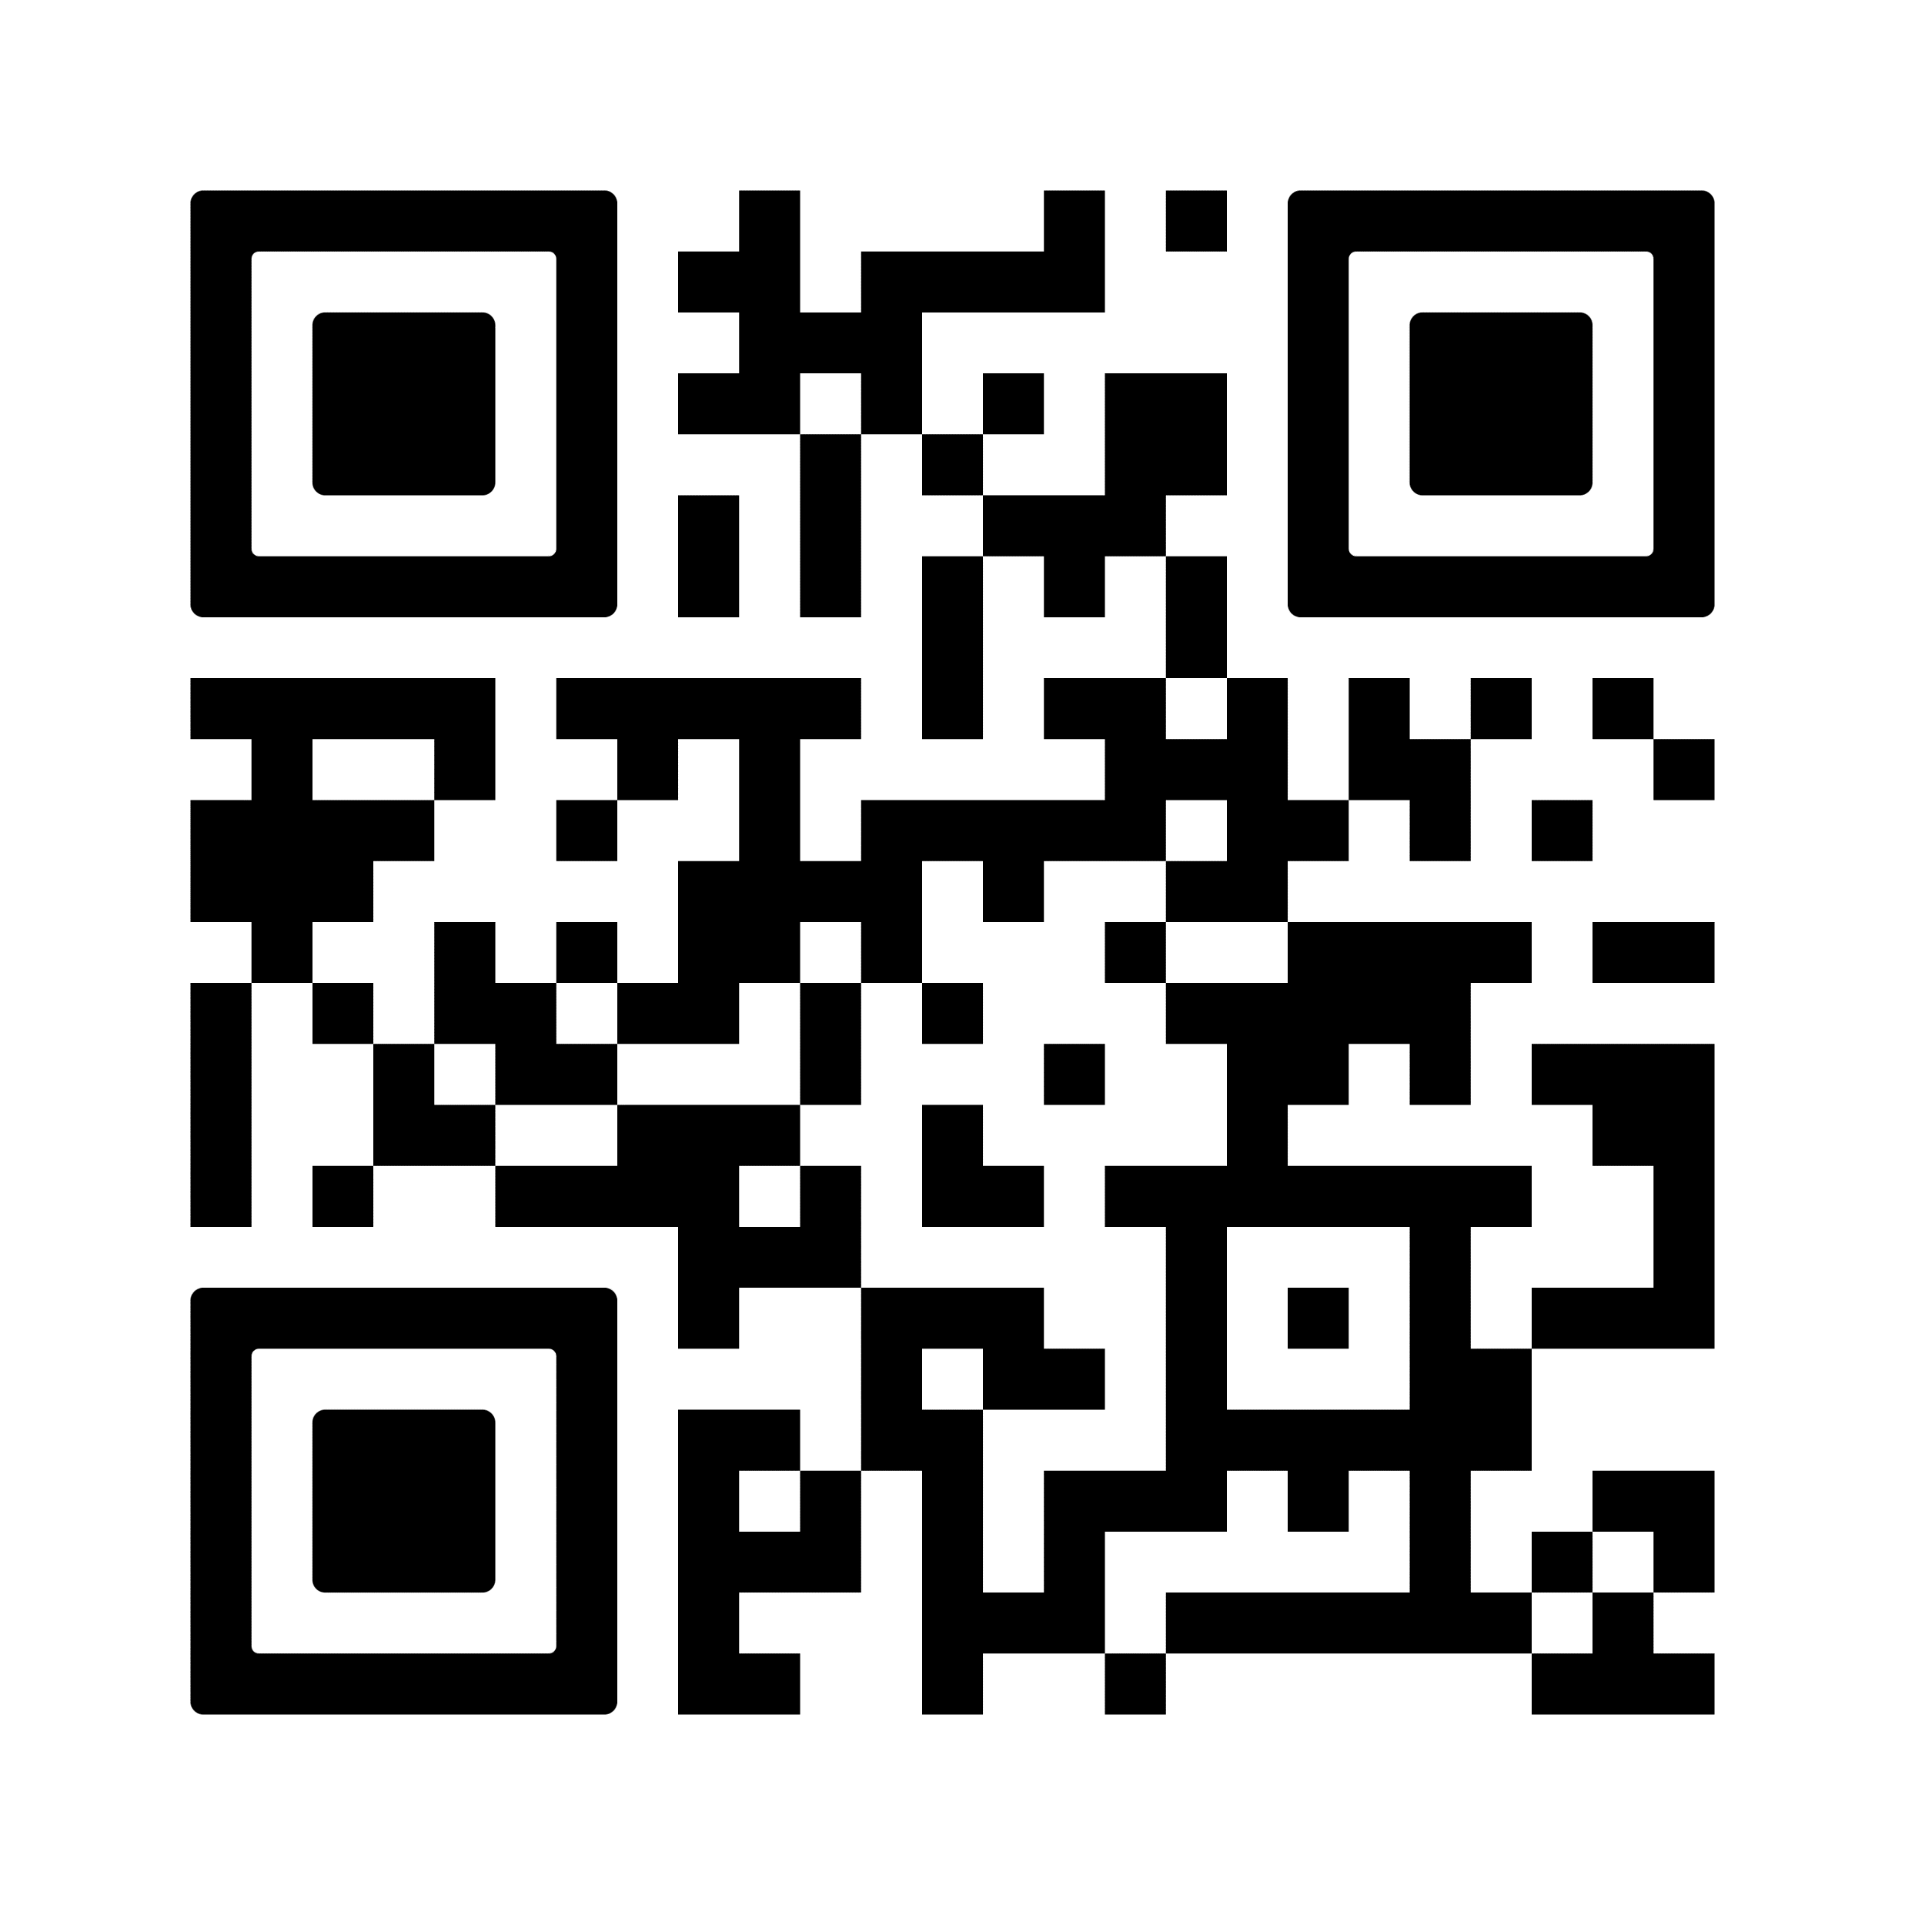
Training Schedule
TRAINING SCHEDULE (SAS)
Frequently Asked Questions
Date TBD
RESOURCES
WWW.PDESAS.ORG
WWW.EDUCATION.PA.GOV
CONTACT
RA-EDGRADREQUIREMENT@PA.GOV
The mission of the Department of Education is to ensure that every learner has access to a world-class education system that academically prepares children and adults to succeed as productive citizens. Further, the Department seeks to establish a culture that is committed to improving opportunities throughout the commonwealth by ensuring that technical support, resources, and optimal learning environments are available for all students, whether children or adults.

