Slide 1
Act 13
Interactive Toolkit
A Deep Dive
January 26, 2022

Slide 2
Agenda
Toolkit Overview
Toolkit Options
Deep Dive into the Interactive Toolkit

Slide 3



Office Hours Etiquette
Listen to the presenter and enter relevant questions in the chat.
Use pause points to enter questions into the chat.
Monitor chat for responses.

Slide 4
Toolkit Overview Slide 1
Toolkit Overview

Slide 5






Toolkit Overview
Evaluation Measures
Evaluation Process
Training & Professional Development
Resources
Act 13
References
Notes:
https://www.pdesas.org/Frameworks/TeacherFrameworks/TeacherEffectiveness/
Evaluation Measures
Measures & weighting, Observation & Practice
Building-Level Data
Teacher-Specific Data
LEA Selected Measures
Performance Goals
Evaluation Process
Rating Scale
Rating Frequency
Rating Protocol
Maintaining Records & Reporting Data
Training & Professional Development
Training Requirements
Professional Development Opportunities
Resources
Rating Tools
Frameworks for Observation & Practice
References
Definitions & Terms
Statutes & Regulations

Slide 6
Toolkit Slide 1
Toolkit

Slide 7
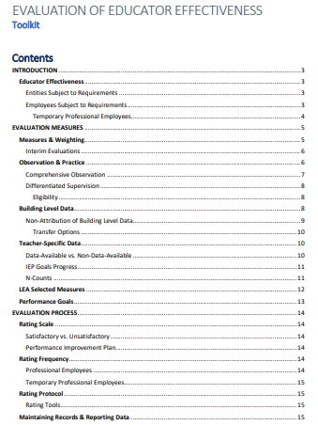
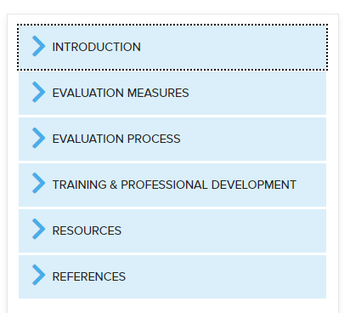
Toolkit Options
Interactive
PDF Download
Notes:
Download a PDF version
Interactive Toolkit

Slide 8
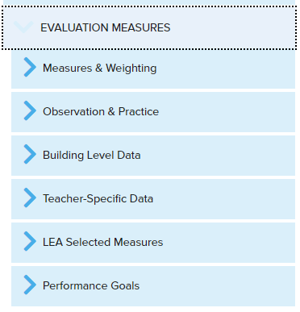
Toolkit Deep Dive: Subcategories
Organized within subcategories
Notes:
The subcategories assist in finding the information quickly and allow it to be user-friendly.

Slide 9
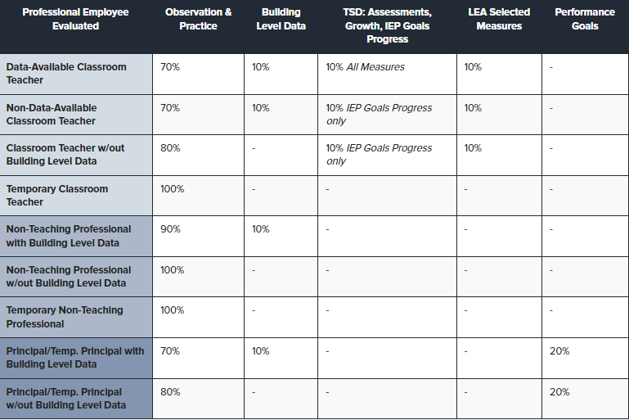
Toolkit Deep Dive: Charts
Notes:
Charts throughout to view the content in an easier format

Slide 10
Toolkit Deep Dive: Examples
Applications
By way of example, the TSD rating for a classroom teacher reported only as providing instruction in 12th Grade English and with no directly attributable assessment and/or growth data would be comprised solely of IEP Goals Progress - if IEP Goals Progress data are available and attributable to that teacher. Otherwise, the 10% weighting for Teacher-Specific Data is reallocated to LEA Selected Measures, increasing the significance of that rating area to 20% of the overall performance rating for the classroom teacher.
Conversely, a math specialist who is not the teacher of record but who co-taught an Algebra I course could be considered data-available if the specialist planned, provided, and assessed the instruction of eligible content measured by a state assessment for a sufficient student cohort (see N-Counts) and, for growth, has attributable assessment data for the past three years.
Notes:
Examples throughout the Toolkit allow for readers to understand the content by way of real-life examples.

Slide 11

Toolkit Deep Dive: Resource Links
To assist in evaluation, the Department has provided the Student Performance Measure: IEP Goals Progress template.
Link to template.
Notes:
Links directly to resources throughout the toolkit

Slide 12
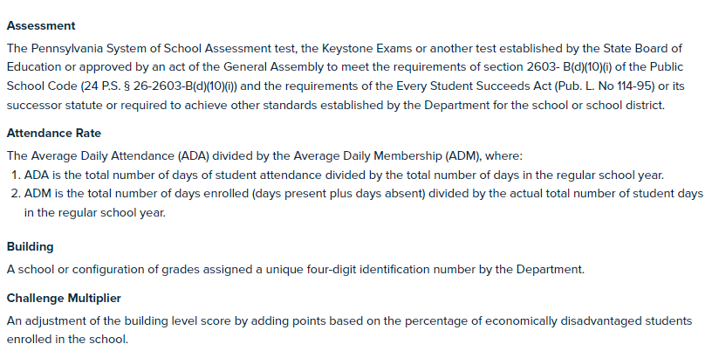
Toolkit Deep Dive: Definitions
References
Notes:
Easy to find definitions to ensure clarity of content.

Slide 13
What’s next?
Frequently Asked Questions: TPE, IEP Goals Progress, and Employee Categories/Rating
This session will address commonly asked questions in the Act 13 resource account.
February 3 - 12:00 & 3:00
Notes:
Reminder that all three sessions are presenting the same information. So you only need to register for one session.

Slide 14
Contact/Mission
For more information on Act 13, please visit PDE’s website at www.education.pa.gov ​
https://www.pdesas.org/EducatorFrameworks/EducatorEffectiveness/
Act 13 Questions:
RA-PDE-Evaluation@pa.gov
The mission of the Department of Education is to ensure that every learner has access to a world-class education system that academically prepares children and adults to succeed as productive citizens. Further, the Department seeks to establish a culture that is committed to improving opportunities throughout the commonwealth by ensuring that technical support, resources, and optimal learning environments are available for all students, whether children or adults.​

