Slide 1

STEELS Professional Learning Series
Science, Technology & Engineering, Environmental Literacy Sustainability
STEELS
Foundation Boxes
www.education.state.pa.us
>
1

Slide 2
Shift in Focus: Students . . .
Engage in science and engineering practices as part of sustained and meaningful investigations applying disciplinary core ideas and cross-cutting concepts.
Explain phenomena by developing and applying the science and engineering practices, disciplinary core ideas, and crosscutting concepts in a real-world context.
Utilize critical thinking and problem-solving to apply knowledge in novel, real-world situations.
www.education.state.pa.us
>
2

Slide 3
Standards Organization
The document is organized with three main sections:
  PA Standards
  Foundation Boxes
  Connection Boxes
www.education.state.pa.us
>
3

Slide 4
PA Standards
PA Standards are performance expectations.
All standards are three-dimensional.
Foundation Boxes include:
Disciplinary Core Ideas
Science and Engineering Practices
Crosscutting Concepts
www.education.state.pa.us
>
4

Slide 5
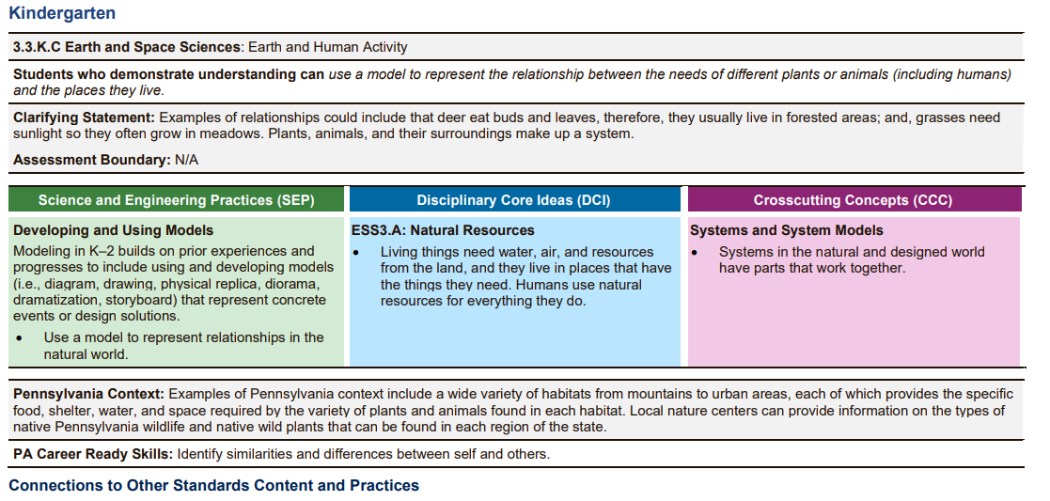
PA Standards
www.education.state.pa.us
>
5

Slide 6
PA Standards – Kindergarten ESS
Students who demonstrate understanding can use a model to represent the relationship between the needs of different plants or animals (including humans) and the places they live.
(Systems in the natural and designed world have parts that work together)
Each standard includes:
Disciplinary Core Ideas
Science and Engineering Practices
Crosscutting Concepts
www.education.state.pa.us
>
6

Slide 7
PA Standards
www.education.state.pa.us
>
7

Slide 8
PA Standards
Clarifying Statements supply examples or additional clarification and emphasis to the language of the performance expectations.
Assessment Boundaries specify limits to large-scale assessment. They are not meant to put limits on what can be taught or how it is taught, but to provide guidance to assessment developers.
www.education.state.pa.us
>
8

Slide 9
PA Standards
www.education.state.pa.us
>
9

Slide 10
Science & Engineering Practices
Asking questions (for science) and defining problems (for engineering)
Developing and using models
Planning and carrying out investigations
Analyzing and interpreting data
Using mathematics and computational thinking
Constructing explanations (for science) and designing solutions (for engineering)
Engaging in argument from evidence
Obtaining, evaluating, and communicating information
www.education.state.pa.us
>
10

Slide 11
PA Standards
www.education.state.pa.us
>
11

Slide 12
PA Standards
www.education.state.pa.us
>
12

Slide 13
Crosscutting Concepts
Patterns
Cause and effect
Scale, proportion, and quantity
Systems and system models
Energy and matter
Structure and function
Stability and change
www.education.state.pa.us
>
13

Slide 14
PA Standards
www.education.state.pa.us
>
14

Slide 15
Phenomena . . .
are accessible locally.
must be grounded in relevant, real-world scenarios.
are observable events that occur in students’ world.
www.education.state.pa.us
>
15

Slide 16
PA Standards
www.education.state.pa.us
>
16

Slide 17
PA Standards
www.education.state.pa.us
>
17

Slide 18
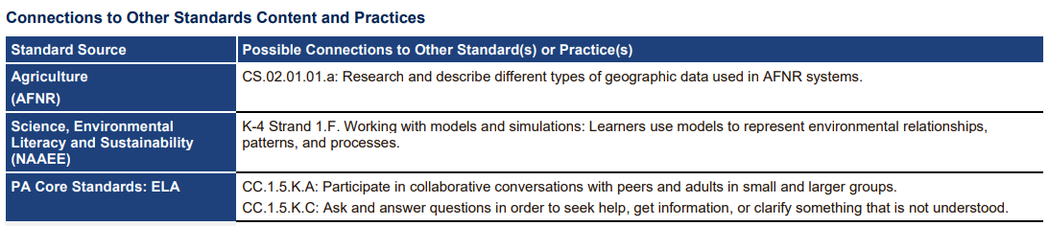
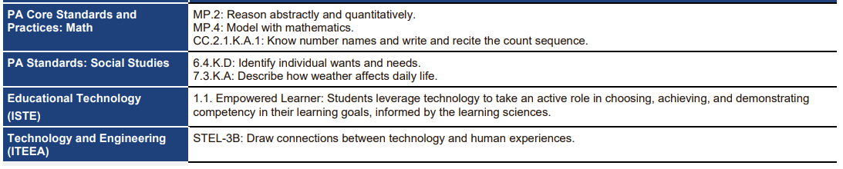
Possible Connections
www.education.state.pa.us
>
18

Slide 19
Contact / Mission
For more information, please visit the STEELS Hub on SAS.
The mission of the Department of Education is to ensure that every learner has access to a world-class education system that academically prepares children and adults to succeed as productive citizens. Further, the Department seeks to establish a culture that is committed to improving opportunities throughout the commonwealth by ensuring that technical support, resources, and optimal learning environments are available for all students, whether children or adults.
www.education.state.pa.us
>
19

