Slide 1
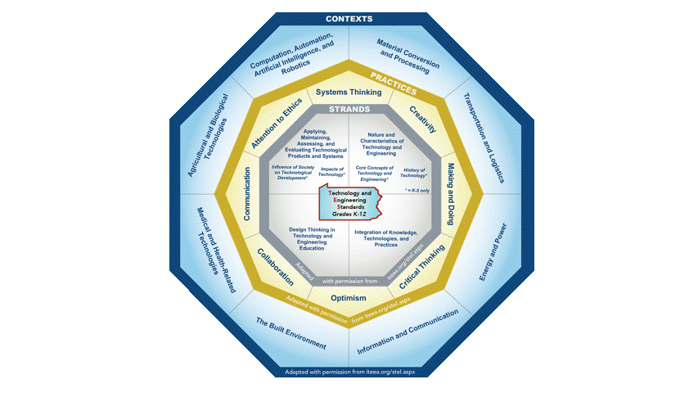
STEELS
Professional Learning Series
Science, Technology & Engineering,
Environmental Literacy & Sustainability
Standards
STEELS
UNPACKING THE TECHNOLOGY
& ENGINEERING STANDARDS
Notes:
This webinar is part of the STEELS Professional Learning Series on the STEELS Hub.
This session will focus on Unpacking the Technology & Engineering Standards.

Slide 2
Introduction
The Science, Technology & Engineering, and Environmental Literacy & Sustainability Academic (STEELS) Standards guide the study of the natural and human-made world through inquiry, problem solving, critical thinking, and authentic exploration.
Notes:
The Science, Technology & Engineering, and Environmental Literacy & Sustainability Standards or (STEELS) guide the study of the natural and human-made world through inquiry, problem solving, critical thinking, and authentic exploration.

Slide 3
Timeline
Timeline
STEELS Standards approved 2022
Three-year implementation period
Notes:
The STEELS standards were approved in July of twenty-twenty two.
Districts now have a three-year period to implement the new standards.

Slide 4
Shift in Focus
Increased emphasis on design and design thinking.
Students create, utilize, and assess current and emerging technologies by developing and applying the Technology & Engineering practices and disciplinary core ideas in a variety of contexts.
Students practice inquiry, critical thinking, hands-on making and doing, and a focus on learning skills that can be applied throughout their lives, regardless of context.
Notes:
There is a major shift of focus with the new Technology & Engineering standards. (PAUSE)
This shift includes an emphasis on design and design thinking.
Students create, utilize, and assess current and emerging technologies by developing and applying the Technology & Engineering practices and disciplinary core ideas in a variety of contexts.
Students practice inquiry, critical thinking, hands-on making and doing, and focus on learning skills that can be applied throughout their lives, regardless of context.

Slide 5
Shift in Focus
Focus on the interactions among technology, engineering, society, the environment, and other content areas.
Technology & Engineering standards are student performance expectations – NOT curriculum.
Technology & Engineering concepts build coherently from K–12.
Focus on a broader understanding of content as well as application of content.
Science, Technology & Engineering, and Environment Literacy & Sustainability are integrated.
Prepare students for college, career, and citizenship.
Notes:
The standards focus on the interactions among technology, engineering, society, the environment, and other content areas.
The standards are student performance expectations – NOT curriculum.
Technology & Engineering concepts build coherently from K–12.
There is a focus on a broader understanding of content as well as application of content.
Science, Technology & Engineering, and Environment Literacy & Sustainability are integrated.
The goal of these standards are to prepare students for college, career, and citizenship.

Slide 6
Standard Design and Architecture
Technology & Engineering
The standards are written as grade-banded performance expectations built around Technology & Engineering strands, practices, and contexts and integrated into a set of specific standards. These components are elaborated upon in Foundation Boxes (hyperlinked for each standard) providing support for design of curriculum and instruction.
Notes:
The Technology & Engineering standards are written as grade-banded (K-2, 3-5, 6-8, and 9-12) performance expectations built around Technology & Engineering strands, technology & engineering practices, technology & engineering contexts, and integrated into a set of specific standards.

Slide 7
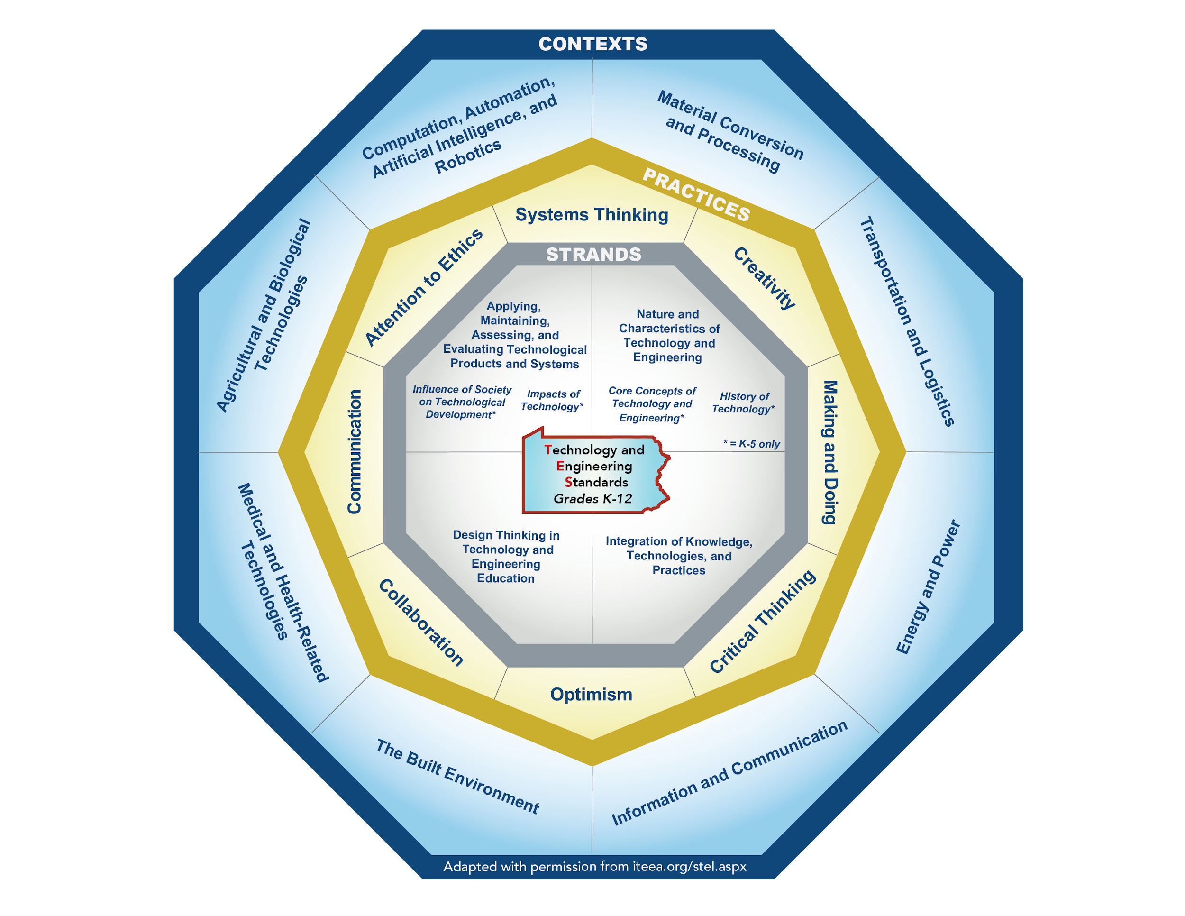
Technology & Engineering Standard Organization
Notes:
The Technology & Engineering standards utilize three organizers that work together as a framework for teaching Technology & Engineering within a Technology & Engineering program or class. These include:
Strands (which include the standards). These are located in the innermost octagon.
Practices, (These are located in the second octagon moving out from the center).
and Contexts. (These are located in the outermost octagon).

Slide 8
Technology & Engineering Strands
1. Nature and Characteristics of Technology & Engineering
2. Core Concepts of Technology & Engineering
3. Integration of Knowledge, Technologies, and Practices
4. Impacts of Technology
5. Influence of Society on Technological Development
6. History of Technology
7. Design Thinking in Technology & Engineering Education
8. Applying, Maintaining, Assessing, and Evaluating Technological Products and Systems
Notes:
The 8 strands guide students to the big ideas and central understandings of the content area of Technology & Engineering. The strands also identify the relationship between technology, engineering, and other fields of study as well as Technology & Engineering in a broader context.
The strands include:
Nature and Characteristics of Technology & Engineering
Core Concepts of Technology & Engineering
Integration of Knowledge, Technologies, and Practices
Impacts of Technology
Influence of Society on Technological Development
History of Technology
Design Thinking in Technology & Engineering Education and,
Applying, Maintaining, Assessing, and Evaluating Technological Products and Systems

Slide 9
Technology & Engineering Strands (and standards)
PSTE Strands
PSTE Strands
What all students should know and understand…
(Cognitive Domain)
What they should be able to do…
(Psychomotor Domain)
And their attitudes towards…
(Affective Domain)
Notes:
The 8 strands and their associated grade-banded standards encompass three types:
What all students should know and understand about Technology & Engineering…(The Cognitive Domain)
What they should be able to do…(The Psychomotor Domain)
and their attitudes towards Technology & Engineering…(The Affective Domain)

Slide 10
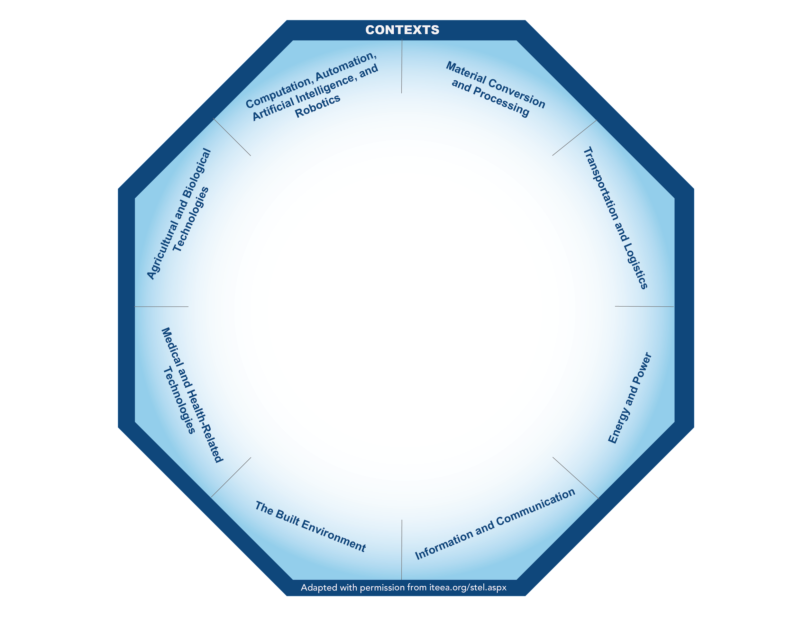
Technology & Engineering Strands
Notes:
The strands and standards within represent the information, ideas, and processes all students should know and be able to do regardless of their eventual academic pursuit or career destination. Specific to Technology & Engineering, they are to be used within the Contexts.

Slide 11
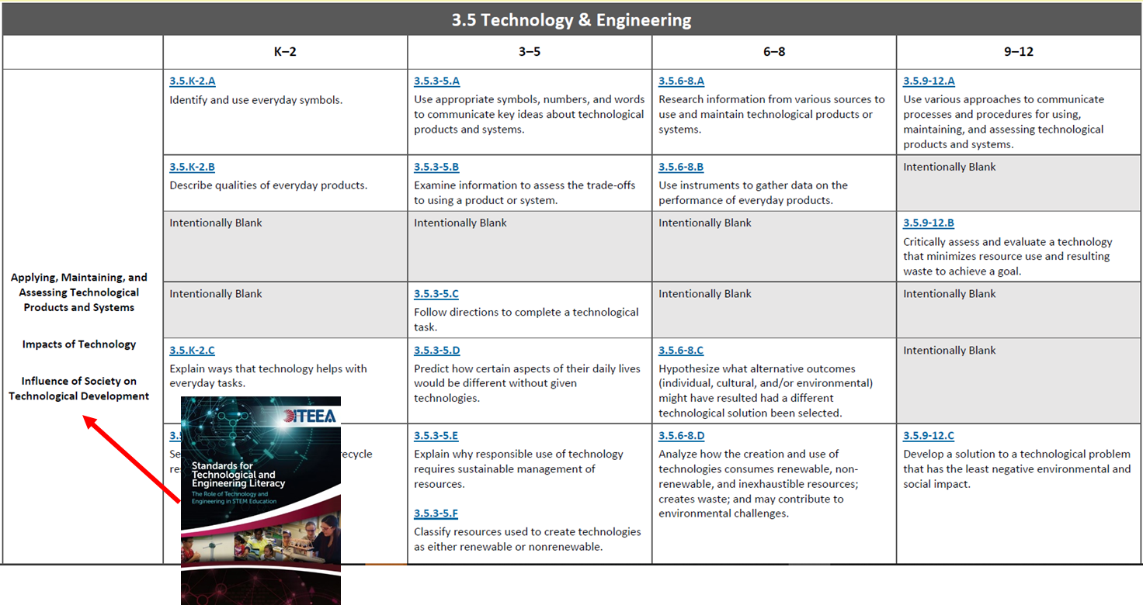
Technology & Engineering Strands
Notes:
Displayed here are the Technology & Engineering standards which include the strands in the left hand column. These strands were derived from the International Technology & Engineering Educators Association’s Standards for Technological and Engineering Literacy (the STEL). Standards are organized by strand and progress coherently from K-12.

Slide 12
Coding of the Standards within the Strands
Each standard has a four-digit code. In the example below, for 3.5.9-12.N
The first digit (3) represents the content (T&E, Science, and ELS). All Technology & Engineering, Science, and Environmental Literacy and Sustainability standards are representative with a 3.
The second digit is the discipline. 5 represents Technology & Engineering.
The third number represents the grade band.
The fourth character represents the standards: N.
3.5.9-12.N
Analyze and use relevant and appropriate design thinking processes to solve technological and engineering problems.
Notes:
Each standard has a four-digit code. In the example below, for 3.5.9-12.N
The first digit (3) represents the content (Technology & Engineering, Science, and ELS). All Technology & Engineering, Science, and Environmental Literacy and Sustainability standards are represented with a 3.
The second digit is the discipline. 5 represents Technology & Engineering.
The third number represents the grade band (9-12)
The fourth character represents the standards: N which is: Analyze and use relevant and appropriate design thinking processes to solve technological and engineering problems.

Slide 13
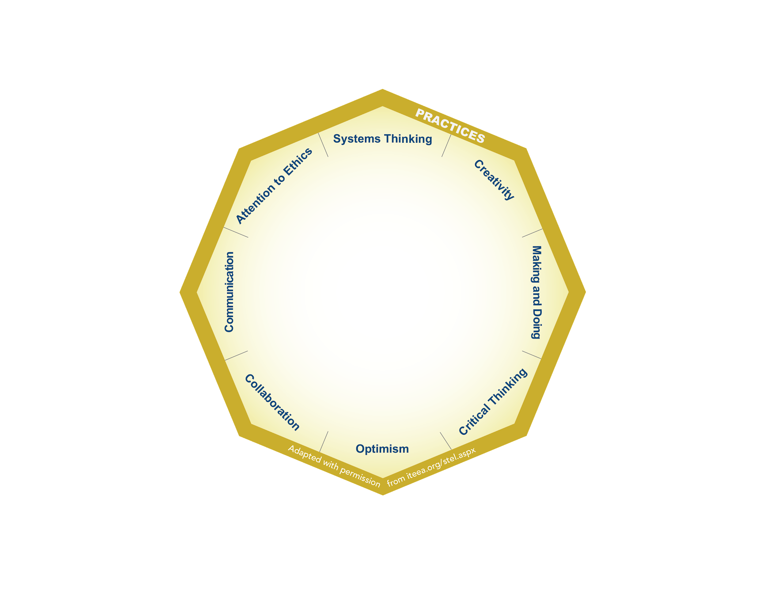
Technology &
Engineering Practices
1.Systems Thinking
2. Creativity
3. Making and Doing
4. Critical Thinking
5. Optimism
6. Collaboration
7. Communication
8. Attention to Ethics
Notes:
The second organizer within the Technology & Engineering standards are the Technology & Engineering practices.
The 8 Technology & Engineering Practices are:
Systems Thinking
Creativity
Making and Doing
Critical Thinking
Optimism
Collaboration
Communication
Attention to Ethics
The practices were adapted from the 21st Century Skills and from the research on Engineering Habits of Mind.
The practices are student centered and reflect the knowledge, skills, and dispositions students need in order to successfully apply the standards in different context areas.

Slide 14
Technology &
Engineering Practices
USED IN
A VARIETY
OF
CONTEXTS
Notes:
Technology & Engineering Practices are intentionally used in a variety of contexts providing educators with opportunities to incorporate authentic and real-world expectations into lessons, activities, and other learning experiences to mimic work and life outside of the classroom.

Slide 15
Technology &
Engineering Contexts
1. Computation, Automation, Artificial Intelligence, and Robotics
2. Material Conversion and Processing
3. Transportation and Logistics
4. Energy and Power
5. Information and Communication
6. The Built Environment
7. Medical and Health-Related Technologies
8. Agricultural and Biological Technologies
Notes:
The final organizer in the standards are the contexts. Technology & Engineering classrooms and laboratories vary greatly in Pennsylvania, therefore, contexts are not course titles rather they group together 8 areas that broadly represent the breadth of technology.
The contexts are:
Computation, Automation, Artificial Intelligence, and Robotics
Material Conversion and Processing
Transportation and Logistics
Energy and Power
Information and Communication
The Built Environment
Medical and Health-Related Technologies
Agricultural and Biological Technologies
3. The contexts can be thought of as areas that organize the content to be studied.
4. The contexts are the settings where the standards and practices may be taught, however, the standards can be applied in any or all of the contexts.
5. The contexts allow for future development of technology.

Slide 16
Technology & Engineering Standard Organization
Notes:
This graphical depiction shows three octagons that are rotating indicating application of the strands (and the standards within), and Technology & Engineering practices in a variety of contexts.

Slide 17
Technology & Engineering Standard Vignette (Grades K-2)
Kindergarteners apply standard 3.5.K-2.J, design new technologies that could help improve their daily lives, in the context of The Built Environment. Teachers can challenge their students asking, “If you and your friends could build something in the school’s playground to make recess more fun, what would you build?” Students utilize the the primary Technology & Engineering Practice of Making and Doing while they sketch ideas and build a prototype of new playground equipment.
Notes:
The following vignettes illustrate how learning experiences may be constructed using a Technology & Engineering standard, context, and practice.
One special note…considering the variations of Technology & Engineering classrooms and laboratories in Pennsylvania, contexts are provided in the following vignettes only as examples. Standards and practices may be taught or applied in any or all of the contexts.
In this example, Kindergarteners apply standard 3.5.K-2.J, which is design new technologies that could help improve their daily lives. This experience is occurring in the context of The Built Environment.
Teachers can challenge their students asking, “If you and your friends could build something in the school’s playground to make recess more fun, what would you build?” Students utilize the the primary Technology & Engineering Practice of Making and Doing while they sketch ideas and build a prototype of new playground equipment.

Slide 18
Technology & Engineering Standard Vignette (Grades 3-5)
In an Energy and Power context, third-grade students learn to apply 3.5.3-5.F, classify resources used to create technologies as either renewable or non-renewable by creating a chart of all energy systems that they use during a typical day and then classifying them using the primary Technology and Engineering Practice of Critical Thinking as either renewable or non-renewable.
Notes:
This vignette occurs in a Energy and Power context.
Third-grade students learn to apply standard 3.5.3-5.F, which is classify resources used to create technologies as either renewable or non-renewable by creating a chart of all energy systems that they use during a typical day and then classifying them as either renewable or non-renewable.
Students utilize the primary Technology & Engineering Practice of Critical Thinking as they classify resources.

Slide 19
Technology & Engineering Standard Vignette (Grades 6-8)
In the context of Bio-Related Technologies and/or Material Conversion and Processing, middle school students investigate waste management. Addressing standard 3.5.6-8.H, evaluate trade-offs based on various perspectives as part of a decision process that recognizes the need for careful compromises among competing factors, students study the process of trash collection and processing by following how it travels from their home to a final destination in their community. Pose questions to explore such as: (1) How does trash impact the local environment? (2) How much trash is recycled and how does this facility operate? Promote students’ engagement in this process by asking them to work as a collaborative team to develop a plan to help improve the community’s waste issues. Take it one step further by having students propose how materials can be recycled into a new, functional product by creating a prototype, optimizing the design based on material use, and analyzing the tradeoffs. Emphasize Optimization as the primary Technology & Engineering Practice and the practices of Making and Doing, Critical Thinking, and Collaboration during this team project.
Notes:
In the context of Bio-Related Technologies and/or Material Conversion and Processing, middle school students investigate waste management.
Addressing standard 3.5.6-8.H, evaluate trade-offs based on various perspectives as part of a decision process that recognizes the need for careful compromises among competing factors, students study the process of trash collection and processing by following how it travels from their home to a final destination in their community. Pose questions to explore such as: (1) How does trash impact the local environment? (2) How much trash is recycled and how does this facility operate?
Promote students’ engagement in this process by asking them to work as a collaborative team to develop a plan to help improve the community’s waste issues. Take it one step further by having students propose how materials can be recycled into a new, functional product by creating a prototype, optimizing the design based on material use, and analyzing the tradeoffs.
Emphasize Optimization as the primary Technology & Engineering Practice and the practices of Making and Doing, Critical Thinking, and Collaboration during this team project.

Slide 20
Technology & Engineering Standard Vignette (Grades 9-12)
Students can apply standard 3.5.9-12.AA, safely apply an appropriate range of making skills to a design thinking process, in the context of Bio-Related Technologies by designing and making a device that will safely capture an invasive pest. One example specific to Pennsylvania is the spotted lantern fly. The spotted lantern fly is native to China and was first spotted in Pennsylvania in Berks County during 2014. It feeds on plants that are important to Pennsylvania’s economy and has increasingly caused extensive damage in the state. Students utilize Making and Doing as the primary Technology and Engineering Practice along with and Creativity to study the spotted lantern fly and safely use appropriate materials and processes to build a device to catch the invasive pest.
Notes:
This vignette occurs in a Bio-Related Technologies context.
Grade 9-12 students apply standard 3.5.9-12.AA, safely apply an appropriate range of making skills to a design thinking process by designing and making a device that will safely capture an invasive pest. One example specific to Pennsylvania is the spotted lantern fly. The spotted lantern fly is native to China and was first spotted in Pennsylvania in Berks County during 2014. It feeds on plants that are important to Pennsylvania’s economy and has increasingly caused extensive damage in the state.
Students utilize Making and Doing as the primary Technology and Engineering Practice along with Creativity to study the spotted lantern fly and safely use appropriate materials and processes to build a device to catch the invasive pest.

Slide 21
Contact/Mission
For more information, please visit the STEELS Hub on SAS.
The mission of the Department of Education is to ensure that every learner has access to a world-class education system that academically prepares children and adults to succeed as productive citizens. Further, the Department seeks to establish a culture that is committed to improving opportunities throughout the commonwealth by ensuring that technical support, resources, and optimal learning environments are available for all students, whether children or adults.
Notes:
For more information, please visit the STEELS Hub on SAS. If you have any questions, please reach out to the Pennsylvania Department of Education and we will be sure to address your needs. Thank you.

