Slide 1
Student Performance Measures Performance Templates
February 9, 2022

Slide 2
Agenda
LEA Selected Measures
IEP Goals Progress
Principal Performance Goals

Slide 3
Office Hours Etiquette
Listen to the presenter and enter relevant questions in the chat.
Use pause points to enter questions into the chat.
Monitor chat for responses.

Slide 4
Intro slide – LEA Selected measures
LEA Selected Measures (SPM)

Slide 5
LEA Selected Measures
Account for 10% of the classroom teacher’s annual evaluation.*
Must utilize at least one of the following measures to assess student performance directly attributable to the classroom teacher:
Locally developed rubrics
District-designed measures and examinations
Nationally recognized standardized tests
Industry certification examinations
Student projects pursuant to local requirements
Student portfolios pursuant to local requirements
*Accounts for 20% if no Teacher-Specific Data
Notes:
Minimally, LEA Selected Measures (LEA SM) account for 10% of the annual evaluation of a professional employee serving as a classroom teacher.
Where no Teacher-Specific Data are available or attributable, LEA SM comprise 20% of the teacher’s annual evaluation.

Slide 6
LEA Selected Measure continued
The Student Performance Measure (SPM) Template, crafted as a customizable document, is designed to facilitate active participation in the evaluation process while:
Aligning an identified student challenge or need to related school-level objectives and/or LEA-level priorities,
Encouraging instructional innovation based on latest research and trends, and
Improving educator practice.
Notes:
The use of this template is optional; however, a Student Performance Measure (SPM) is required as part of the evaluation of Educator Effectiveness for professional employees serving as classroom teachers and for the interim rating of all professional employees. TPEs will not have this as part of LEA SM as part of their evaluation. Note: n-count does not play a part in LEA Selected Measures.

Slide 7
Initial Conference
Prior to the initial conference, the educator should reflect on student challenges/needs and draft a plan of action,
During the initial conference, the educator and supervising administrator should review and revise the draft.
During the initial conference, the educator and supervising administrator should agree upon the student performance measure(s) and criteria for delineating the four levels of student performance used to inform the educator rating
Part I and Part II of the SPM Template should be completed, with the educator and supervising administrator providing signatures, dates, and any comments in the Initial Conference and SPM Approval fields under Part V
Notes:
If using multiple measures, the educator and supervising administrator should pre-determine the proportional significance (i.e., weighting) to be assigned to each measure during the initial conference.

Slide 8
Mid-point Review
Prior to the mid-point review, the educator should complete the Mid-Point Reflection field under Part III.
During the mid-point review, the educator and supervising administrator should examine initial evidence of student performance and discuss progress, unanticipated barriers, and needed supports, revising the SPM Template as appropriate and agreed upon by the educator and supervising administrator.
The educator and supervising administrator should sign, date, and provide any comments in the Mid-Point Review field, and if applicable, the SPM Revision Approval field, under Part V.

Slide 9
End-of-Rating Review
Prior to the end-of-rating review, the educator should complete the Final Reflection field under Part III.
During the end-of-rating review, the educator and supervising administrator should examine final evidence of student performance and discuss successes, unanticipated barriers, and any supports that might have been useful to the educator, which shall be used cumulatively to inform the Educator Rating in Part IV.
The educator and supervising administrator should sign, date, and provide any comments in the End-of-Rating Review field under Part V.
The rating in Part IV should be entered into the LEA-Selected Measures section of the corresponding PDE rating form to be factored as part of the overall rating of Educator Effectiveness for the professional employee.

Slide 10
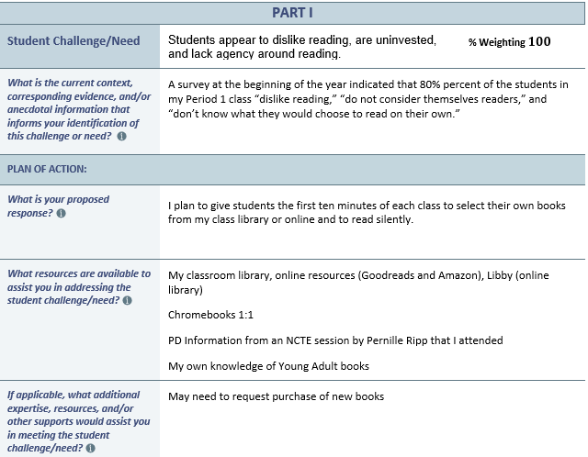
Examples of LEA Selected Measures
Example

Slide 11
Intro Slide – IEP Goals progress measure
IEP Goals Progress Measure

Slide 12
IEP Goals Progress Measure
Chapter 19 of the Pennsylvania School Code clarifies “applicable and attributable” thusly: “Regardless of certification area, all classroom teachers shall be accountable for student progress toward IEP Goals.”
The IEP Goals Progress measure is required under the Individuals with Disabilities Education Act if:
the teacher provides instruction to a sufficient number of students with IEPs (meeting n count), and
those students have similar academic or non-academic IEP Goals to which the teacher contributes data used by the IEP team to monitor student progress.

Slide 13
IEP Goals Progress Measure (cont’d)
The n count is defined as follows:
The n count set must be less than or equal to 11.
An “active n count” based on the portion of instructional responsibility may be used rather than an “actual n count”.
The n count should apply to a grade-level cohort or correlate to all students within a subject area rather than a single class or course taught by the teacher.

Slide 14
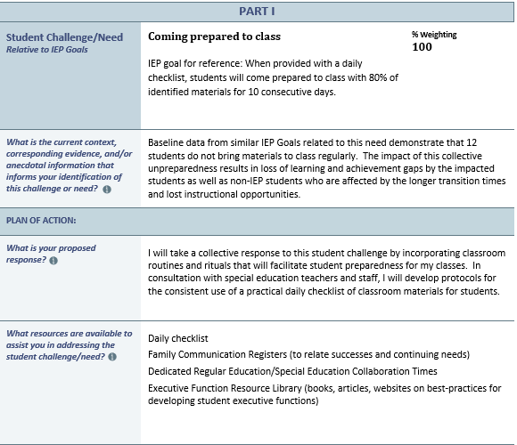
Example of IEP Goals Progress Measure
Example
Notes:
If using multiple measures, the educator and supervising administrator should pre-determine the proportional significance (i.e., weighting) to be assigned to each measure during the initial conference.

Slide 15
Intro slide – principal performance goals
Principal Performance Goals

Slide 16
Principal Performance Goals
Account for 20% of the evaluation of professional employees and temporary professional employees serving in principal roles:
Building Principals
Assistant and Vice Principals
Directors of Career and Technical Education
Supervisors of Special Education.
Must be developed before the beginning of each school year by the employee and the supervising administrator.
Notes:
Reference the Observation and Practice leadership domains and practice models to inform the focus areas of performance.
Goals may be district-specific or building-specific, and the plan of action should include explicit measurable areas and the evidence to be collected during the year.

Slide 17
Principal Performance Goals continued
This Performance Goal Template, crafted as a customizable document, is designed to facilitate active participation in the evaluation process while:
Improving the school leader’s effectiveness
Fostering collaboration among colleagues.
The use of this template is optional; however, a Performance Goal is required as part of the evaluation of Educator Effectiveness for school leaders
Notes:
Professional employees serving as principals, assistant principals, vice principals, directors of career and technical education, and supervisors of special education).

Slide 18
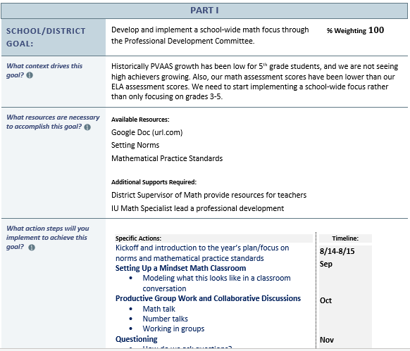
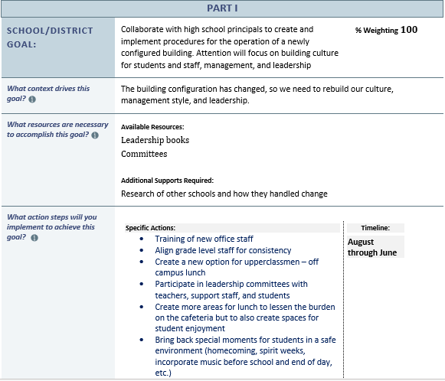
Examples of Principal Performance Goals
Example 1
Example 2
Notes:
If using multiple measures, the educator and supervising administrator should pre-determine the proportional significance (i.e., weighting) to be assigned to each measure during the initial conference.

Slide 19
What’s next?
Rating Tools
The rating tools for the educator categories will be reviewed.
February 22 – 12:00
February 23 – 3:00
Notes:
Reminder that all three sessions are presenting the same information. So, you only need to register for one session.

Slide 20
Contact/Mission
For more information on Act 13, please visit PDE’s website at www.education.pa.gov ​
https://www.pdesas.org/EducatorFrameworks/EducatorEffectiveness/
Act 13 Questions:
RA-PDE-Evaluation@pa.gov
The mission of the Department of Education is to ensure that every learner has access to a world-class education system that academically prepares children and adults to succeed as productive citizens. Further, the Department seeks to establish a culture that is committed to improving opportunities throughout the commonwealth by ensuring that technical support, resources, and optimal learning environments are available for all students, whether children or adults.​

