Slide 1
PSSA and Keystone Exams
Science, Technology & Engineering, Environmental Literacy & Sustainability STEELS PSSA and Keystone Exams
July 2023
www.education.state.pa.us
>
1
Notes:
This webinar is focusing on the Science PSSA and Biology Keystone exam that focus on the new STEELS standards. As the standards have been approved by the State Board of Education, the process of developing and implementing the PSSA and Biology Keystone Exam started once the standards were approved. The process of developing the new state assessments is flexible and shifting, which will require districts to focus on the implementation of the standards and not focus strictly on the exams.

Slide 2
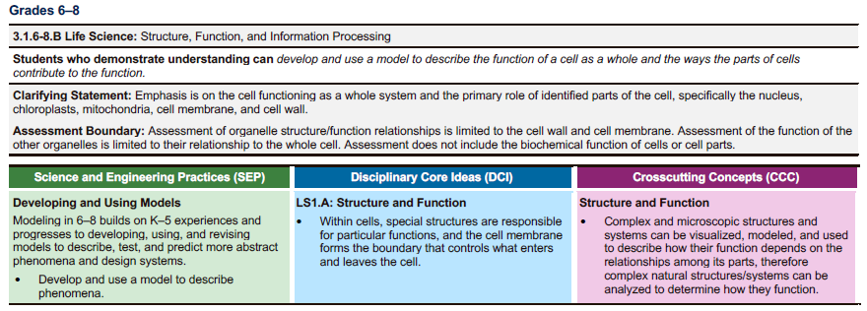
Multi-Dimensionality of Standards
Multi-Dimensionality of Standards
www.education.state.pa.us
>
2
Notes:
All STEELS standards are multidimensional. This is an example of a life science standard for grades 6-8. The standard is written to include DCIs (content), Science and Engineering Practices (SEP), and Crosscutting Concepts (CCC). All science and environmental literacy and sustainability standards are three dimensional and many of the technology and engineering standards are two dimensional. The TE standards include the Engineering Practices (TEP) and Disciplinary Core Ideas (DCI). Therefore, the questions must be multi-dimensional in the development of the state assessments. This is an example of how the process is much like pulling taffy . . . there is give and take within the process to remain consistent and assessing the important items within the standards.

Slide 3
Multi-Dimensionality of Standards, 2
Multi-Dimensionality of Standards
Each Science and Environmental Literacy & Sustainability standard includes Science and Engineering Practices (SEP), Disciplinary Core Ideas (DCI), and Crosscutting Concepts (CCC).
Most Technology and Engineering standards include Technology and Engineering Practices (TEP) and Disciplinary Core Ideas (DCI).
Both the PSSA and Biology Keystone Exams will be multi-dimensional.
www.education.state.pa.us
>
3
Notes:
All STEELS standards are multidimensional. This is an example of a life science standard for grades 6-8. The standard is written to include DCIs (content), Science and Engineering Practices (SEP), and Crosscutting Concepts (CCC). All science and environmental literacy and sustainability standards are three dimensional and many of the technology and engineering standards are two dimensional. The TE standards include the Engineering Practices (TEP) and Disciplinary Core Ideas (DCI). Therefore, the questions must be multi-dimensional in the development of the state assessments. This is an example of how the process is much like pulling taffy . . . there is give and take within the process to remain consistent and assessing the important items within the standards.

Slide 4
Multi-Dimensionality of Standards, 3
Multi-Dimensionality of Standards
The PSSA will include the following disciplines:
Physical Science
Life Science and Environmental Literacy & Sustainability
Earth & Space Science
Technology & Engineering
The Biology Keystone Exam is an end of course exam and will include:
Life Science
www.education.state.pa.us
>
4
Notes:
The STEELS Standards include physical science, life science, earth and space science, environmental literacy and sustainability, and technology and engineering. Therefore the PSSA will include the following disciplines. List/repeat again.
The Biology Keystone Exam will remain an end of course exam and will include the 9-12 Life Science Standards.

Slide 5
Steps in Development Process
Steps in Development Process
Documents will be created that include test designs and blueprints.
Performance Level Descriptors will be developed and reviewed by Pennsylvania educators and PDE.
Test items will be written to the new standards and are currently being reviewed by Pennsylvania educators and PDE.
www.education.state.pa.us
>
5
Notes:
In the development of the PSSA and Keystone Exams, documents will be created that include test designs and blueprints. Performance Level Descriptors are currently being developed and are being reviewed by Pennsylvania educators. These items will be utilized in the development of test items and give direction to the writing of questions. At this time, Assessment Anchors and Eligible Content will not be developed for the assessments. The test items will be written to the new standards. These questions are currently being reviewed by Pennsylvania educators. Utilizing this process, the focus remains on the standards themselves.

Slide 6
PSSA Test Design
PSSA Test Design
PDE plans to move Grade 4 assessment to Grade 5.
Testing time will be similar to the current assessments.
Items and scenarios will be multi-dimensional.
Design will likely include three 3-point operational constructed-response items per grade level.
Items will include scenarios to engage students.
Up to 3 scenarios in Grade 5
Up to 5 scenarios in Grade 8
www.education.state.pa.us
>
6
Notes:
Due to the structure of the standards, PDE is planning to move the fourth grade PSSA to fifth grade. This follows the structure of the standards being K-5, and grades 6-8. The testing times will remain the same for the science PSSA. As described earlier, the items and scenarios on the PSSA will be multi-dimensional. Up to three 3-point constructed response items in each grade level PSSA. Scenarios will also be included, up to three scenarios in grade 5 and up to five scenarios in grade 8.

Slide 7
PSSA Reporting Categories
PSSA Reporting Categories
Each reporting category will equate to 25% of the total assessment for each grade regardless of the number of assessable standards:
Life Science and Environmental Literacy & Sustainability, Science and Engineering Practices, and Crosscutting Concepts (25%)
Physical Science, Science and Engineering Practices, and Crosscutting Concepts (25%)
Earth and Space Science, Science and Engineering Practices, and Crosscutting Concepts (25%)
Technology and Engineering, Technology and Engineering Practices, and Disciplinary Core Ideas (25%)
www.education.state.pa.us
>
7
Notes:
The reporting categories must also be consistent with the STEELS standards. Therefore, each of the four reporting categories will consist of 25% of the total assessment for each grade, regardless of the number of the assessable standards. The reporting categories will include LS/ELS, PS, ESS, and TE. Note that within each of the reporting categories, LS/ELS includes SEPs and CCCs; PS includes SEPs and CCCs; ESS includes SEPs and CCCs; T&E includes TE Practices and DCIs. The focus is on more than the content, which brings us back to the multi-dimensionality of the standards. The reporting categories reflect the shift in teaching and learning required by the implementation of the STEELS standards. The focus is on all dimensions, DCIs, SEPs, CCCs, TE Practices.

Slide 8
Keystone Reporting Categories
Keystone Reporting Categories
Existing Keystone Test Design
Keystone Test Design based on 2022 standards
Content is split into two modules:
Cells and Cell Processes
Continuity and Unity of Life
The two modules are yet to be determined.
Content of the two modules to be determined.
Need to balance content between modules.
All new standards have greater rigor than the old standards.
www.education.state.pa.us
>
8
Notes:
The Biology Keystone will remain an end of course exam that is biology focused. Currently, the existing Biology Keystone Exam includes two modules. Cells and Cell Processes, along with Continuity and Unity of Life. With the new standards, there will be two modules, but it has not been determined what each module will contain. The new standards have greater rigor than the old standards, which necessitates a need to balance the content between the two modules. Given that, the modules have yet to be determined. Here again, the focus must be on the STEELS life science standards in developing curricula and preparing students for the Keystone Exam.
The two modules are yet to be determined.
Some old standards do not have an analogous new standard.
Some new standards do not have an analogous old standard.
All of the new standards have greater rigor than the old standards.

Slide 9
Timeline
Timeline
2024 - 2025
2024 - 2025
2025 - 2026
CDTs will be fully aligned with the new standards.
PSSA will begin field testing with items aligned to the new standards.
Biology Keystone will begin field testing with items aligned to the new standards.
PSSA will be operationally assessing the new standards.
Biology Keystone will be operationally assessing the new standards.
www.education.state.pa.us
>
9
Notes:
The timeline for implementation of the state assessments will be over a several year period. During the 2024-2025 school year, the CDTs will be fully aligned with the STEELS standards. The CDTs, which is free for all districts, will be very useful in the implementation of the new standards. During the 2024-2025 school year, the science PSSA will begin field testing in grades 5 and 8 with the new test items. This will mean that fourth graders will take the science PSSA in 2023-3024, and then again as fifth graders in 2024-2025. The science PSSA will be fully operational for grades five and eight during the 2025-2026 school year. The Biology Keystone will follow a similar timeline. The CDTs will be fully aligned with the Biology Keystone in 2024-2025; the Biology Keystone will begin field testing during the 2024-2025 school year, and will be fully operational during the 2025-2026.

Slide 10
Contact/Mission
Contact/Mission
For more information, please visit the STEELS Hub on SAS.
The mission of the Department of Education is to ensure that every learner has access to a world-class education system that academically prepares children and adults to succeed as productive citizens. Further, the Department seeks to establish a culture that is committed to improving opportunities throughout the commonwealth by ensuring that technical support, resources, and optimal learning environments are available for all students, whether children or adults.
www.education.state.pa.us
>
10
Notes:
For further information or questions, please visit the STEELS hub on SAS or contact PDE.

