Slide 1
Act 13
Office Hour
Targeted Topics

Slide 2
Agenda
Survey
  Your opportunity to list top questions
Targeted Topics
Questions most frequently asked in the resource account and during webinars
Open Forum
Your opportunity to pose additional questions

Slide 3
Survey
What topics would you like to be included in today’s session?
  Act 13 Overview
  Temporary Professional Employee
  SLO vs SPM
  IEP Goals Progress
  PEERS/Rating Forms
  Interim Evaluation
  Resources

Slide 4
Survey, continued
What topics would you like to be included in today’s session?
  Act 13 Overview
  Temporary Professional Employee
  SLO vs SPM
  IEP Goals Progress
  PEERS/Rating Forms
  Interim Evaluation
  Resources

Slide 5



Office Hours Etiquette
Listen to the presenter and enter relevant questions in the chat.
Use pause points to enter questions into the chat.
Monitor chat for responses.

Slide 6
Act 13 Frameworks
Classroom Teacher
Non-Teaching Professional
Principal
Includes Professional or Temporary Employee
Provides direct instruction to students related to specific subject or grade level
Includes Professional or Temporary Employee
Provides services other than classroom instruction
Examples: Counselor, Social Worker, IT Specialist, School Health Specialist, Psychologist, Speech and Language Pathologist
Includes the following:
  Principal
  Assistant Principal
  Vice Principal
  Director of Career and Technical Education
  Supervisor of Special Education
  (new with Act 13)
Notes:
Pull up the SAS site to showcase the Frameworks

Slide 7
Employee Category Scenarios
Occupational Therapist/ Physical Therapist
Social Worker
Individual is a licensed OT/PT and works full time across the district.
Individual is licensed and certificated and works full time across the district.
What category is used to evaluate the therapist?
What category is used to evaluate the social worker?
Notes:
Occupational Therapist/Physical Therapist
Not a certificated employee – doesn’t fall under Act 13. Not reportable. My choose to use whatever district determines appropriate. Framework for observation and Practice- Other if looking for an observation instrument.
Another Example - Behavior Analyst - If licensed but not certificated, then they do not fall under Act 13.
Social Worker
NTP 13-3 or 13-3 TPE

Slide 8
Temporary Professional Employee
Article XI of the Pa. Public School Code defines the term "temporary professional employee" (TPE) to mean any individual who has been employed to perform, for a limited time (established by the LEA), the duties of a newly created position or of a regular professional employee whose services have been terminated by death, resignation, suspension, or removal.
Although Pa. Act 13 of 2020 amends the measures by which a TPE will be evaluated, the legislation does not alter the definitions of professional employees under Article XI. Administrators should check with their Human Resource personnel on how professional employees are currently classified by the LEA.
Notes:
Article XI defines the term to mean any individual who has been employed to perform, for a limited time, the duties of a newly created position or of a regular professional employee whose services have been terminated by death, resignation, suspension, or removal.
While the definition does not address tenure explicitly, commonwealth case law has held that the distinction between a professional employee and a temporary professional employee is that the former has secured tenure.

Slide 9
Data vs. Non-Data Available Scenario
Who is classified as a Data Available Classroom Teacher?
Who is classified as a Non-Data Available Classroom Teacher?
vs
Notes:
Find the answers in the toolkit. – Someone drop the definitions in the chat.
Identify 3 teacher positions in your building/LEA who would be classified as a Data Available Classroom Teacher.
Identify 3 teacher positions in your building/LEA who would be classified as a Non-Data Available Classroom Teacher.

Slide 10
Act 13: Teacher Specific Data (Set 10%)
Academic Achievement
Only 2 Measures
available and directly attributable
Only 1 Measure
available and directly attributable
3 Measures
available and directly attributable
ELA 15 points
Math 15 points
Science 10 points
Applicable Measures (5% each)
State Assessments (2.5%)
PVAAS (5.0%)
IEP Goals Progress (2.5%)
Applicable Measure (10%)
If no measures are available and directly attributable to the teacher,
the 10% will be re-allocated to LEA Selected Measures.
Notes:
Reminder – these percentages cannot be altered.
In fall 2022, the Department will make available 21/22 SY Assessment data for Teacher-Specific Data attribution, where applicable to the professional employee.
Growth data for Teacher-Specific Data attribution will NOT be made available by the Department for the 21/22 SY or the 22/23 SY. However, the Department will make available 23/24 SY Growth data for Teacher-Specific Data attribution, where applicable to the professional employee, in the fall of 2024.

Slide 11
SLO vs. Student Performance Measure
SLO (Act 82)
Required and complex template
Rigid structure
Quantitative (assessment focus)
Lack of alignment between educator and principal templates
SPM (Act 13)
Optional and streamlined template
Flexible structure
Qualitative addition
Close alignment to Principal Performance Goal Template
Notes:
To assist in evaluation, the Department has provided the Student Performance Measure: LEA Selected Measure template. The optional-use template is designed to offer increased flexibility in the identification of student need, educator response, and use of qualitative as well as quantitative measures; however, LEAs may elect to utilize other methods or continue with current processes for measuring student objectives. Whichever approach is chosen, LEAs must assign a rating of 0, 1, 2, or 3 in accordance with Act 13. If more than one student need is identified, an SPM template should be completed for each and weighted accordingly; the total weightings may not exceed 100% of the single, summative LEA Selected Measures rating of 0, 1, 2, or 3.
• an N-count is not to be factored into this

Slide 12
IEP Goals Progress Measure
Chapter 19 of the Pennsylvania School Code clarifies “applicable and attributable” thusly: “Regardless of certification area, all classroom teachers shall be accountable for student progress toward IEP Goals.”
The IEP Goals Progress measure is required under the Individuals with Disabilities Education Act if:
the teacher provides instruction to a sufficient number of students with IEPs (meeting n count), and
those students have similar academic or non-academic IEP Goals to which the teacher contributes data used by the IEP team to monitor student progress.

Slide 13
IEP Goals Progress Measure (cont’d)
The n count is defined as follows:
The n count must be set by the LEA at less than or equal to 11.
An “active n count” based on the portion of instructional responsibility may be used rather than an “actual n count”.
The n count should apply to a teacher’s roster rather than a single class or course taught by the teacher.
Notes:
Show completed IEP Goals Progress from IU 3’s module 3

Slide 14
Building Level Score
The Building Level Score will provide a quantitative academic score based upon a 100-point scale to represent the overall academic performance of each school in Pennsylvania.
Academic Achievement
Academic Growth
Academic Achievement
Other Academic Indicators
ELA 15 points
Math 15 points
Science 10 points
ELA 15 pts
Math 15 pts
Science 10 pts
ELA 15 points
Math 15 points
Science 10 points
Attendance Rate 10 pts
Graduation Rate 10 pts
*Absent a Graduation Rate, Attendance Rate is 20 Points.
Where a school is missing an Assessment or Growth indicator, the 100-point scale is reduced proportionally. For example, a K-3 school with no PVAAS data (40 points) and no Science Assessment data (10 points) will have a denominator of 50 points.
Notes:
In fall 2022, the Department will make available Building Level Scores comprised of Assessment, Growth, Attendance Rate, and Graduation Rate for the 21/22 SY, where the measures are applicable to the building.
PDE sends the scores and publishes them on its website. Chief School Administrator also receives them.

Slide 15
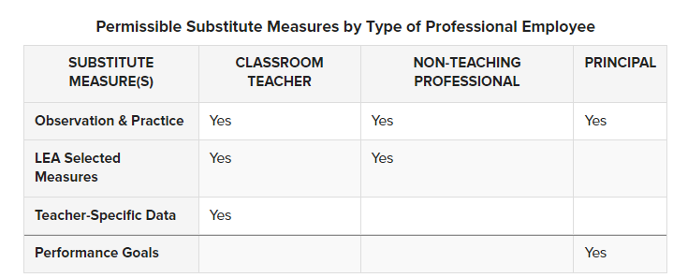
Transfer Option
A professional employee who transfers from one building to another within an LEA has the option of using a substitute measure in lieu of BLD for the first two school years of the new location assignment.
The following table delineates permissible substitute measures by type of professional employee:
Notes:
Before evaluation in the new location assignment, the employee and the LEA must agree on the substitute measure(s).

Slide 16
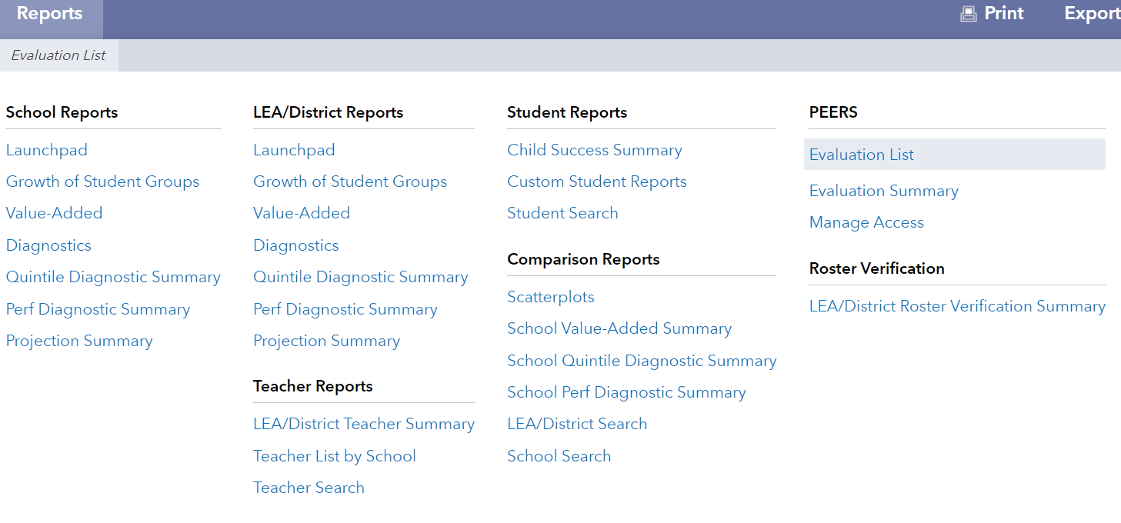
PEERS & Act 13 Ratings
www.pvaas.sas.com
Notes:
Recorded version of PEERS training - https://zoom.us/rec/share/JMLYqYvRNF21V1eWLqY8D75H5YX8Um_A8nUdYApnFntpa7g6LxpsxmX9EG6osaJS.E39pOEvJlRs_eqeR
All rating forms have been moved to PEERS and can be accessed there with a PVAAS account. If you require technical assistance to log on to PEERS or help in printing out the rating forms, contact pdepvaas@iu13.org.
Both the PEERS FAQ and the Getting Started Guide are available to provide detailed information on the PEERS system.
Note: Excel spreadsheets and other data files may get infected by a macro virus. These infections are usually difficult to detect and can cause damage to your documents and computer software; thus, Act 13 Excel rating forms are no longer a safe option.

Slide 17
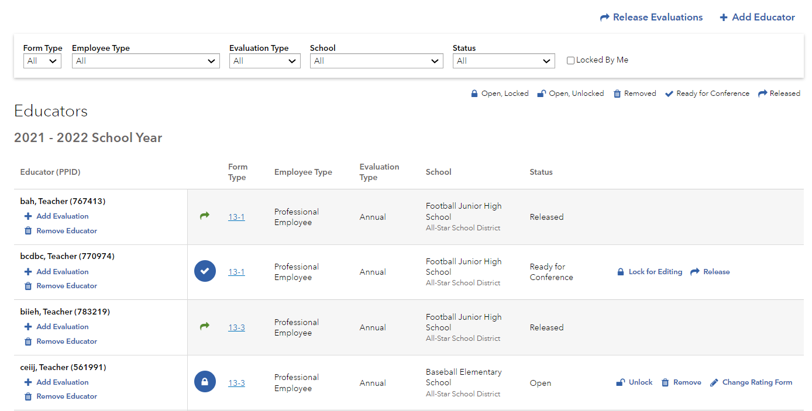
Initial View: PEERS Evaluation List
4
1
3
2
Notes:
This view is the entrance to PEERS. As an evaluator, I see the list of educators assigned to me for a given school year. This list can be filtered by parameters such as school year and form type. Each educator is a separate row and their created forms are described in various stages.
1 – For this educator, I could add another evaluation, such as “Annual, 13-1.” I could also remove this educator if needed.
2 – This form is currently in progress and locked by me. There are various actions I can take in working with this evaluation form:
Unlock – if my work is done and someone else needs to enter information then I would need to release the lock I am holding. Only one evaluator can edit at a time.
Mark Ready for Conference –When all evaluation data is entered, I can select “ready for conference”. This signals that the evaluation is complete and that I’m ready to hold a conference with the educator. Edits can still be made to the evaluation at this stage, but they can only be made by the District Admin and/or Administrative Evaluator.
Release – once I have marked “ready for conference” and held the conference, the District Admin and/or Administrative Evaluator can “release” the form. This means the educator can view the completed evaluation within PEERS. No changes can be made to a form after it is released.
Remove – I can remove the form if it is no longer needed or was created in error. Note: the form cannot be removed after it is released, however.
Change Rating Form – if for whatever reason the initial form type is wrong, it can be changed.
Change between Employee type- Professional Employee or Temporary Professional Employee
3 – The form type for all evaluations is displayed. I can click on the link to open a form. If I have locked the form for editing, I can input information/complete the form.
4 - And you can see from your evaluation list screen at the top right of the screen, is the button to add an educator to your evaluation list. You may be able to surface the educator from your account, but if you don’t see an option for that, you’ll need to contact your District Administrator or an Administrative Evaluator to add that educator to your evaluation list.
Please note:
It is an LEA decision to determine the appropriate form (13-1, 13-2, 13-3 or 13-4PDE) for the evaluation of professional employees in the various roles within an LEA.
For purposes of this online tool, PDE provided a crosswalk of each staff role submitted into PIMS by LEAs to one of the forms (13-1, 13-2, 13-3) for the purpose of pre-assigning one of the three rating forms to as many LEA staff as possible and saving time for LEAs, with the understanding that LEAs adjust/change to the appropriate rating form as determined necessary by the LEA.

Slide 18
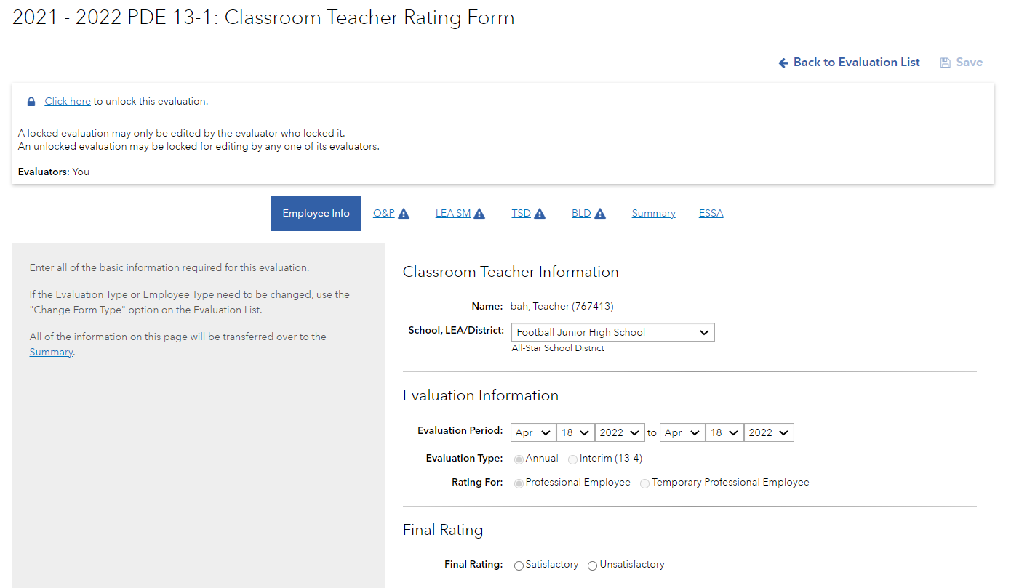
Act 13 Rating Form
4
5
1
3
2
Notes:
As mentioned previously, the forms in PEERS are designed to Act 13 while taking advantage of a web-enabled environment.
1 – Links to each section of the evaluation are provided so that you can easily navigate from one section to another. The sections are provided in a logical order, but you can certainly jump to any section you wish using these tabs.
2 – The gray box on the left hand side of the screen provides on-screen guidance
3- The actual work is completed on the right hand side of the screen. Some of this information would be pre-populated with data from PIMS for your convenience, but you’re able to change the information if needed.
4- The lock status bar indicates if the form is locked for editing. If you have the form locked for editing (as in the example above), you can choose to unlock it for other users. The lock status bar will also indicate if someone else has the form locked for editing – in that case, you will not be able to make changes to the form until that user unlocks it.
5-Additionally, you’ll see the other evaluators who have been granted access to the educator’s summary evaluation form. This eases the process of sharing data input by multiple evaluators: each assigned evaluator can see who else has access to this educator’s summative rating form.

Slide 19
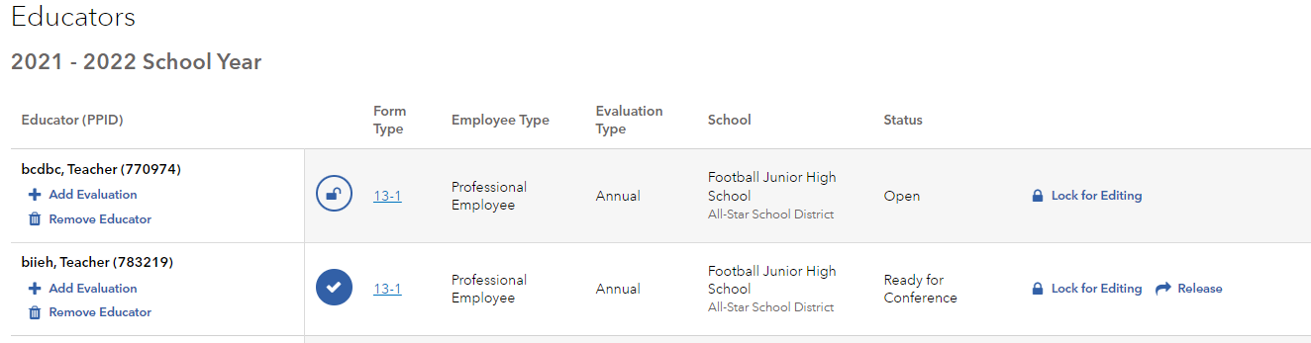
Completing the Process: Release to Educator
  District Admin and/or Administrative Evaluator(s) can release the form when it is FINAL, and no other changes are needed.
  No changes can be made to Released forms within PEERS. Released forms cannot be removed from PEERS, nor edited.
Notes:
Only the District Admin and/or Administrative Evaluator(s) can release evaluation forms in PEERS. When the form is released, the educator will be able to view his/her final evaluation within PEERS.
NO CHANGES CAN BE MADE TO EVALUATION FORMS THAT HAVE BEEN RELEASED.

Slide 20
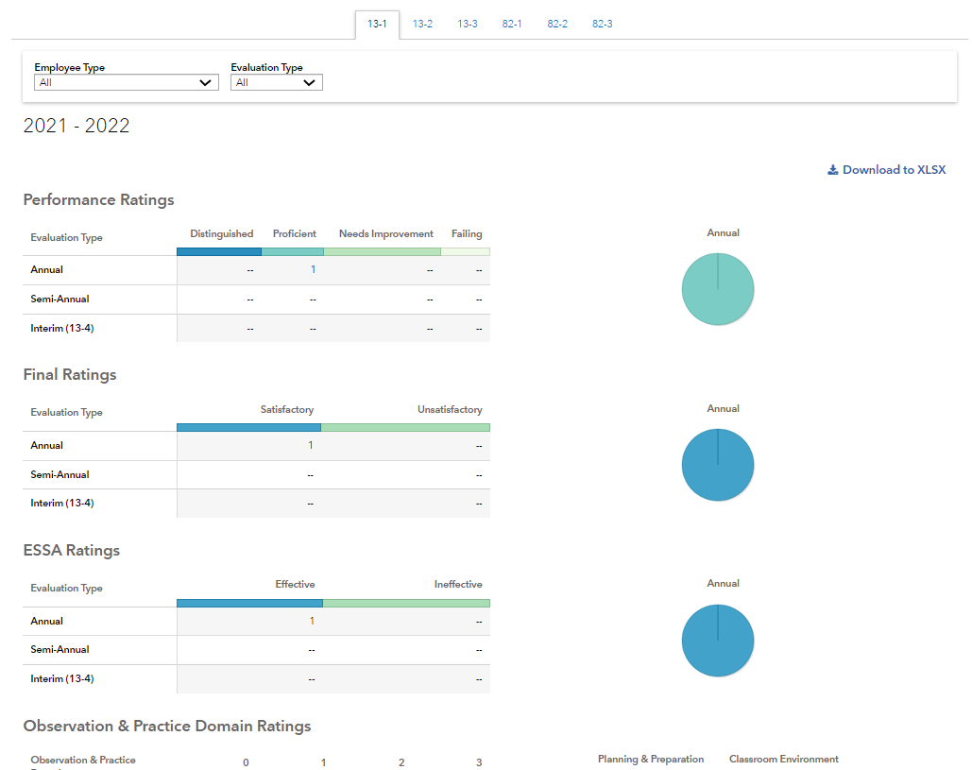
Evaluation Summary
The Evaluation Summary includes only evaluations that have been RELEASED.
Notes:
Scrolling down on the Summary page, you’ll see data for the observation and practice domain ratings. This is displayed in both chart form and pie graph form. A summative display of educators’ ratings by performance within each domain constitutes the essence of this report.
This information can be useful in a variety of ways:
PD planning at both district and school level
PLC focus areas
Completion of the Annual PDE Teacher and Principal Evaluation Survey
The bottom of the Summary page shows yet a 4th summary report. This summary report provides a listing of educators, with their ratings in each of the Act 13 measures, and includes the overall performance rating as well as the final rating.

Slide 21
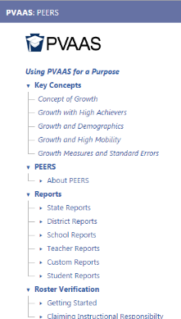
PEERS Resources
Access PEERS Resources:
  On the PVAAS site: https://pvaas.sas.com, in the online “Help” system (screenshot at right)
Included:
  This presentation & webinar recording (when available)
  PEERS FAQ
  PEERS Getting Started Guide
  Links to Act 13 Resources
  Email pdepvaas@iu13.org if you’d like assistance accessing these resources!
Notes:
PEERS Resources can be accessed on the PVAAS website, https://pvaas.sas.com, via the online “Help” system. These resources can also be accessed on the “PVAAS Resources” Google site, https://sites.google.com/a/iu13.org/pvaas-pl-resources/peers-resources.
This PowerPoint and a recording of this webinar will be available for your review and use.

Slide 22
13-4 Interim Rating
Professional employees deemed Unsatisfactory in the last evaluation must be rated at least once a year using the measures and weightings appropriate to the employee, as indicated in the table above.
Subsequent ratings during the same evaluation period (i.e., interim evaluations) are not mandated; however, should an LEA elect to perform one, the interim evaluation must be comprised of the following:
  70% Observation & Practice (aligns with the 13-1, 13-2, 13-3)
  30% LEA Selected Measures
For the LEA Selected Measures rating, the LEA should use measure(s) appropriate to the type of professional employee. Examples as follows:
  Performance Goal benchmarks might serve as a locally developed rubric in the evaluation of a principal.
  Student career readiness portfolios might be used in the evaluation of a school counselor.
Notes:
For the Observation & Practice rating, the LEA should apply the same domains, weightings, and professional practice models utilized during the prior annual evaluation.
LEA Selected Measures reflective of the role and responsibility of the professional employee
Reminder: An interim rating is not a replacement for a semi-annual (TPE) or annual (TPE and PE) rating.

Slide 23
Performance Improvement Plan
Act 13 does not limit an employer's authority to design a Performance Improvement Plan; however, an employee who receives an overall performance rating of Failing or Needs Improvement must participate in a Performance Improvement Plan (PIP) designed by the employer with documented input from the employee. The PIP must:
Provide actionable feedback on the specific domain within the comprehensive observation and practice models that prevented the employee from achieving a Proficient rating, and
Identify employer resources to be provided to assist the employee in improving performance, including mentoring, coaching, professional development recommendations, and intensive supervision based on the contents of the rating tool.

Slide 24
Interim Rating Scenario
Counselor A received an Unsatisfactory rating at the conclusion of the last school year.
What mid-year rating obligation exists?
What LEA Selected Measure is applicable?
Notes:
There is no obligation to rate mid-year; however, if hosen to evaluate, the 13-4 applies.
The employee and evaluator determine the LEA Selected Measure. May use the SPM template or another format to meet the 30% requirement.

Slide 25
What’s next?
Office Hour
Targeted Topics
July 28
August 4
August 11
12:00 pm
Notes:
Reminder that all three sessions are presenting the same information.

Slide 26
Contact/Mission
For more information on Act 13, please visit PDE’s website at www.education.pa.gov ​
https://www.pdesas.org/EducatorFrameworks/EducatorEffectiveness/
Act 13 Questions
RA-PDE-Evaluation@pa.gov
The mission of the Department of Education is to ensure that every learner has access to a world-class education system that academically prepares children and adults to succeed as productive citizens. Further, the Department seeks to establish a culture that is committed to improving opportunities throughout the commonwealth by ensuring that technical support, resources, and optimal learning environments are available for all students, whether children or adults.​

