Slide 1
A Pathway to the Pathways – Using PVAAS to Better Inform the Graduation Pathways
Tuesday, March 14, 2023 - 1:00pm-1:45pm
Wednesday, April 5, 2023 - 9:00am-9:45am
Today’s PPT will be posted in the chat. For access to the PPT after today, contact the
PVAAS Statewide Team for PDE
Email: pdepvaas@iu13.org
Look out for a survey link after today’s session!

Slide 2
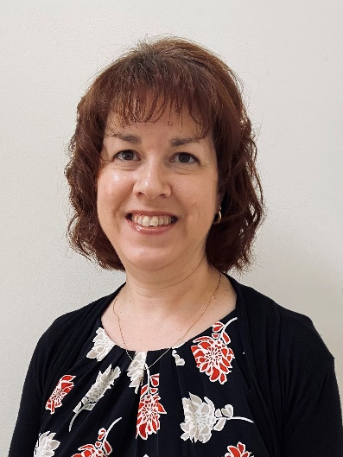
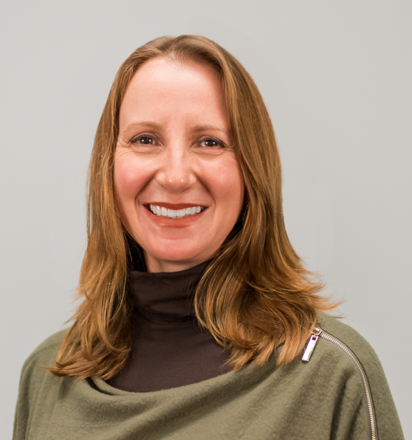


Welcome!
Session Facilitator:
Jen Ross
PVAAS Statewide Team for PDE
Session Facilitator:
Laurie Kolka
PVAAS Statewide Team for PDE
Session Facilitator:
Charlie Trovato
Consultant to the PVAAS Statewide Team for PDE
District Perspective
Angela Rohrbaugh
Guidance Counselor, Galeton Area SD
Questions?
Email us at pdepvaas@iu13.org

Slide 3

Tell Us Who You Are!
  LEA/District Leaders?
  School Leaders?
  Teacher Leaders / Teachers?
  Data Specialists?
  IU Staff?
  Others?

Slide 4
Our Focus Today
Support use of data to ensure students have access to all graduation pathways where they are likely to be successful
Explore 3 of the 5 pathways where PVAAS student level projections can support the planning and discussion of appropriate pathways for all students
Consider how data can increase equity and access to the pathways for underrepresented student populations
Notes:
With Act 158 in full effect for graduating seniors this year and subsequent cohorts, educators want to continue to ensure students have access to all graduation pathways as they enter and continue through their high school years. In this session, participants will dig further into three of the five pathways to explore the use of PVAAS student level projection data to support the proactive planning for those using both state and alternative assessments. Participants will walk away with a plan for how to best identify students who would benefit from engaging in and exploring these pathways (including potential courses) to increase equity and access for underrepresented populations.

Slide 5
Graduation Pathways
Act 158

Slide 6

For Graduation Requirements
Act 158: High School Graduation Requirement
Class of 2023 = 5 Pathways to Graduation
Questions?
Email RA-EDGRADREQUIREMENT@pa.gov
Although a student may not be required to achieve proficiency on the Keystone Exams in order to graduate, students are required to take the Keystone Exams for purposes of federal accountability. Failure to do so will affect a Local Education Agency (LEA) and school’s participation rate.
Notes:
Now, I do want to point out that there are high school graduation requirements through Act 158. You are likely familiar with the four pathways for students who are graduating in the class of 2023 and beyond. We won’t be going into the details of that today, but it will be something you will want to keep in mind as you move forward with your decision-making process. We’ve provided a link to the PDE webpage that provides details about those requirements should you need more info. If you have questions, you will want to use the email address here.
For presenter information only:
There is no requirement to test twice.
Pathway 2 – Keystone Composite Pathway
Student will earn proficient or advanced on at least one keystone exam and score at least basic on the other two keystone exams and have a composite score of at least 4452.
Are project-based assessments still an option to meet proficiency?
No school entity may be required to offer nor, may any student be required to participate in or complete a project-based assessment in order to meet statewide graduation requirements as provided for in 22 Pa. Code § 4.51c.
Do the graduation requirements apply to students who opt out of a Keystone Exam?
Yes. Students who opt out of one or more Keystone Exams must still meet state and local graduation requirements. Students may meet the statewide graduation requirement through one of the multiple pathways described in the Requirements section above. Note that students opting out will affect the student participation rate related to a school’s accountability status.
Is supplemental instruction required for those students who do not meet proficiency?
A school entity may offer supplemental instruction to a student who does not demonstrate proficiency on a Keystone Exam or on a locally validated assessment; however, no student is required to participate. When offered, supplemental instruction must: Be consistent with the student's educational program. • Assist the student to attain proficiency in the state academic standards. • Ensure that students who accept the school entity's offer of supplemental instruction are able to participate in both supplemental instruction and instruction related to their career, military or postsecondary education plans. When offered, supplemental instruction must not: • Intrude into instructional time for career and technical education. • Occur during a student's dedicated time in a career and technical education program

Slide 7


Share With Colleagues
What is your current process for determining the various graduation pathways for students?
What could strengthen your process?
Notes:
[note for facilitator – anyone using PVAAS projections within these decisions?]

Slide 8
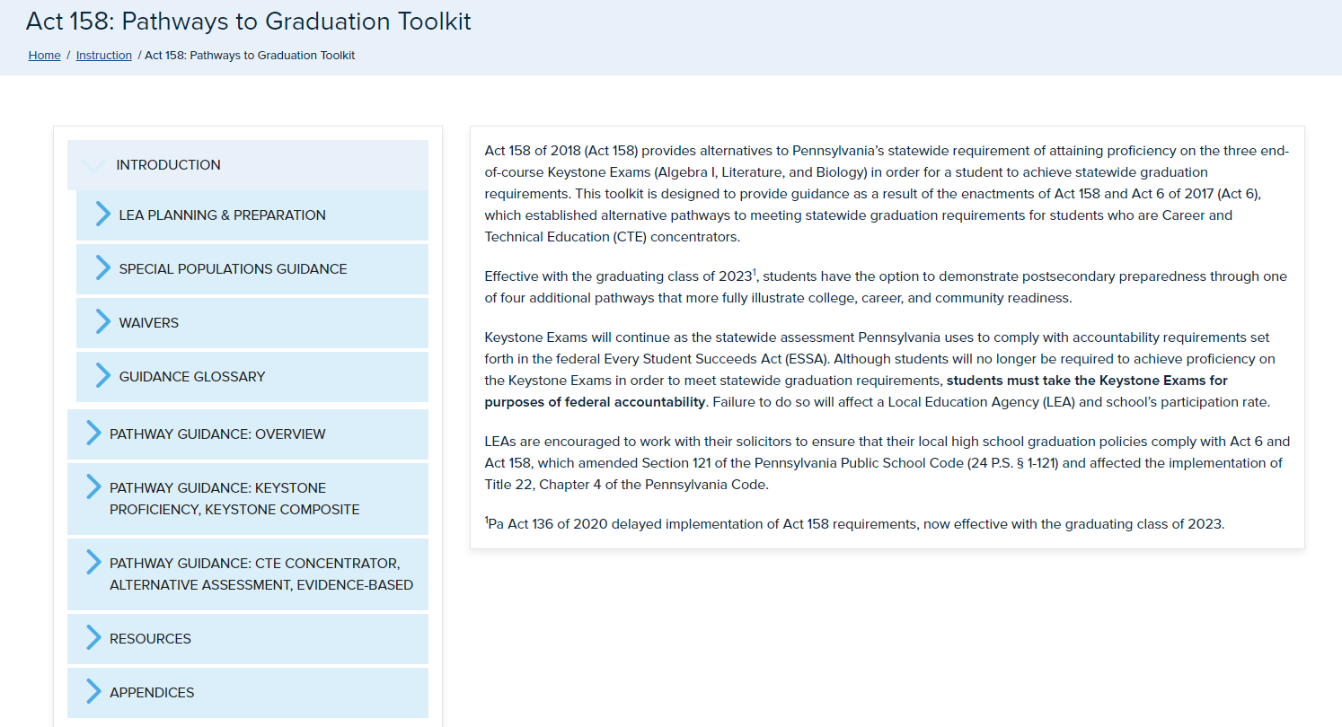
Act 158 Toolkit
Act 158: Pathways to Graduation Toolkit
Notes:
This is for your reference – you may want to check out the Graduation Toolkit provided by PDE. There is a wealth of information found here – everything from resources and info on planning, waivers, and specifics about each pathway.

Slide 9
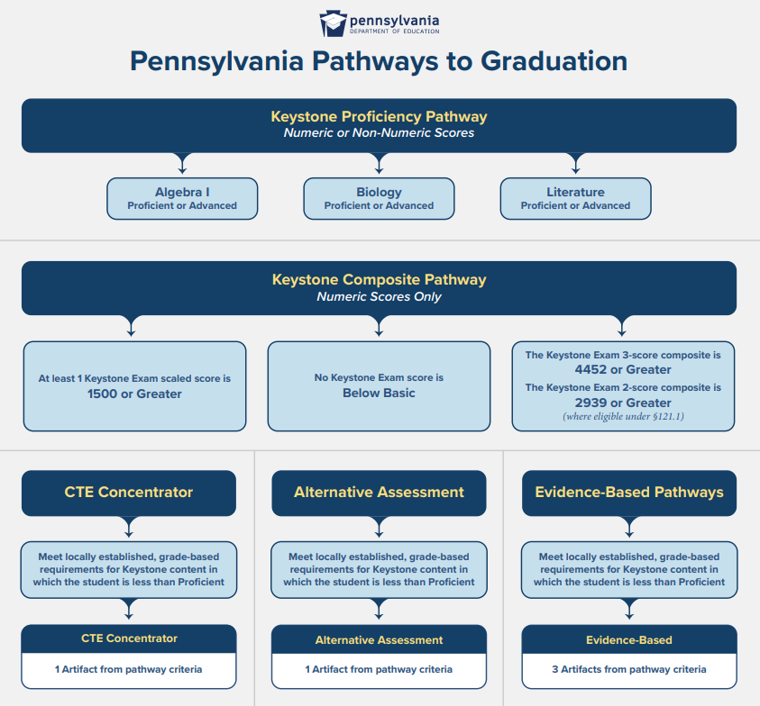
Act 158: The Graduation Pathways
Keystone Proficiency
Keystone Composite
Career and Technical Education (CTE) Concentrator
Alternative Assessment
Evidence-Based
Notes:
There are 5 overall pathways to graduation under Act 158. Here is a visual outlining them.
Each has several other layers on ways to meet and complete that pathway.
Today we are going to be talking about 3 of these 5 pathways where we see a direct connection to the use of PVAAS projections as a way to inform discussions and decisions about students pursuing those pathways – pathways 1 (Keystone Proficiency), 2 (Keystone Composite) and 4 (Alternative Assessment).

Slide 10
PVAAS Student Projections
Informing Graduation Pathways

Slide 11

What Are Projections?
Given a student’s assessment history in PA,
…what’s the most likely outcome for the student when taking a future assessment?
It is NOT an absolute indicator of what will happen in the future!
Notes:
First and foremost, please keep in mind that projections are NOT a prediction of the future! We know that there are many paths on which a student may head or go. The projection is NOT indicating the path the student will take. It is simply indicating the most likely path or outcome based on what we know about that student – and students who have a similar history as that student.
Basically the projections are saying to you – given a student’s assessment history in PA, what is the most likely outcome for the student when taking the selected assessment?

Slide 12

Information Used in PVAAS Projections
What are they based on?
Expectations based on what we know:
About this student:
  Prior test scores
  Across subjects
Notes:
The individual student projections that are provided in PVAAS are based on the information in a student’s testing history, across grades and subjects – and across years.

Slide 13

PVAAS Projections & Students’ Prior Testing History
What are they based on?
About other students:
  Prior test scores across subjects
  Scores on the test to which we are projecting
Notes:
The projections are also based upon how similar students have scored on the exam we’re projecting to.
Using all of this data, the projection model quantifies the projection in a precise and reliable way.

Slide 14
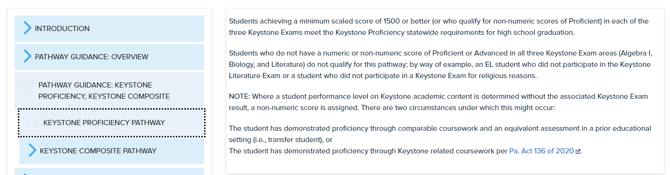
PVAAS Informs Pathway 1…
PVAAS Projections answer - What is the student’s projected probability to reaching proficiency on all Keystone exams (Algebra, Biology, Literature)?
Notes:
This is Pathway 1 … where students need to achieve a proficient score with a minimum scaled score of 1500 in each of the 3 Keystones.
PVAAS projections can help inform who is on track to pursue pathway 1 by answering the question – what are student’s projected probabilities of reaching proficiency on all 3 Keystone exams?

Slide 15
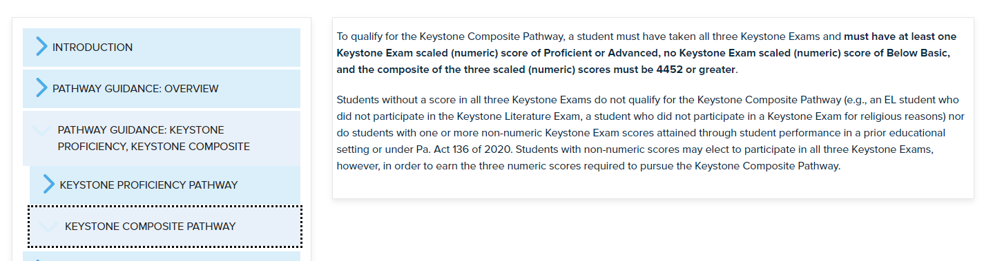
PVAAS Informs Pathway 2…
PVAAS Projections answer:
What is the student’s projected probability to reaching proficiency on any of the Keystone exams?
What is the student’s projected probability to reaching at least Basic on all of the Keystone exams?
Notes:
This is Pathway 2 … where a student must score at least proficient in one of the Keystones, and also score at least Basic in the other two. Additionally, the composite scaled score must be a minimum of 4452.
PVAAS projections can help inform who is on track to pursue pathway 2 by answering the questions – what are students’ projected probabilities of reaching proficiency on any one of the Keystone exams? And, what are students’ probabilities of reaching at least Basic on all of the Keystone exams?

Slide 16
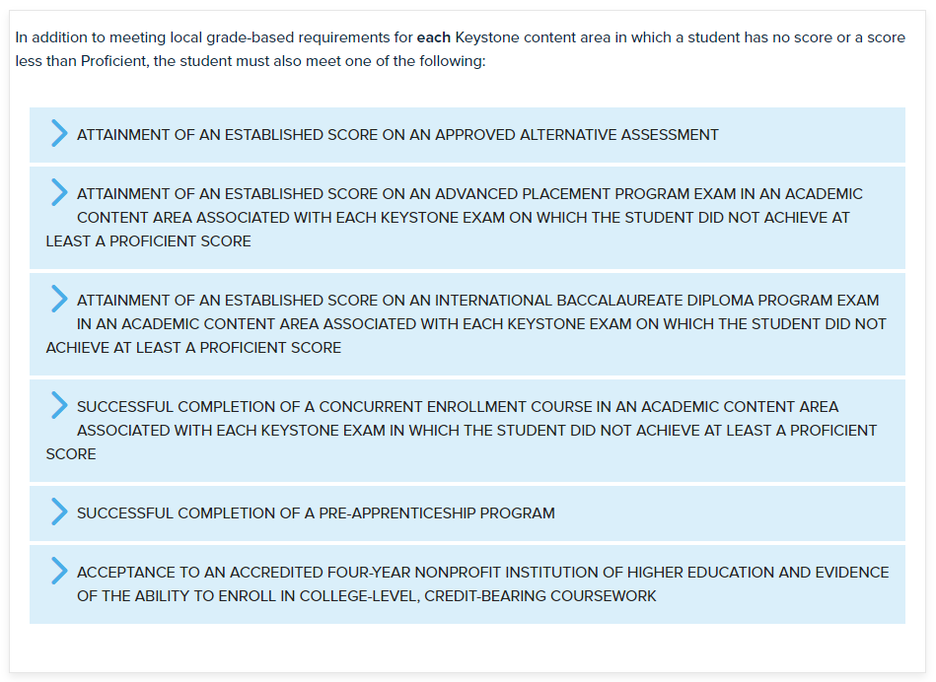
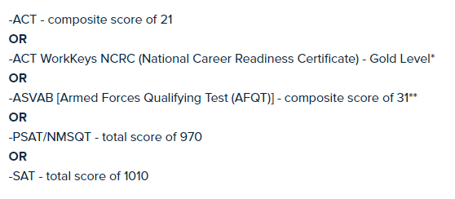
PVAAS Informs Pathway 4 – Alternative Assessment
Notes:
This is Pathway 4 … where there are a number of various assessments that can be used to demonstrate mastery or proficiency beyond our state assessments.
The first of these is the use of college readiness exams like the ACT, PSAT, and SAT – a minimum composite score would be needed on one of those.

Slide 17
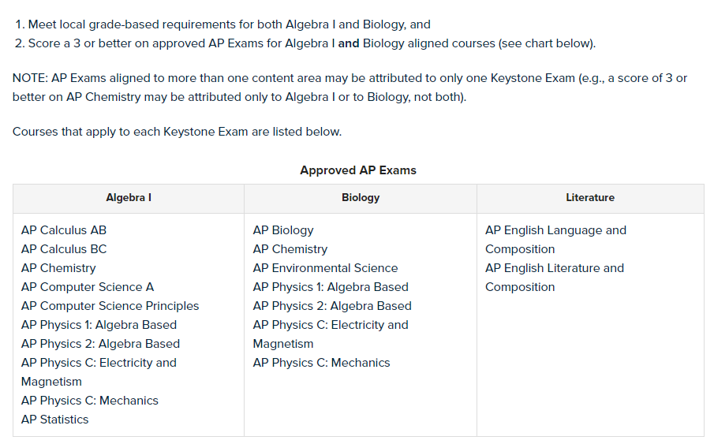
PVAAS Informs Pathway 4 – AP Exams
Notes:
Additionally under Pathway 4 is the option to score a 3 or higher on any of the AP exams that are approved and align to the 3 subject areas of Algebra I, Biology, and Literature.

Slide 18
Galeton Area SD: Using Projections
Angela Rohrbaugh,
Galeton Area HS Guidance Counselor
How we started using projections:
  Decision point for course enrollment
    8th Grade Math or Algebra in 8th grade
      Projections to 8th Grade Math PSSA & Algebra I Keystone
Then our use of projections grew:
  High school scheduling and course recommendations
    Honors sections, AP courses
  What if a student doesn’t quite meet the pre-requisites?
    Do projections offer another data source?
Angela Rohrbaugh
Phone: (814) 435-6571
Email: arohrbaugh@gasd.net

Slide 19
Galeton Area SD: Using Projections
Angela Rohrbaugh,
Galeton Area HS Guidance Counselor
  Now we also consider projections for graduation pathway planning!
  Students who are likely to meet the Pathway 1: Proficiency + on 3 Keystones
    Keep them on track with their schedules!
  What if a student isn’t likely to score Proficient on all 3 Keystones?
    Projections are used to:
      Prioritize a course-based intervention (one per year) in an effort to gain at least 1 Proficient so that Pathway 2 is available
      Recommend intervention programming that supports one of the other graduation pathways
Angela Rohrbaugh
Phone: (814) 435-6571
Email: arohrbaugh@gasd.net

Slide 20
Galeton Area SD: Using Projections
Angela Rohrbaugh,
Galeton Area HS Guidance Counselor
  As we learn, we adjust!
  For example, we used to enroll students in up to three course-based interventions at a time.
  We found that students scored very, very close to proficiency, but they didn’t meet proficiency in any area, so Pathway 2 closed for them.
  Now, we enroll in one intervention at a time. It’s a more focused approach for students and teachers.
Angela Rohrbaugh
Phone: (814) 435-6571
Email: arohrbaugh@gasd.net

Slide 21

What thoughts and questions do you have so far?
Notes:
Let’s pause here for thoughts or questions you have so far.

Slide 22
Pathways 1 & 2
Examples / Scenarios
Notes:
Let’s look first at how we can pursue this with pathway 1 & 2 with an example.

Slide 23
PVAAS Informs …
Pathway 1: What is the student’s projected probability to reaching proficiency on ALL Keystone exams (Algebra, Biology, Literature)?
Pathway 2:
What is the student’s projected probability to reaching proficiency on any one of the Keystone exams?
What is the student’s projected probability to reaching at least Basic on all of the Keystone exams?

Slide 24
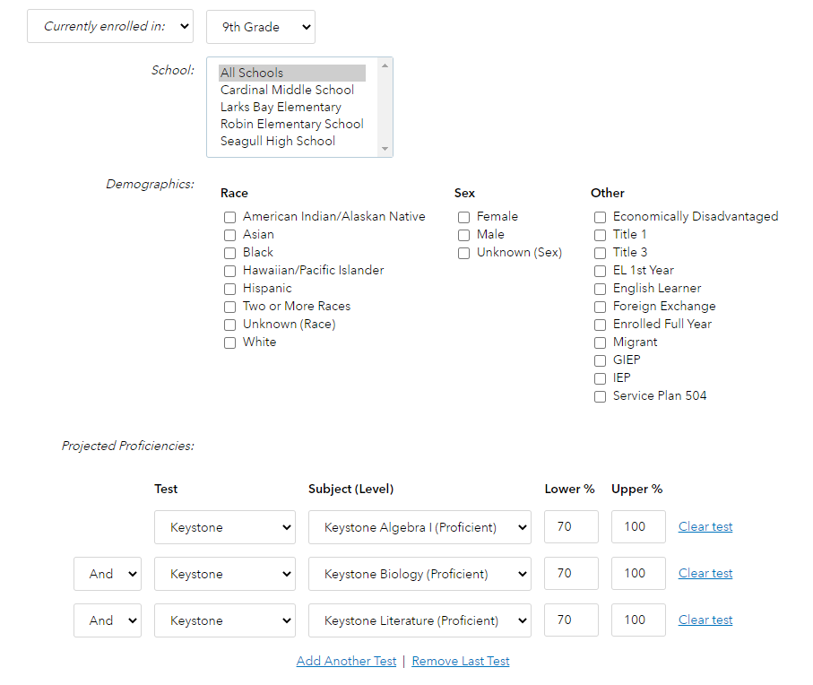
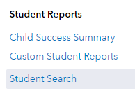
Pathway 1: At a System View
Using the “AND” option allows you to find students who meet ALL of the criteria you selected!
Notes:
I can also look at this as a whole cohort using the Student Search feature
[click]
Where I have options to search based on certain criteria
[click]
I can set my cohort I am interested in viewing (example, current 9th graders)
[click]
Set the criteria of 70% probability or higher of reaching proficiency or higher on all 3 exams
[click]
Note that setting the option to AND in between all 3 tests allows me to search only for students who meet all 3 of the criteria I selected.

Slide 25
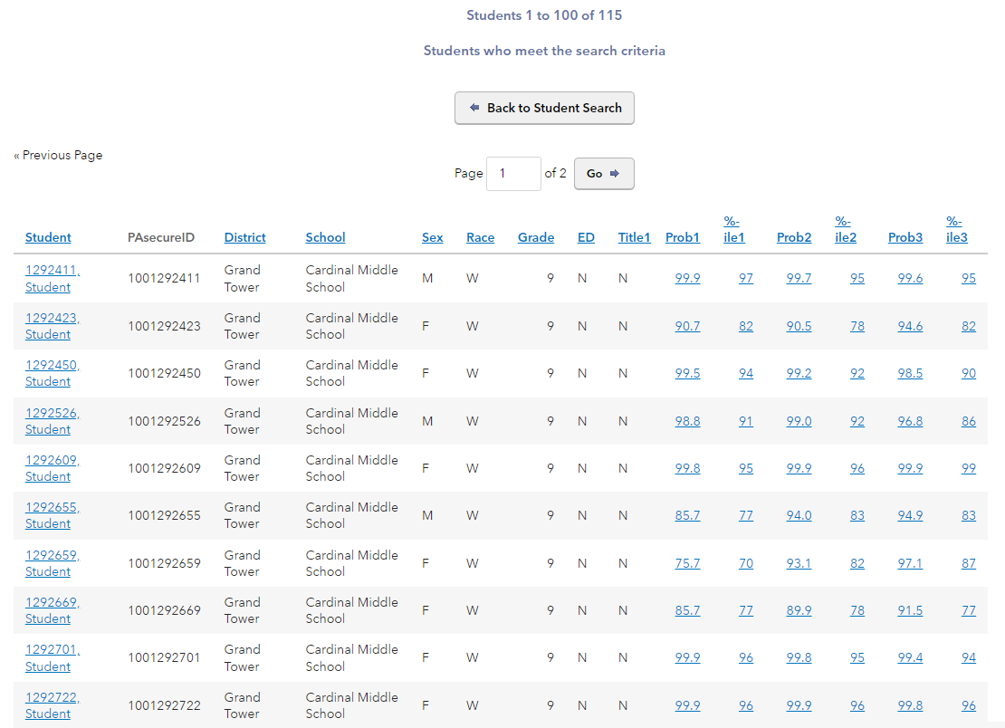
Pathway 1: At a System View (Cont’d)
In my example, I now see a full list of all 115 students who meet this criteria of having a good likelihood of reaching proficiency on all 3 Keystone exams.
Notes:
I now see the students who met my search criteria.
These 115 may be the students I want to be sure are pursuing pathway 1 at a minimum. What do we have in place to support them on this pathway?

Slide 26
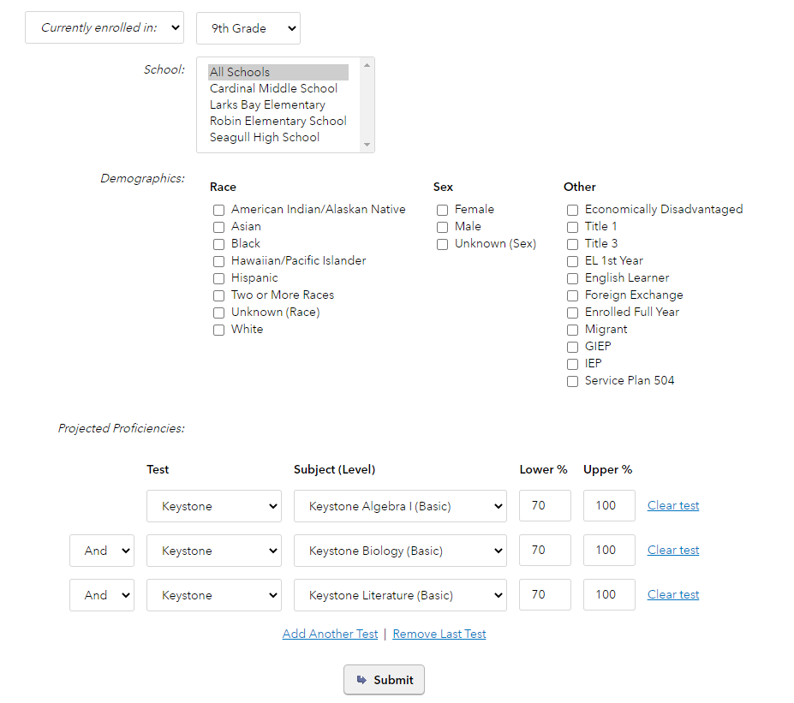
Pathway 2: At a System View
Using the “AND” option allows you to find students who meet ALL the criteria you selected!
Notes:
For Pathway 2, I can do the same thing but change my search criteria a bit.
[click]
Here I select a 70% probability or higher to be at least Basic on one of these exams.

Slide 27
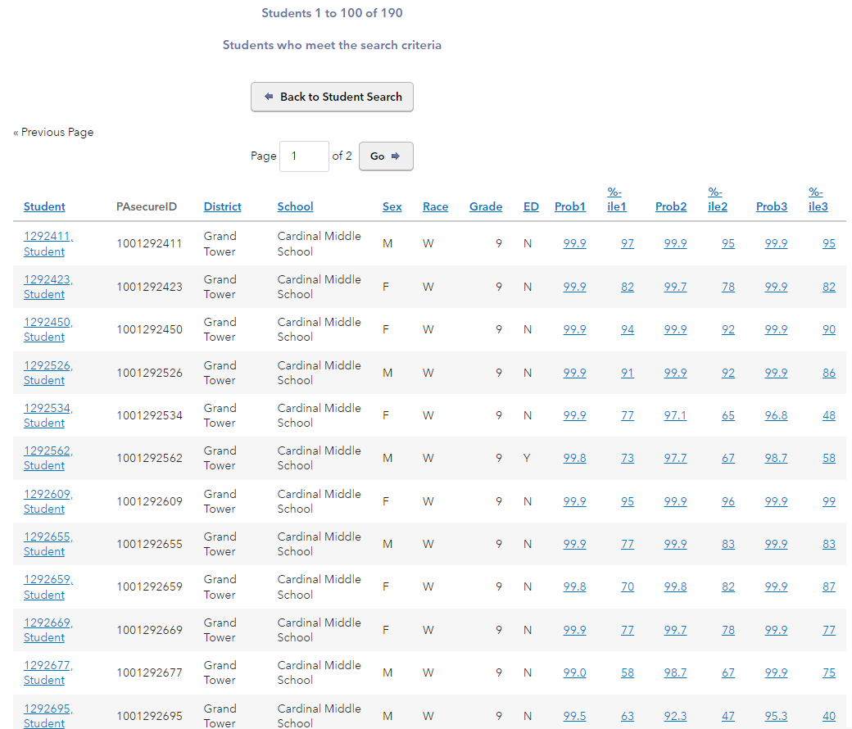
Pathway 2: At a System View (Cont’d)
In my example, I now see a list of all 190 students who meet this criteria of having a good likelihood of reaching at least Basic on these exams.
(Note this will include the students from prior search who have high probability of proficiency on all 3 exams.)
Notes:
I now see the students who met my search criteria.
These 285 do include the 115 students who have high probability of proficiency on all 3, so if I exclude them I am left with the 170 students who we want to encourage pursuing pathway 2 at a minimum. What do we have in place to support them on this pathway?

Slide 28
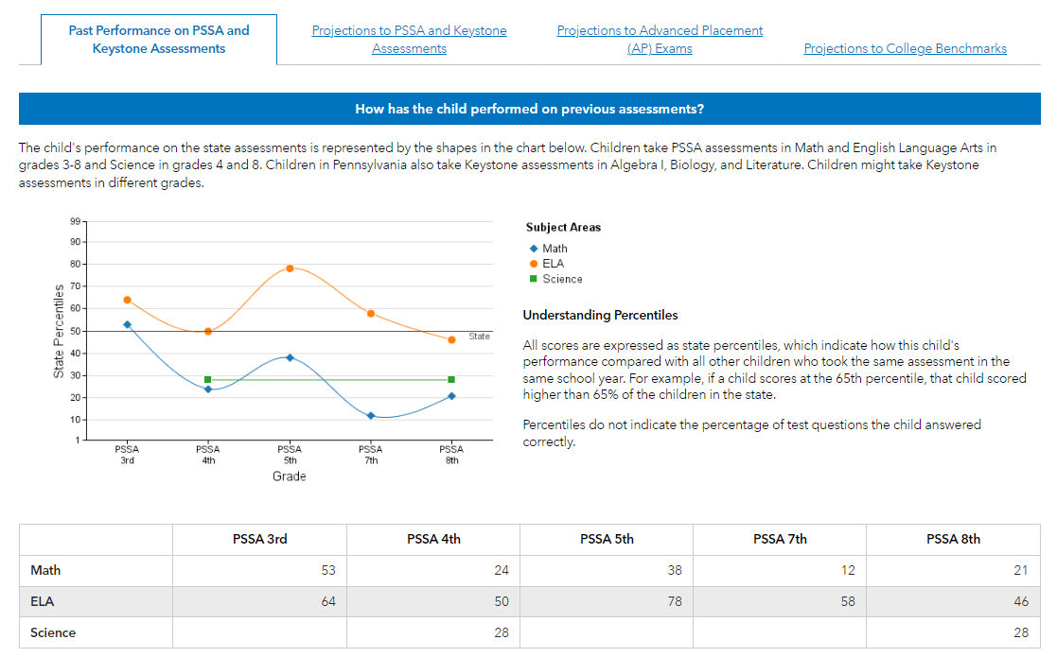
Sam: PSSA / Keystone History
Missing 6th grade PSSA

Slide 29
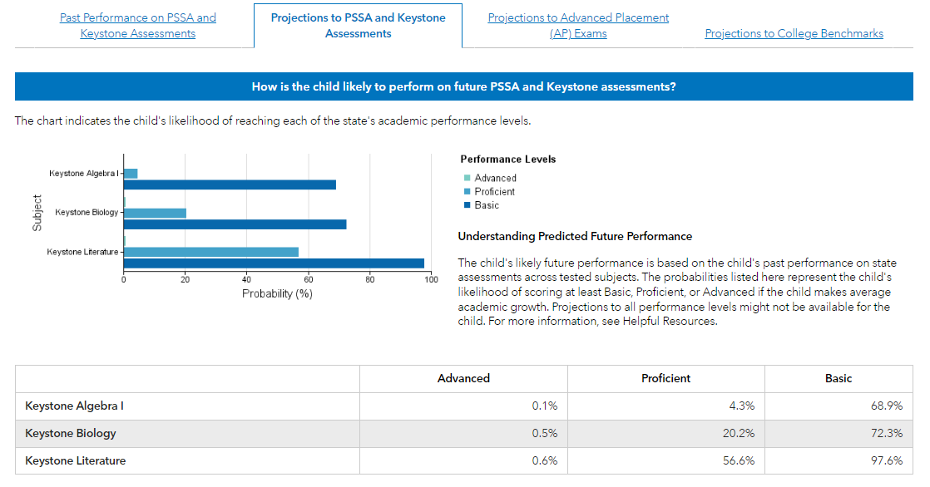
Sam: Projections to Keystones

Slide 30
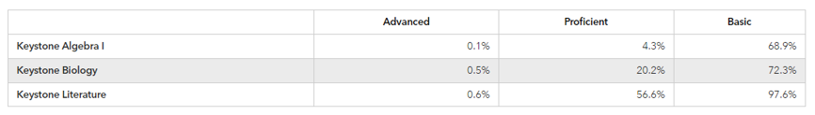
Sam’s Pathway(s)
How might this information help inform the success of Sam pursuing pathways 1 and/or 2?

Slide 31
Thoughts and Questions about PVAAS Projections for Pathways 1 & 2?

Slide 32
Pathway 4
Example

Slide 33
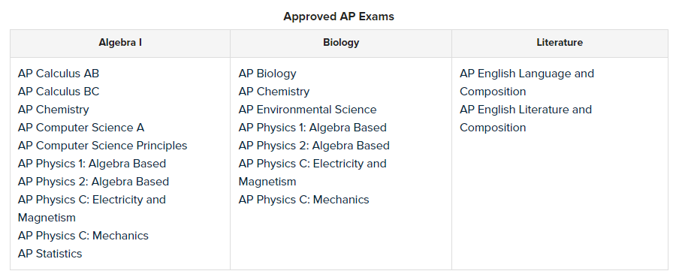
PVAAS & Pathway 4
Notes:
Here is a reminder about the ways students could graduate under Pathway 4.

Slide 34
Areas PVAAS May Support Decisions
Attainment of Established Score on Approved Alternative Assessment
  ACT – composite score of 21
    ACT Math 22
    ACT Reading 22
  PSAT/NMSQT – composite score of 970
    PSAT Reading 460
    PSAT Math 510
  SAT – composite score of 1010
    SAT Math 530
    SAT Reading 480
Notes:
PVAAS has projections available (shown in red) to these benchmarks set by ACT and the College Board. High probabilities of reaching these benchmarks would be indicators that students are likely to be successful under this graduation pathway.
Do we know who these students are and what supports we have available for them to pursue pathway 4 under this criteria?

Slide 35
PVAAS Probabilities to AP Exams
Probabilities to a 3 or higher, 4 or higher, or 5
Notes:
Additionally PVAAS has probabilities out to 5 of the approved AP exams under Pathway 4. These probabilities are available to reaching a 3 or higher (or even a 4 or 5). Students with higher probabilities of reaching a 3 or higher would be those who are good candidates for pursuing Pathway 4.
Do we know who these students are and what supports we have available for them to pursue pathway 4 under this criteria?

Slide 36
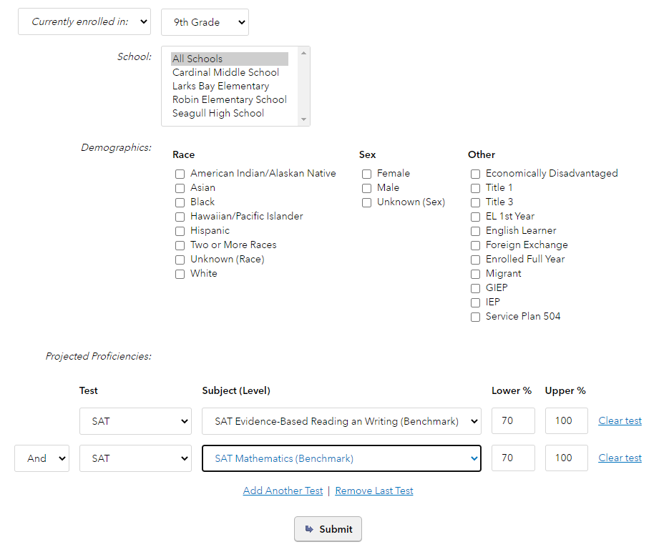
Pathway 4: At a System View (“AND”)
Using the “AND” option allows you to find students who meet ALL of the criteria you selected, so that they would meet the overall Composite criteria!
Notes:
Remember the Student Search – we could do this here as well – using the AND feature to find students with high probabilities of meeting both Math and Reading and Writing benchmarks on the SAT (or the ACT although not shown here)

Slide 37
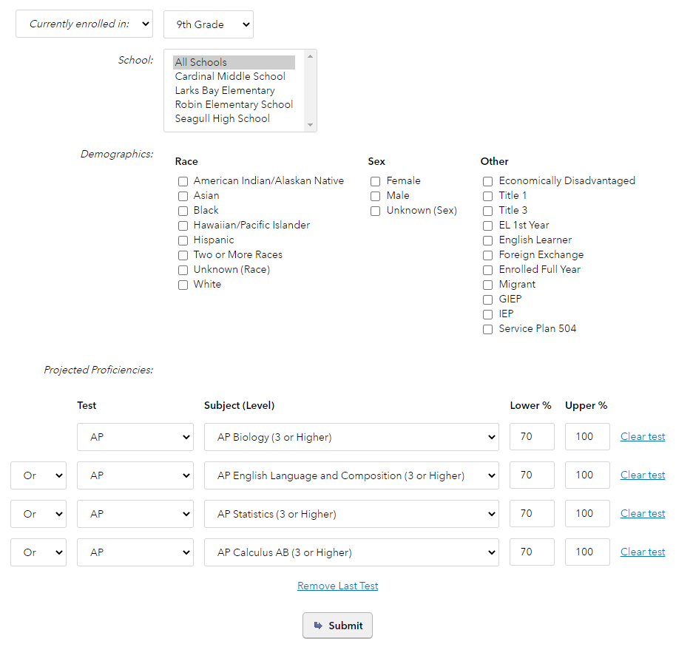
Pathway 4: At a System View (“OR”)
Using the “OR” option allows you to find students who meet ONE of the criteria you selected for any of the AP exams!
Notes:
Remember the Student Search – we could do this here as well – using the OR feature to find students with high probabilities of meeting the criteria for any of the approved AP exams.

Slide 38
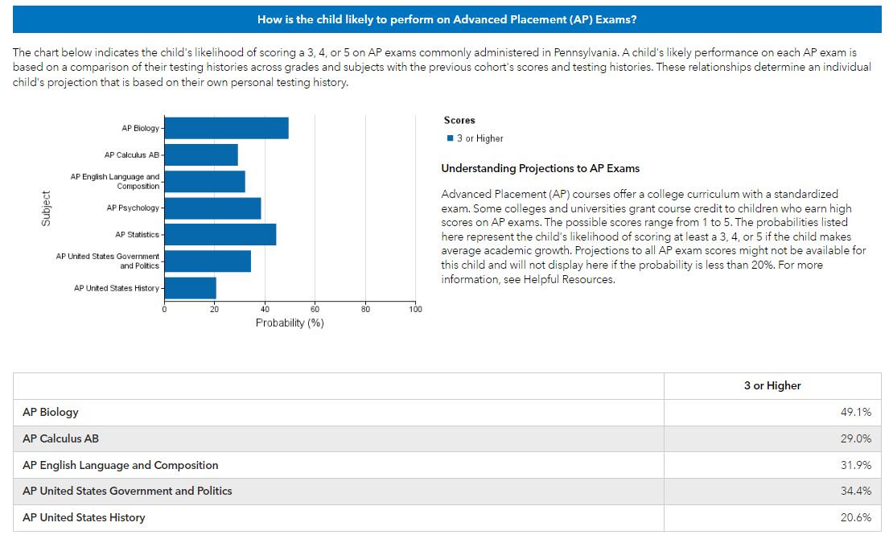
Chris: Projections to AP Exams

Slide 39
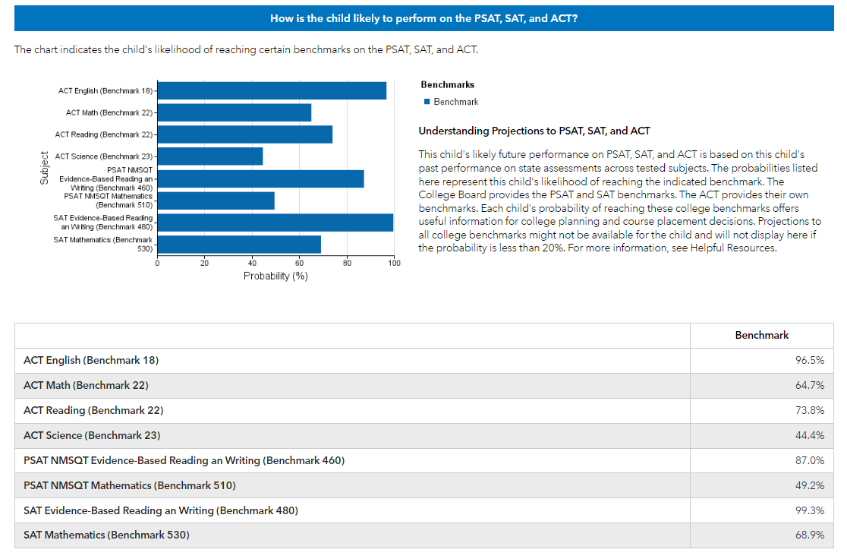
Chris: Projections to ACT/SAT

Slide 40
Thoughts and questions about PVAAS projections for Pathway 4?
Notes:
Let’s pause here for any thoughts or questions you have so far.

Slide 41

Share Your Thoughts
What is ONE new learning you had today?
What are your next steps in developing criteria for using PVAAS student projections for informing potential graduation pathways for students?

Slide 42
Resources & Supports
Getting more information

Slide 43
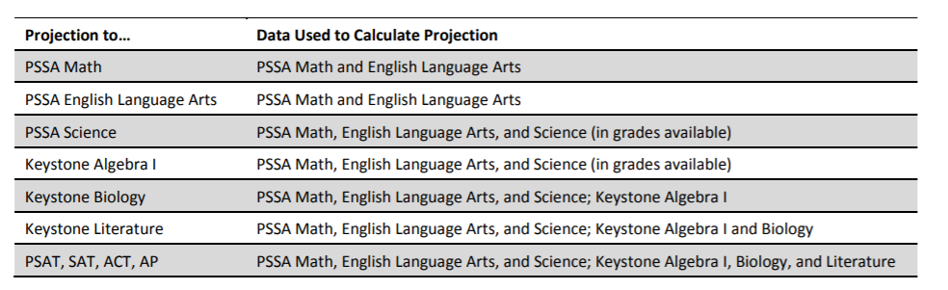
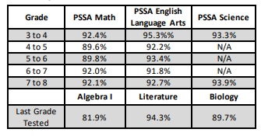
Projections Resource
What Educators Should Know about PVAAS Projection Probabilities
What projections are available?
What data in a student’s testing history is used in the projection?
How accurate are the projections?
Notes:
Finally a few resources to share as we end.
There is a resource called What Educators Should Know about PVAAS Projection Probabilities found using this link on the screen.
This provides a list of all available projections (you see that on the left of the table). And it provides information that can answer the question about what data in a student’s testing history is used in the calculation of the projection.
This resource also provides you with information about the reliability or accuracy of the projections.

Slide 44

NEW! Projections to
PA Higher Ed Benchmarks
Did you know that recently…
PVAAS updated student testing history to include PSAT, SAT and ACT data
PVAAS added projection probabilities to PA Higher Ed benchmarks (i.e., more college readiness benchmarks)
Consider: College Navigator

Slide 45

PVAAS Export Feature
Can export student projections, selecting all assessments and benchmarks of interest
Available to District Admin by default
District Admin can grant this option to District Users and School Admins, as needed

Slide 46
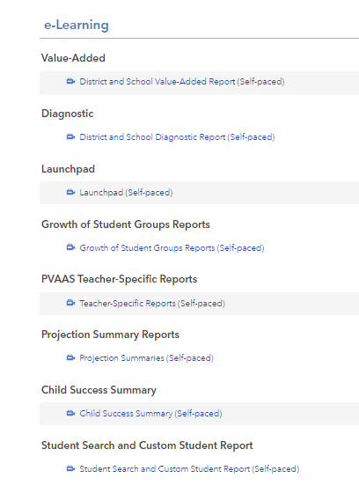
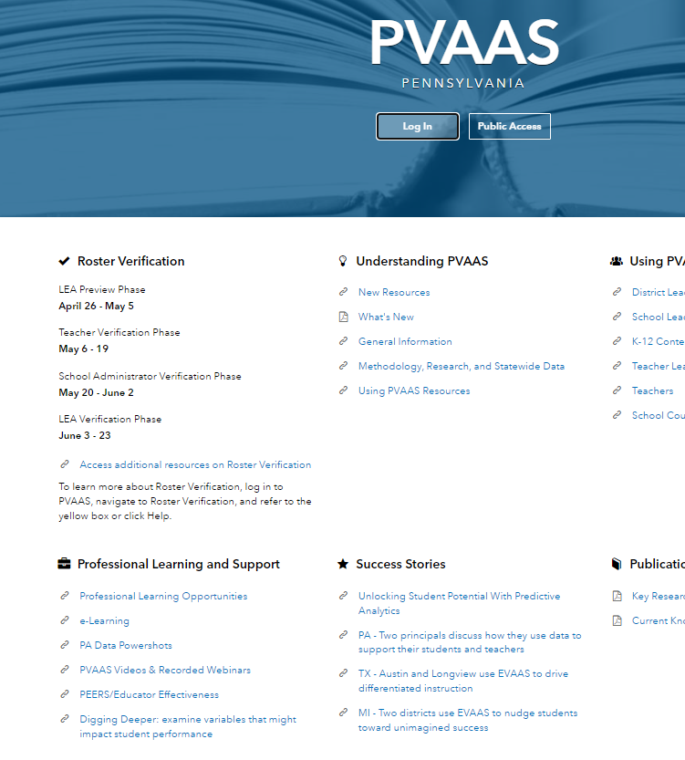
PVAAS e-Learning: Projections
Notes:
There is e-Learning available by clicking on that link on the login page … then you will see there are a number of e-Learning – one specifically on the Child Success Summary.

Slide 47
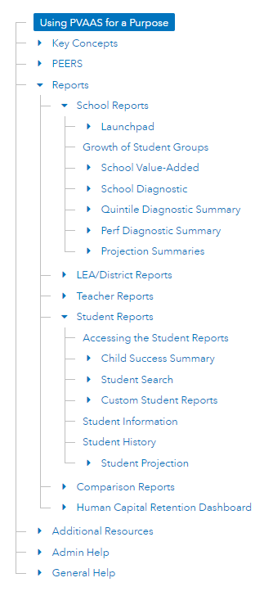

PVAAS Online Help:
Projections
Notes:
There is also online help available on this report.

Slide 48

Contacts for PVAAS Questions
Contact local IU PVAAS Point of Contact
  Link on Contact Us Page
Contact SAS EVAAS Support Team
  Issues concerning the accessing or navigating the system
  Link also on Contact Us Page - select PVAAS Technical Support
Contact PVAAS Statewide Team for PDE, pdepvaas@iu13.org
  Issues concerning policies or use of the reporting
Notes:
For questions about PVAAS, each IU has a PVAAS Points of Contact.
The SAS EVAAS Support Team is a great resource if you have questions about access to the system or navigating and understanding the data in the reports.
Visit the Contact Us page on the PVAAS site where you can find links to both of those (IU PoCs and SAS EVAAS Support).
The PVAAS Statewide Team can be reached at pdepvaas@iu13.org for questions about the use of the reporting or any PA policies or implementation of the reporting.

