Slide 1
Act 13: Toolkit and Rating Forms Overview
January 20, 2022

Slide 2
Agenda
Overview
Toolkit
Professional Educator Categories
Rating Tools

Slide 3



Office Hours Etiquette
Listen to the presenter and enter relevant questions in the chat.
Use pause points to enter questions into the chat.
Monitor chat for responses.

Slide 4
Toolkit Overview

Slide 5






Toolkit Overview
Evaluation Measures
Evaluation Process
Training & Professional Development
Resources
Act 13
References
Notes:
https://www.pdesas.org/Frameworks/TeacherFrameworks/TeacherEffectiveness/
Evaluation Measures
Measures & weighting, Observation & Practice
Building-Level Data
Teacher-Specific Data
LEA Selected Measures
Performance Goals
Evaluation Process
Rating Scale
Rating Frequency
Rating Protocol
Maintaining Records & Reporting Data
Training & Professional Development
Training Requirements
Professional Development Opportunities
Resources
Rating Tools
Frameworks for Observation & Practice
References
Definitions & Terms
Statutes & Regulations

Slide 6
Professional Educator Categories and Rating Forms

Slide 7
Act 13 Requirements
Classroom Teacher*
Non-Teaching Professional*
Principal*
Provides direct instruction to students related to specific subject or grade level
Provides services other than classroom instruction
Examples: Speech Language Pathologist, Social Worker, Home and School Visitor, School Psychologist, Health Specialist, Counselor, Instructional Technology Specialist, Other
Includes the following:
  Principal
  Assistant Principal
  Vice Principal
  Director of Career and Technical Education
  Supervisor of Special Education
  (new with Act 13)
*Includes Professional and Temporary Professional Employee

Slide 8
Classroom Teachers
Data Available Teachers
Non-Data Available Teachers
Teachers w/out Building Level Data
Temporary Teachers

Slide 9
Building Level Data
Act 82
15%
Act 13
10%
Academic Achievement - State Assessments
Closing the Achievement Gap - All students
Closing the Achievement Gap - Historically Underperforming Students
Academic Growth - PVAAS
Attendance
Promotion
Graduation
Advanced Achievement
Challenge Multiplier - Adjusted based on economically disadvantaged student population

Slide 10
Building Level Score
The Building Level Score will provide a quantitative academic score based upon a 100-point scale to represent the overall academic performance of each school in Pennsylvania.
Academic Achievement
Academic Growth
Other Academic Indicators
ELA 15 points
Math 15 points
Science 10 points
ELA 15 pts
Math 15 pts
Science 10 pts
Attendance Rate 10 pts
Graduation Rate 10 pts
*Absent a Graduation Rate, Attendance Rate is 20 Points.
Where a school is missing an Assessment or Growth indicator, the 100-point scale is reduced proportionally. For example, a K-3 school with no PVAAS data (40 points) and no Science Assessment data (10 points) will have a denominator of 50 points.

Slide 11
Challenge Multiplier
 | Unadjusted Building Score | Adjusted Building Score
School A 92% Economically Disadvantaged | 61.0 | 65.1
School B 38.5% Economically Disadvantaged | 61.0 | 62.7

Slide 12
Teacher-Specific Data
Act 82
15%
Act 13
10%
Student Performance - State Assessments
Student Growth - PVAAS
IEP Goals Progress
Locally Developed Rubrics

Slide 13
Act 13: Teacher Specific Data (Set 10%)
Academic Achievement
Only 2 Measures
available and directly attributable
Only 1 Measure
available and directly attributable
3 Measures
available and directly attributable
ELA 15 points
Math 15 points
Science 10 points
Applicable Measures (5% each)
State Assessments (2.5%)
PVAAS (5.0%)
IEP Goals Progress (2.5%)
Applicable Measure (10%)
If no measures are available and directly attributable to the teacher,
the 10% will be re-allocated to LEA Selected Measures.

Slide 14
Act 13: Data Available Teacher

Slide 15
Act 13: Non-Data Available Teacher
Assessment and Growth removed

Slide 16
Act 13: Teachers w/out Building Level Data

Slide 17
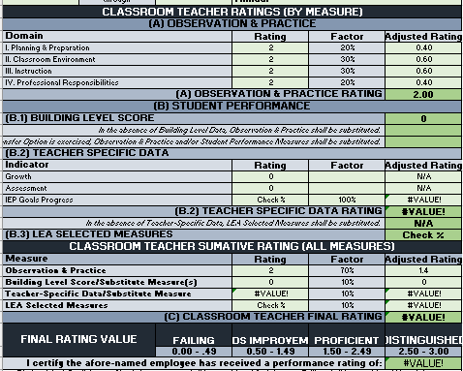
13-1 PE Rating Form

Slide 18
What’s a Temporary Professional Employee?
Article XI of the Pa. Public School Code defines the term "temporary professional employee" (TPE) to mean any individual who has been employed to perform, for a limited time (established by the LEA), the duties of a newly created position or of a regular professional employee whose services have been terminated by death, resignation, suspension, or removal.
Although Pa. Act 13 of 2020 amends the measures by which a TPE will be evaluated, the legislation does not alter the definitions of professional employees under Article XI. Administrators should check with their Human Resource personnel on how professional employees are currently classified by the LEA.
Notes:
Article XI defines the term to mean any individual who has been employed to perform, for a limited time, the duties of a newly created position or of a regular professional employee whose services have been terminated by death, resignation, suspension, or removal.
While the definition does not address tenure explicitly, commonwealth case law has held that the distinction between a professional employee and a temporary professional employee is that the former has secured tenure.

Slide 19
Act 13: Temporary Teacher

Slide 20
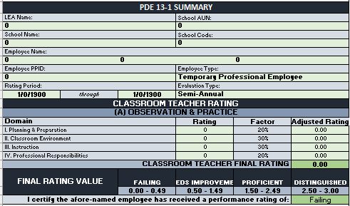
13-1 TPE Rating Form

Slide 21
Non-Teaching Professionals
Non-Teaching Professionals w/Building Level Data
Non-Teaching Professionals w/out Building Level Data
Temporary Non-Teaching Professionals

Slide 22
Classroom Teacher vs. NTP
Act 82
To determine whether you are a teaching professional, you must be able to answer yes to the following two questions:
Are you working under your instructional certification?
Do you provide direct instruction* to students in a particular subject or grade level?
*Direct instruction is defined as planning and providing the instruction and assessing the effectiveness of the instruction.
Act 13
Local determination

Slide 23
Act 13: NTP w/Building Level Data

Slide 24
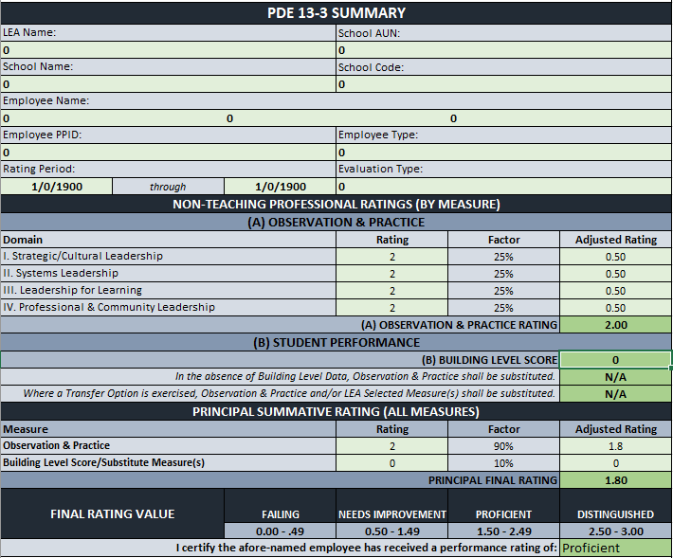
13-3 PE Rating Form

Slide 25
Act 13: NTP w/out Building Level Data or Temporary NTP

Slide 26
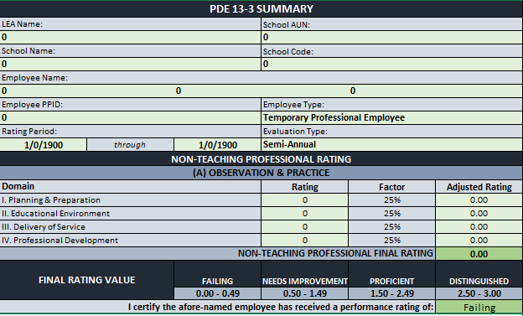
13-3 TPE Rating Form

Slide 27
Principals*
Principals w/Building Level Data
Principals w/out Building Level Data
Temporary Principals
*Principal includes building principals, assistant/vice principals, CTC Directors, and Special Education Directors

Slide 28
Building Level Data
Act 82
15%
Act 13
10%
Academic Achievement - State Assessments
Closing the Achievement Gap - All students
Closing the Achievement Gap - Historically Underperforming Students
Academic Growth - PVAAS
Attendance
Promotion
Graduation
Advanced Achievement
Challenge Multiplier - Adjusted based on economically disadvantaged student population
Note: Correlation Data Based on Teacher-Level Measures (15%) no longer included.

Slide 29
Act 13: Data Available Principals

Slide 30
Act 13: Principals w/out Building Level Data

Slide 31
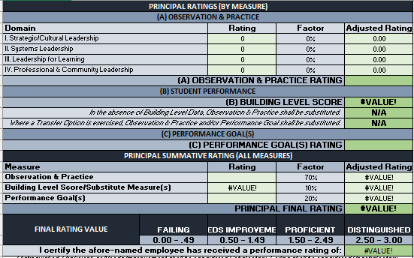
13-2 PE Rating Form

Slide 32
Interim Rating
Unsatisfactory Professional Employee

Slide 33
13-4 Interim Rating
Professional employees deemed Unsatisfactory in the last evaluation must be rated at least once a year using the measures and weightings appropriate to the employee, as indicated in the table above.
Subsequent ratings during the same evaluation period (i.e., interim evaluations) are not mandated; however, should an LEA elect to perform one, the interim evaluation must be comprised of the following:
  70% Observation & Practice (aligns with the 13-1, 13-2, 13-3)
  30% LEA Selected Measures
For the LEA Selected Measures rating, the LEA should use measure(s) appropriate to the type of professional employee. Examples as follows:
  Performance Goal benchmarks might serve as a locally developed rubric in the evaluation of a principal.
  Student career readiness portfolios might be used in the evaluation of a school counselor.
Notes:
For the Observation & Practice rating, the LEA should apply the same domains, weightings, and professional practice models utilized during the prior annual evaluation.
LEA Selected Measures reflective of the role and responsibility of the professional employee

Slide 34
Act 13: 13-4 Interim Rating Allocations
Notes:
For the Observation & Practice rating, the LEA should apply the same domains, weightings, and professional practice models utilized during the prior annual evaluation.

Slide 35
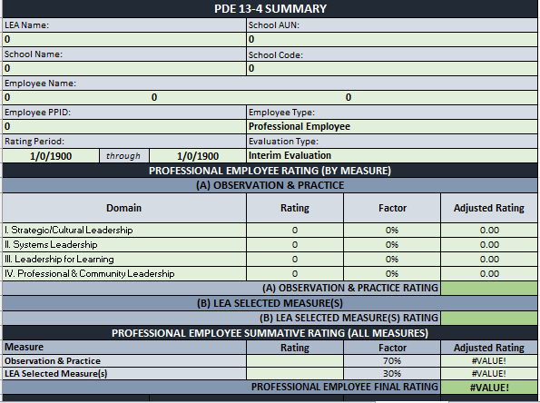
13-4 PE Rating Form

Slide 36
What’s next?
Interactive Toolkit: A Deep Dive
PDE will offer an in-depth walkthrough of the interactive toolkit.
January 26 - 12:00 & 3:00
January 27 – 4:00
Notes:
Reminder that all three sessions are presenting the same information. So you only need to register for one session.

Slide 37
Contact/Mission
For more information on Act 13, please visit PDE’s website at www.education.pa.gov ​
https://www.pdesas.org/EducatorFrameworks/EducatorEffectiveness/
Act 13 Questions:
RA-PDE-Evaluation@pa.gov
The mission of the Department of Education is to ensure that every learner has access to a world-class education system that academically prepares children and adults to succeed as productive citizens. Further, the Department seeks to establish a culture that is committed to improving opportunities throughout the commonwealth by ensuring that technical support, resources, and optimal learning environments are available for all students, whether children or adults.​

